Slide 1
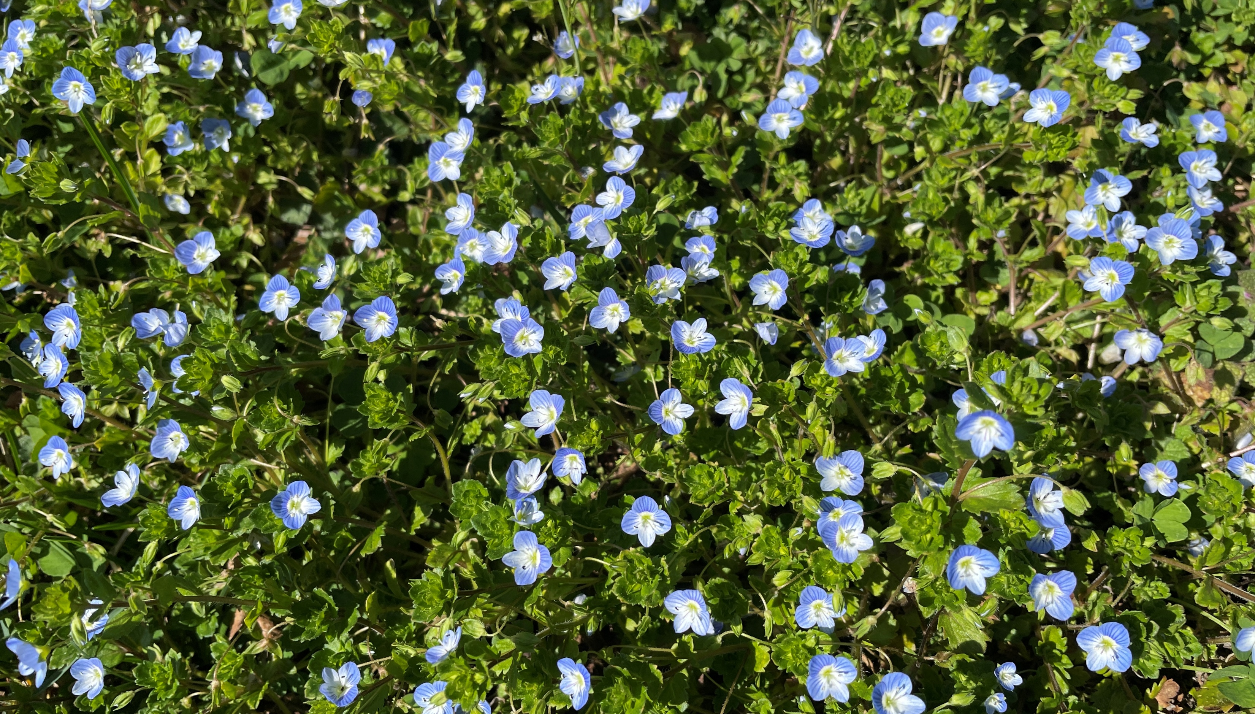
Welcome
As for man, his days are like grass; he flourishes like a flower of the field. Ps 103:15

Slide 2
Do you like HISTORY?
Have you traced your family’s GENEOLOGY?
Are there PHOTO ALBUMS in your home, or on your phone?
ACTS describes how the church got STARTED.

Slide 3
2:14 Peter’s sermon.
2:41 Church birthed.
2:42 Simple priorities.
4:1-3 Outside persecution.
5:1,2 Inside hypocrisy.
5:41,42 Suffering and joyful tenacity.
6:1 Inside conflict.
A complaint arose because certain widows were being neglected in the daily distribution.

Slide 4
Acts 6:6 (7 men) were set before the apostles, and they prayed and laid their hands on them.
7 Then the word of God spread, and the number of the disciples multiplied greatly in Jerusalem, and a great many of the priests were obedient to the faith.

Slide 5
Acts 6 - Servants/Deacons chosen, including …
Acts 7 - Stephen
Acts 8 - Philip
6:8 Reputation of Stephen
6:10,11 Instigation because of Stephen
6:11-14 Accusations against Stephen
- He blasphemed Moses, God, the Law, the Temple.
6:15,7:1 Interrogation of Stephen

Slide 6
Notice …
6:15 - Stephen’s Face (like an angel)
innocent, fearless, radiant like Moses?
Psalm 42:10 My enemies reproach me, while they say to me all day long, "Where is your God?"
11 Why are you cast down, O my soul? And why are you disquieted within me? Hope in God; For I shall yet praise Him, the help of my countenance and my God.

Slide 7
7:1-54 - Notice Stephen’s Words (like knives)
- He captures their attention with Israel’s history.
- He answers their false accusations of blaspheme
➢ (7:1-18) I believe in the God of Glory and His PROMISES
But, in Israel’s history, a God-sent deliverer (Joseph) was rejected by the fathers (7:9),
though God was with him.

Slide 8
Notice Stephen’s Words
➢ (19-41) I believe in Moses and the God of PROVIDENCE and POWER (7:22)
- But, in Israel’s history, this God-sent deliverer (Moses), was not understood (7:25),
was rejected twice (35,39), and disobeyed (39).
- Moses prophesied of One coming who they should hear (37).
- But Israel turned back to Egypt in their heart (39)
and made idols with their hands (41).

Slide 9
Notice Stephen’s Words
➢ (42-46) I believe the Law and the God of PATIENCE
- Israel quickly broke the first 2 commands (42,43).
- Yet God was patient through the Wilderness (42),
tabernacled with them (44),
brought them into the promised land (45),
gave them godly leaders (45,46),
and waited centuries before sending them into Babylonian captivity (43).
But Israel did not keep God’s law (53).

Slide 10
Notice Stephen’s Words
➢ (47-54) I believe in the Temple and the God of PROMINENCE (48)
But Israel has resisted God (51),
persecuted and killed those He sent (52),
including the Just One (Jesus) (52).
The Council of Israel (6:15), like their fathers,
are also betrayers and murderers (7:52),
and now savage beasts (54).

Slide 11
Notice Stephen’s Face & Words
(55,56) - Notice Stephen’s Eyes
- He has a pure heart (Matt 5:8).
- Is this every true believer’s experience (Ps 23:4-6)?
(57-60) - Notice Stephen’s Death
- cast out, stoned, Christ-like, sleep-like, martyr.
- Part of Saul’s conviction/conversion (Acts 22:19,20).

Slide 12
Acts 22:19 I said, “Lord, they know that in every synagogue I imprisoned and beat those who believe on You.
20 And when the blood of Your martyr Stephen was shed, I also was standing by consenting to his death, and guarding the clothes of those who were killing him.”

Slide 13
Acts 8:1 Saul was consenting to Stephen’s death. And a great persecution arose against the church in Jerusalem; and they were all scattered throughout Judea and Samaria, except the apostles.
4 Those who were scattered went everywhere preaching the word.
Psalm 116:15,16 Precious in the sight of the LORD is the death of His saints. O LORD, truly I am Your servant; You have loosed my bonds.

Slide 14
He Will Hold Me Fast
When I fear my faith will fail,
Christ will hold me fast.
When the tempter would prevail,
He will hold me fast.

Slide 15
I could never keep my hold
Through life's fearful path.
For my love is often cold,
He must hold me fast.

Slide 16
He will hold me fast,
He will hold me fast.
For my Savior loves me so,
He will hold me fast!

Slide 17
Those He saves are His delight,
Christ will hold me fast.
Precious in His holy sight,
He will hold me fast.

Slide 18
He'll not let my soul be lost,
His promises shall last.
Bought by Him at such a cost,
He will hold me fast.

Slide 19
He will hold me fast,
He will hold me fast.
For my Savior loves me so,
He will hold me fast!

Slide 20
For my life He bled and died,
Christ will hold me fast.
Justice has been satisfied,
He will hold me fast.

Slide 21
Raised with Him to endless life,
He will hold me fast.
'Til our faith is turned to sight,
When He comes at last!

Slide 22
He will hold me fast,
He will hold me fast.
For my Savior loves me so,
He will hold me fast!

