Slide 1
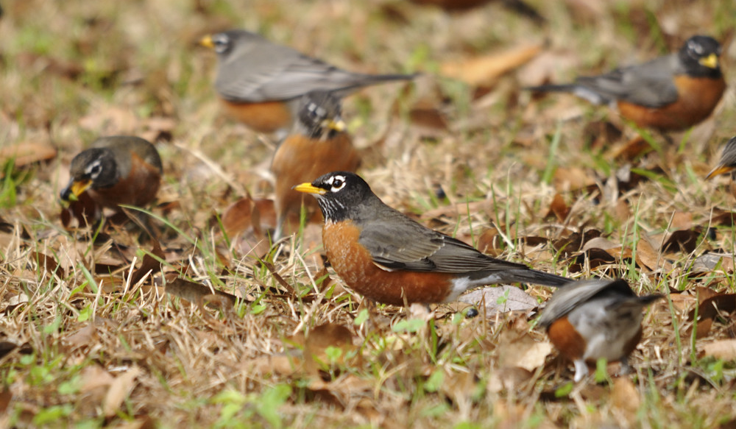
Welcome
Even the bird finds a home, builds her nest and raises her young at a place near your altar, O LORD of Hosts! Ps 84:3

Slide 2
Scripture Reading
Acts 6:1-7
Ephesians 2:11-22

Slide 3
Acts 5:41 They departed from the presence of the council, rejoicing that they were counted worthy to suffer shame for His name.
42 And daily in the temple, and in every house, they did not cease teaching and preaching Jesus as the Christ.

Slide 4
In Acts we have witnessed the …
1:8,9 commission from Jesus and His ascension.
2:14 ff first of Peter’s powerful public sermons.
2:41 promised birth of the church, Christ’s body.
2:42 simple priorities of the church.
4:1-3 rise of persecution from outside the church.
4:32,33 unity, generosity, and power of the church
5:1,2 response to sin within the church.
5:41,42 suffering and joyful tenacity of the church.
6:1 steady growth of the church.

Slide 5
Acts 6:1 In those days, when the number of the disciples was multiplying, there arose a complaint against the Hebrews by the Hellenists, because their widows were neglected in the daily distribution.
2 Then the twelve summoned the multitude of the disciples and said, "It is not desirable that we should leave the word of God and serve tables.
3 Therefore, brethren, seek out from among you seven men of good reputation, full of the Holy Spirit and wisdom, whom we may appoint over this business;

Slide 6
Acts 6:4 but we will give ourselves continually to prayer and to the ministry of the word."
5 And the saying pleased the whole multitude. And they chose Stephen, a man full of faith and the Holy Spirit, and Philip, Prochorus, Nicanor, Timon, Parmenas, and Nicolas, a proselyte from Antioch,
6 whom they set before the apostles; and when they had prayed, they laid hands on them.
7 Then the word of God spread, and the number of the disciples multiplied greatly in Jerusalem, and a great many of the priests were obedient to the faith.

Slide 7
Addressing Internal Church Conflict - Acts 6
(1) Numbers - more needs than the 12 can oversee.
Acts 1:15 - 120 disciples
2:41 - 3,000 new converts
4:4 - 5,000 men
5:14 - multitudes of both men & women
(1) Neglect - language barriers and ethnic prejudice foreshadowing future challenges (Jews/Gentiles).
fallout from the reach & power of the gospel.

Slide 8
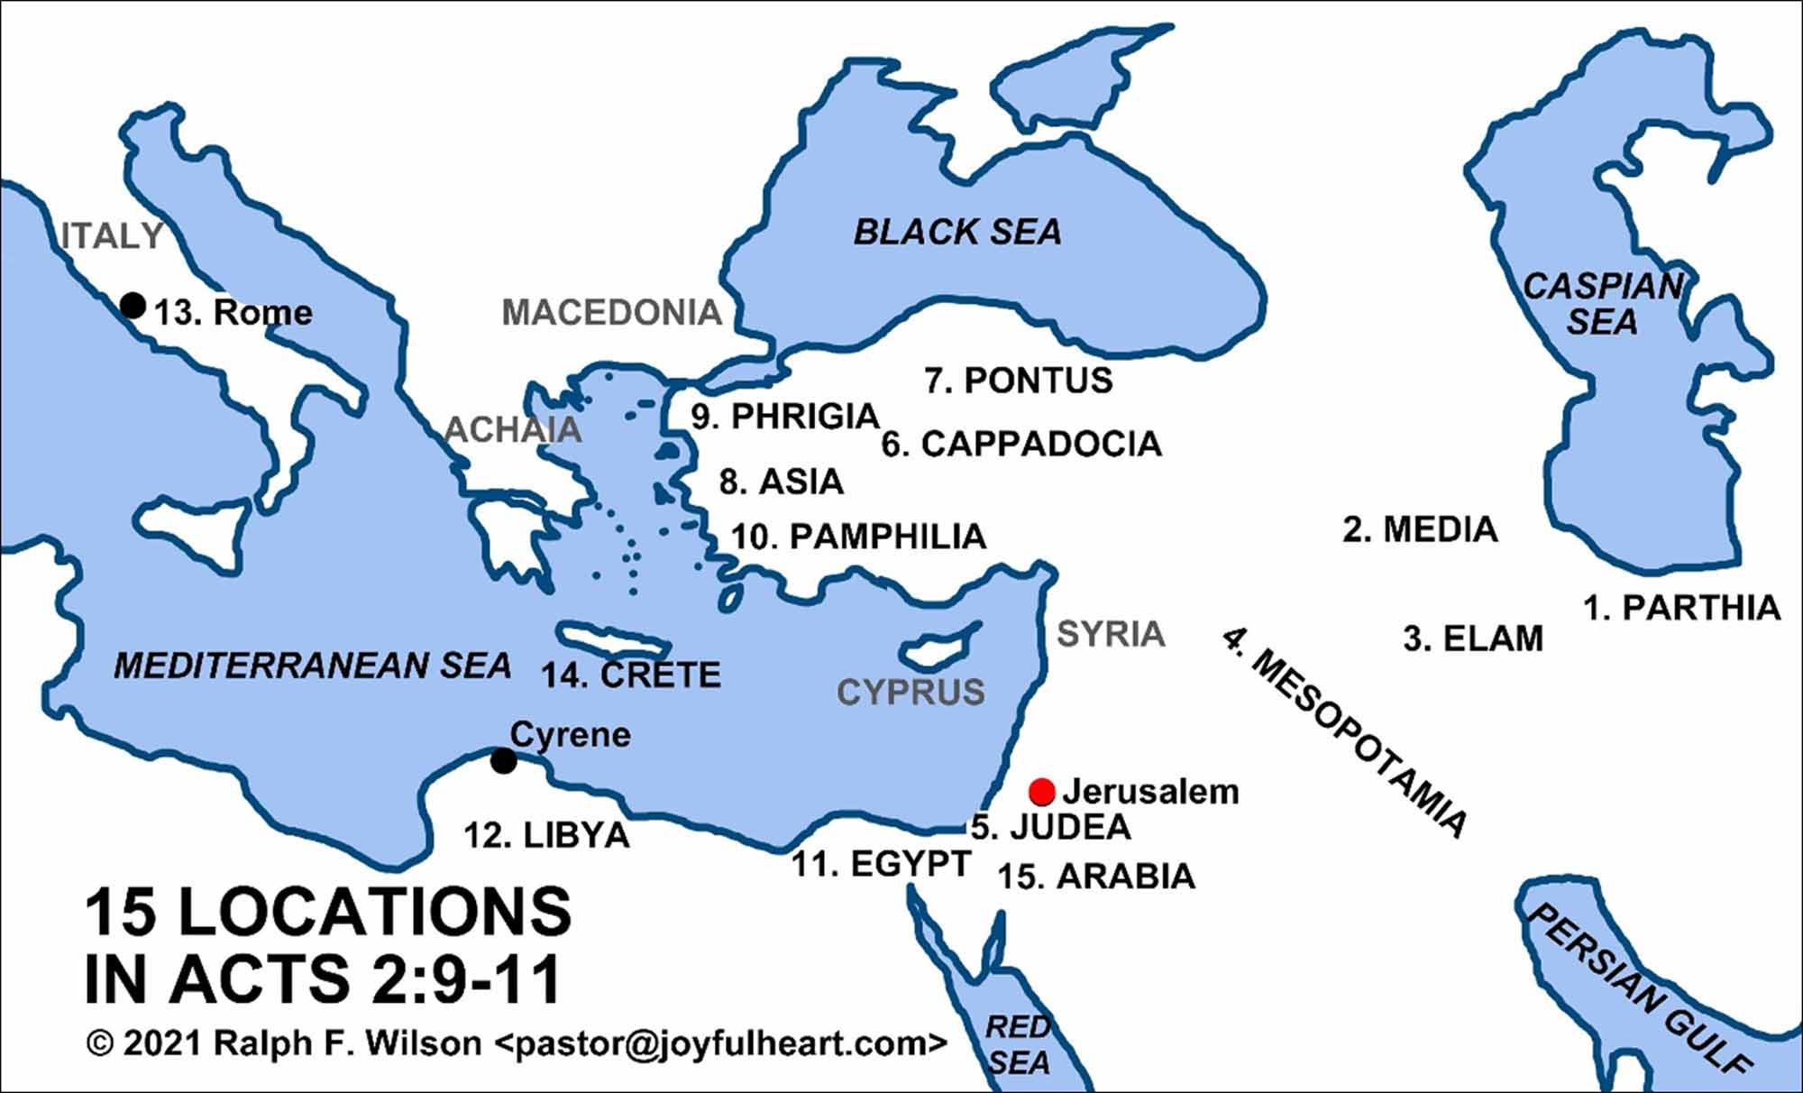

Slide 9
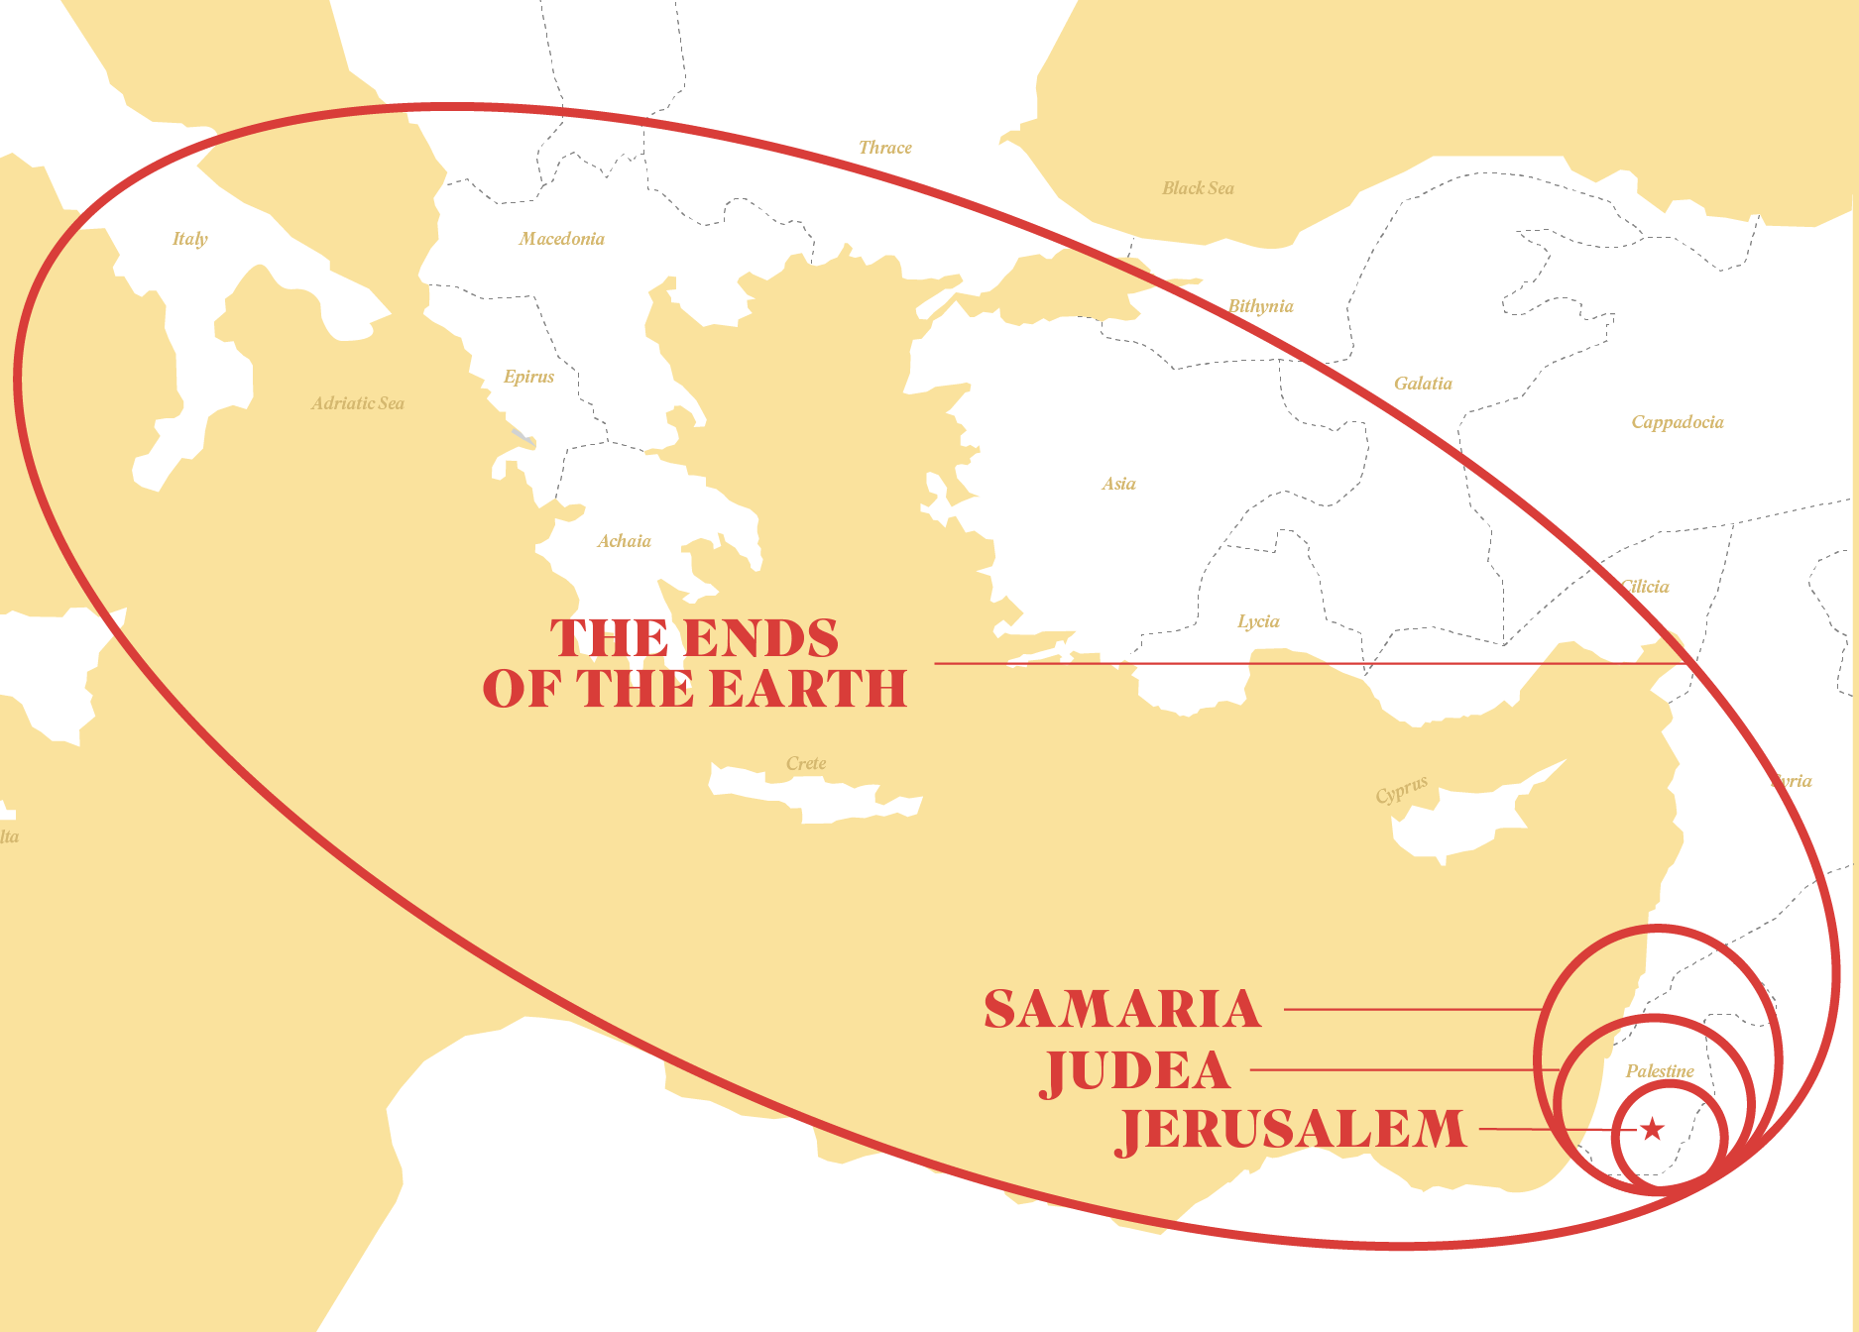

Slide 10
Addressing Internal Church Conflict- Acts 6
(1) Neglect - language barriers and ethnic prejudice
fallout from the reach & power of the gospel.
read from different scriptures (Hebrew Bible vs. Greek Septuagint).
used to speaking/hearing/writing different languages (Aramaic vs. Greek).
different cultural distinctives (clothing, politics, food, customs, etc.)

Slide 11
(1) Neglect - language barriers & ethnic prejudice.
overcome supernaturally
gift of the Spirit - tongues (Acts 2)
fruit of the Spirit - love (Galatians 5)
overcome wisely - distribution (diakonia); serve (diakonos)
Apostles → → Growing Church
Deacons

Slide 12
Addressing Internal Church Conflict - Acts 6
(2) Distractions - priorities of the apostles' doctrine & prayer being threatened (Acts 2:42).
And they continued steadfastly in the apostles' doctrine and fellowship, in the breaking of bread, and in prayers.

Slide 13
Addressing Internal Church Conflict - Acts 6
(3,5,6) Delegation - Spirit-led “congregational governance” (you seek from among you...; they chose …; they set before the apostles).
Simplified Local Church
Saints (people) + Servants (Deacons) + Shepherd (Pastor)
Congregational Responsibilities
Membership (Matt 18:17); Leadership (Acts 6);
Doctrine (Acts 15:22); Finances (II Cor 8:18-21).

Slide 14
Qualities of Deacons - Acts 6
Team player - seven men
Good - witnessed by others as being free from scandal; “martyr” (Stephen)
Holy Spirit filled - governed by God, not flesh;
known for gifts & graces that God produces.
Wise - judicious, see life from God’s perspective.
Faithful - reliable, constant, guided by conviction.
Powerful - not just physical but spiritual might.
Deacon - servant-hearted; “through the dust”.

Slide 15
Qualities of Deacons - I Timothy 3
8 In the same way, deacons must be well respected and have integrity. They must not be heavy drinkers or dishonest with money.
9 They must be committed to the mystery of the faith now revealed and must live with a clear conscience.
10 Before they are appointed as deacons, let them be closely examined. If they pass the test, then let them serve as deacons.

Slide 16
1Timothy 3:11 In the same way, their wives must be respected and must not slander others. They must exercise self-control and be faithful in everything they do.
12 A deacon must be faithful to his wife, and he must manage his children and household well.
13 Those who do well as deacons will be rewarded with respect from others and will have increased confidence in their faith in Christ Jesus.

Slide 17
Addressing Internal Church Conflict - Acts 6
(1) Numbers & Neglect; (2) Distractions
(3,5,6) Delegation - Spirit-led congregation that chooses and benefits from a team of Spirit- filled servants, and undistracted leaders.
(7) Multiplication
Then the word of God spread, and the number of the disciples multiplied greatly in Jerusalem, and a great many of the priests were obedient to the faith.

Slide 18
Servant’s Heart (# 431)
Make me a servant like you, Dear Lord
Living for others each day
Humble and meek
Helping the weak
Loving in all that I say

Slide 19
Give me, Lord, a servant's heart
Here's my life, take every part
Give me, Lord, a servant's heart
Help me draw so close to You
That Your love comes shining through
Give me, Lord, a servant's heart
Give me, Lord, a servant's heart

Slide 20
Make me a witness like You, dear Lord
Showing the love of the cross
Sharing Your Word 'till all have heard
Serving whatever the cost

Slide 21
Give me, Lord, a servant's heart
Here's my life, take every part
Give me, Lord, a servant's heart
Help me draw so close to You
That Your love comes shining through
Give me, Lord, a servant's heart
Give me, Lord, a servant's heart

