Slide 1
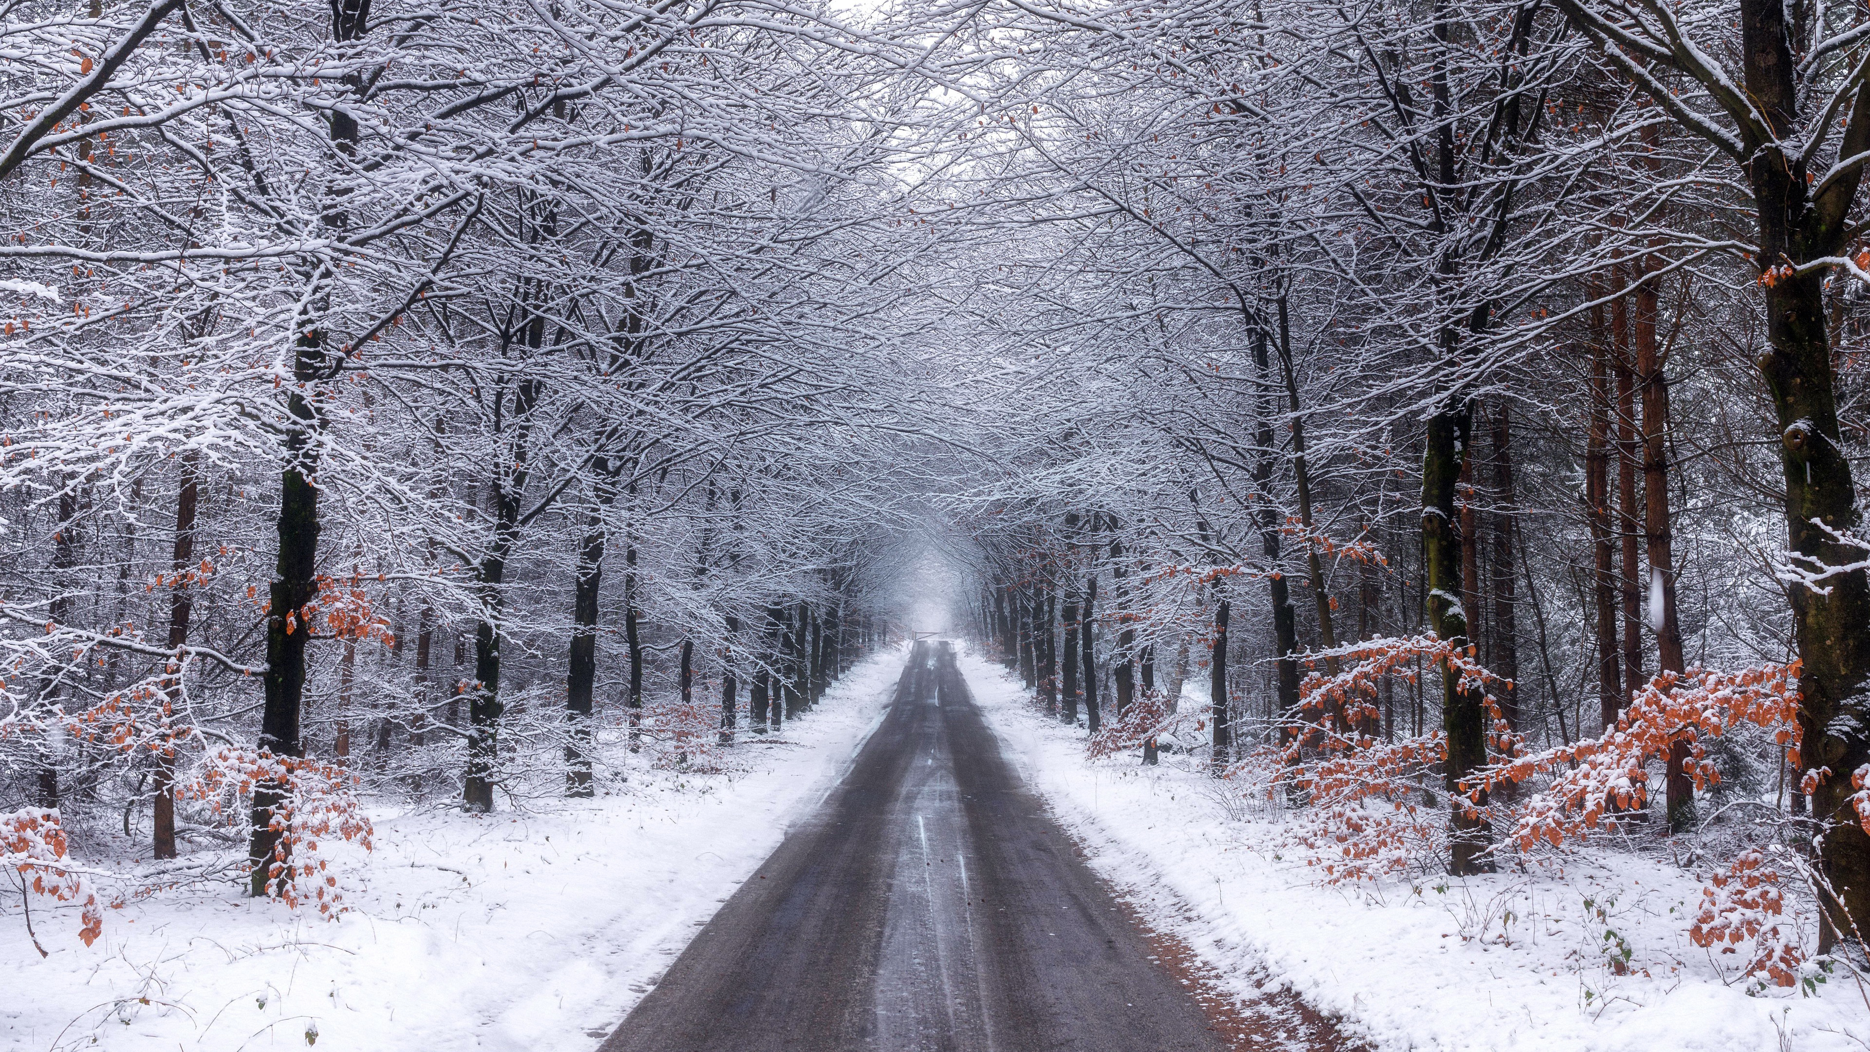
WELCOME
The Lord’s our rock, in Him we hide,
a shelter in the time of storm.

Slide 2
Acts 1:4 Being assembled together with them, Jesus commanded them not to depart from Jerusalem, but to wait for the Promise of the Father, "which you have heard from Me;
5 for John baptized with water, but you will be baptized with the Holy Spirit not many days from now."

Slide 3
Behind the Scenes in Early Acts
Acts 1:12-26 - Replacing Judas Iscariot
(13) 11 disciples gathered.
(14) Prayer meeting with a few important women & Jesus’ family.
(15-17,20) Peter takes charge and applies OT scripture.
(18-19) Luke provides background information on Judas’ horrible death.

Slide 4
Behind the Scenes
(21-23) Resumé for Judas’ replacement, with 2 candidates - Joseph & Matthias.
(24-26) Prayer, lots cast, replacement settled.
Lots - Prov 16:33 God’s control over circumstances
Leviticus 16:8-10 - choosing the scapegoat
Joshua 18:6 - dividing land
Jonah 1:7 - determining guilt

Slide 5
Birth of the Church - Acts 2
1-13 - A Supernatural Birth
(2) mighty wind;
(3) flames of fire;
(4) Spirit filling & speaking in tongues.
Acts 2:4 - Evidence Apostles have God’s blessing.
10:44-46 - Evidence Gentiles are included.
Acts 19:6 - Evidence OT saints are included.

Slide 6
Descriptive (once happened like this)?
✓ Prescriptive (should always happen like this)?
Speaking in Tongues as Originally Described
(6,8) Known birth languages (not gibberish).
(11) Promote “wonderful works of God”.
(13) Causes some to mock (I Cor 14:23).

Slide 7
Birth of the Church - Acts 2
1-13 - A Supernatural Birth
➢ 14-36 - A Scriptural Birth
(16-21) Joel 2:28-32 - Spirit will be poured out;
signs and wonders will be shown;
people will be saved.
(25-28) Ps 16:8-11 - Messiah will rise from death;
be received by the Father;
and pour out the Spirit;
all of which has happened to Jesus.

Slide 8
Birth of the Church - Acts 2
➢ 14-36 - A Scriptural Birth
(34,35) Psalm 110:1 - David’s son (Christ)…
is seated in heavenly honor;
and subjugates all enemies (Lord).
Acts 2:36 Therefore let all the house of Israel know assuredly that God has made this Jesus, whom you crucified, both Lord and Christ.

Slide 9
➢ (37-41) - A Shocking Birth
(37) Who God USES -
Peter the forgiven denier of Jesus;
Apostles only recently declared drunk.
(38) All God DOES - convicts; pardons; invests
(39) Who God INCLUDES - you (Jews see 36);
those afar off (Gentiles - Acts 10:45).
(41) How many God ADDS - 3,000
(+120 Acts 1:15)

Slide 10
Birth of the Church
A Supernatural Birth
A Scriptural Birth
A Shocking Birth
➢ Acts 2:42-47 - A Sustainable Birth (Apgar)
Apostles Doctrine - Bible Teaching
Requirements for Apostles (capital A)
1 - Eye witness of the risen Jesus (Acts 1:21,22)
2 - Personally appointed by Christ (Lk 6:13; Acts 9:15)
3 - Given miraculous abilities (Lk 9:1; II Cor 12:12)

Slide 11
A Sustainable Birth - Acts 2:42
Apostles Doctrine - Bible Teaching
Fellowship - Shared interests & goals (44,45).
Breaking Bread - Informal hospitality (46);
and formal memorial meal (Lord’s Supper).
Prayers - Available to all believers (Lk 19:46);
but a priority of the Apostles (Acts 6:4).
4 Pillars of any Healthy Local Church

