Slide 1
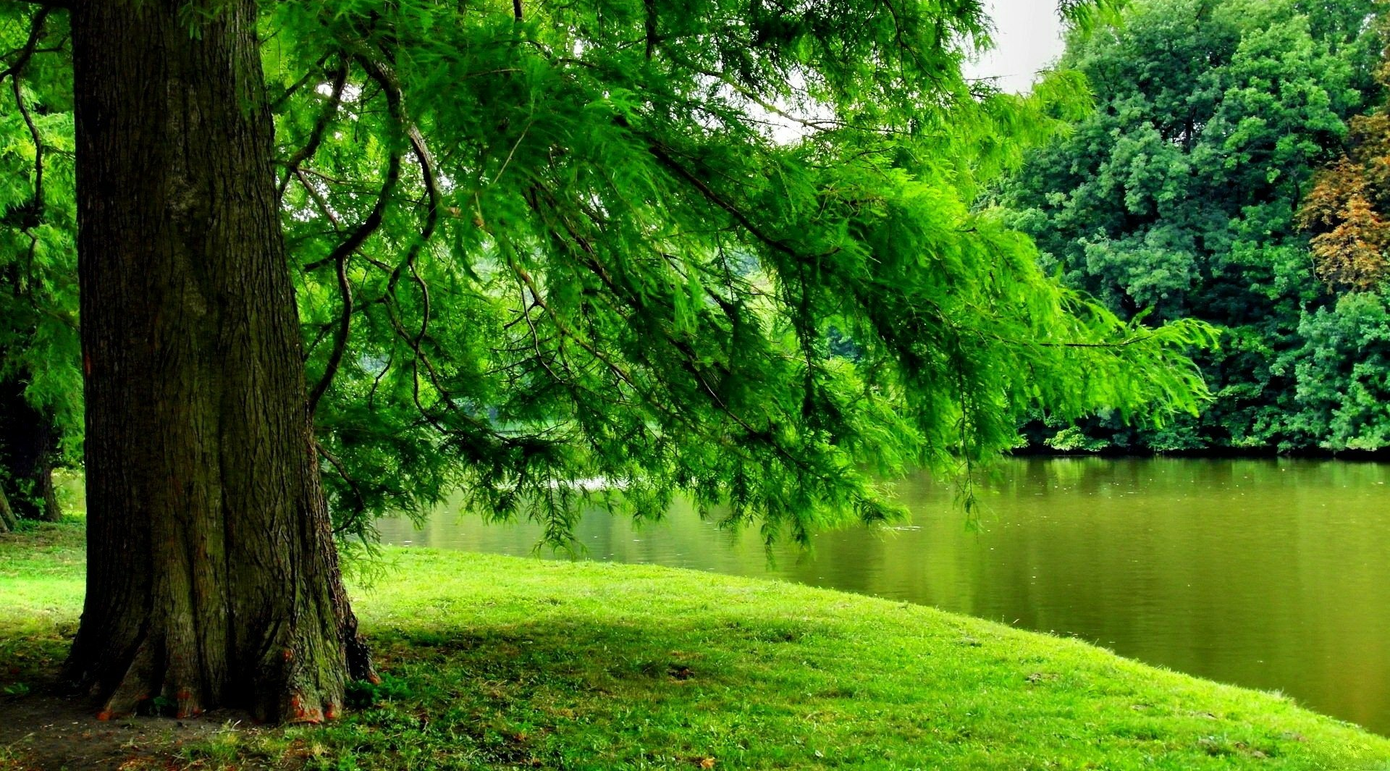
Welcome
Psalm 1:3 He will be like a tree
planted by the rivers of water.

Slide 2
GRACE BIBLE CHAPEL
Exploring our “Middle Name”
in 2024

Slide 3
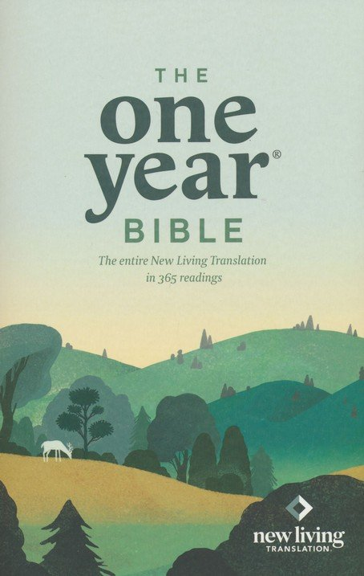
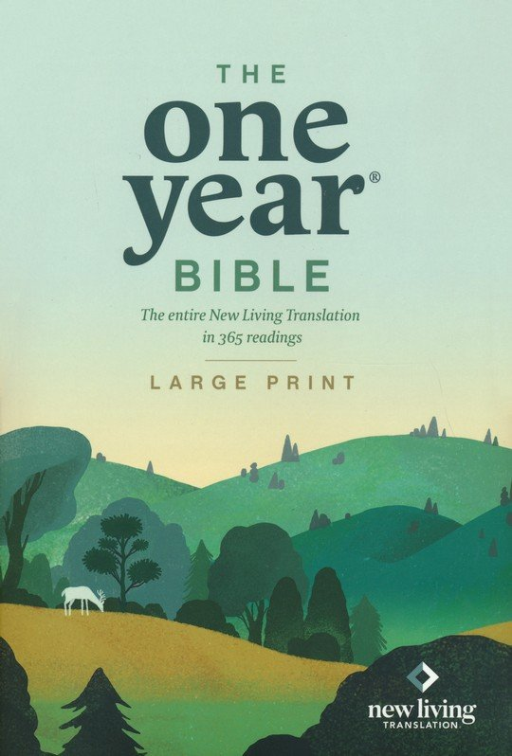
2024 GBC middle name
series.
Wednesdays favorite verse or insights from weekly readings.

Slide 4
JANUARY - Psalm 19
10 More to be desired are they than gold, Yea, than much fine gold (valuable);
Sweeter also than honey and the honeycomb (desirable).
11 By them Your servant is warned (vulnerable),
and in keeping them there is great reward (beneficial).

Slide 5
FEBRUARY
Hebrews 4:12 The word of God is living and powerful, sharper than any two-edged sword, piercing even to the division of soul and spirit, and of joints and marrow, and is a discerner of the thoughts and intents of the heart.

Slide 6
APRIL
2Timothy 3:16 All Scripture is given by inspiration of God, and is profitable for …
➢ doctrine - truths to be taught, learned, lived
➢ reproof - identifying errors to be stopped
➢ correction - turning us away from wrong
➢ instruction - training us in what is right

Slide 7
MAY - The Bible’s “Scarlet Cord”
Gen 3:21 - Adam & Eve’s costly coverings
Gen 22:7,8 - Abraham & Isaac on the Mount
Ex 12:13 - Passover Blood on Israel’s Doorposts
Joshua 2:17-21 - Rahab’s Rescue Rope
Luke 24:25-27 - Jesus on Emmaus Road
Rev 5:6,9 - Heaven’s Lamb Who was slain

Slide 8
JUNE - How the Bible Describes Itself
(Heb 4:12) SWORD that Pierces - Wield it
(James 1:23) MIRROR that Reveals - Look at it
(I Peter 1:23) SEED that Reproduces - Scatter it
(I Peter 2:2) MILK that Nourishes - Serve it
(Psalm 119:105) LAMP that Shines - Lift it
(Jer 23:29a) FIRE that Consumes - Spread it
(Jer 23:29b) HAMMER that Shatters - Swing it

Slide 9
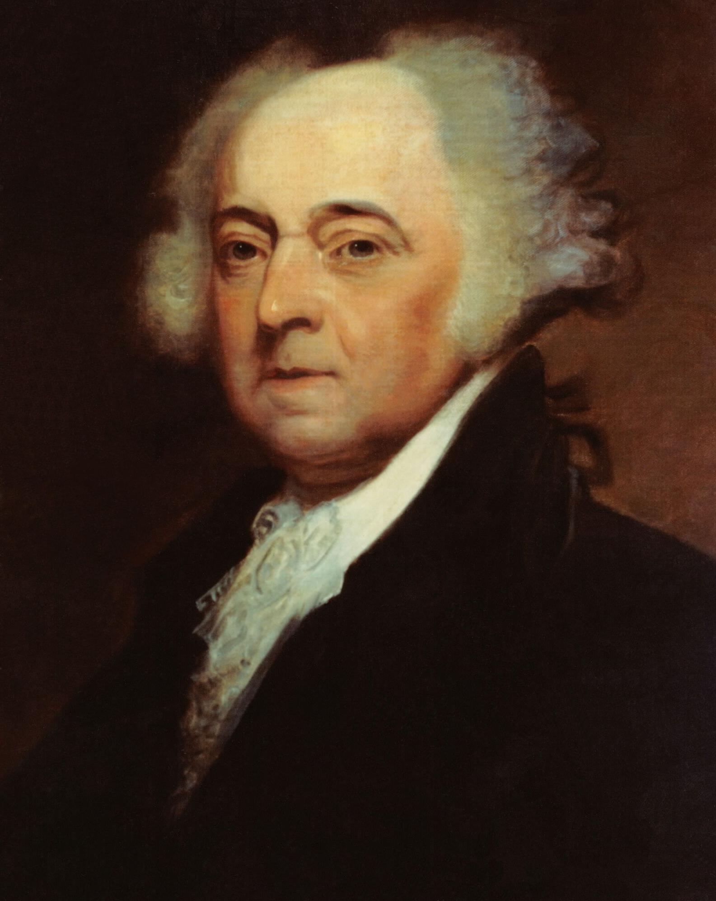
JULY - America and the BIBLE
President John Adams - 1798
We have no government armed
with power capable of contending
with human passions unbridled by
morality and religion.
Our Constitution was made only for
a moral and religious people. It is
wholly inadequate to the government of any other.

Slide 10
AUGUST - Books in God’s Library
Book of the LIVING (Psalm 139:16)
God’s “list” of all born & even conceived.
Book of Earth’s JUDGEMENT (Revelation 5:1-7)
God’s costly plan to redeem fallen creation.
Books of WORKS (Revelation 20:12)
God’s “list” of our deeds, good & bad, seen & unseen.
Lamb’s Book of LIFE (Revelation 21:27)
God’s “list” of all who are BORN AGAIN
Book of REMEMBRANCE (Malachi 3:16)
God’s “list” of people He hears & treasures

Slide 11
SEPTEMBER - Why You Can Believe the Bible
Historical Evidence: Many central Bible events and people have been proven true.
Internal Consistency: Despite being written over centuries by different authors, it hangs together.
Fulfilled Prophecies: Apart from God, the accuracy of biblical predictions are beyond probability.
Jesus’ Testimony: He affirmed the authenticity and authority of the Bible, and so can we.

Slide 12
OCTOBER - Our Bible and Our Politics
Support candidates who …
uphold righteous laws (Isaiah 61:8).
respect proper boundaries (Acts 17:26).
consistently favor Israel (Genesis 12:3).
protect religious liberty (Joshua 24:15).
see gender issues compassionately but clearly (Gen 1:27).
empower biblical families (Psalm 127:3).
➢ believe all human lives matter (Ps 139:13).

Slide 13
DECEMBER - Psalms (150 Hebrew Poems)
More of a Prayer Book than a Hymn Book.
Authors = David (73), Nathan (12), Sons of Korah (11), Solomon & Moses (3), Heman & Ethan (2), Anonymous (49)
Struggles (Lament) - Individual (42) & Community (16)
Joys (Praise) - Declared (11) & Described (26)
Israel’s History - 78, 105, 114
Future Messiah - 24, 72, 89, 96-100, 110

Slide 14
The Psalm of Introduction
Psalm 1:1 Blessed is the man who walks not in the counsel of the ungodly, nor stands in the path of sinners, nor sits in the seat of the scornful;
2 But his delight is in the law of the LORD, and in His law he meditates day and night.
3 He will be like a tree planted by the rivers of water, that brings forth its fruit in its season, whose leaf also will not wither; and whatever he does will prosper.

Slide 15
Psalm 1:4 The ungodly are not so, but are like the chaff which the wind drives away.
5 Therefore the ungodly will not stand in the judgment, nor sinners in the congregation of the righteous.
6 For the LORD knows the way of the righteous, but the way of the ungodly will perish.

Slide 16
Two Types of People
Psalm 1:1 Blessed is the man who doesn’t …
walk in the counsel of the ungodly (morally backward)
stand in the path of sinners (missing the mark)
sit in the seat of the scornful (mocks goodness)
2 But his delight is in the law (Torah) of the LORD, and in His law (Torah) he meditates day and night.
meditate = quietly reciting so as to understand and obey.
regularly “chewing” on God’s words.

Slide 17
Psalm 1:3 He will be like a tree planted by the rivers of water, that brings forth its fruit in its season, whose leaf also will not wither; and whatever he does will prosper.
garden of Eden words - tree, river, fruit, lasting
planted beside life rather than by ruin (vs 1)
promise of prosperity or blessing (vs 1)
key to all this is meditation on God’s Word (vs 2)
Hear (ears), Read (eyes), Study (fingers),
Memorize (mind), Meditate (heart), Apply (all)

Slide 18
Two Types of People
Psalm 1:4 The ungodly are not so, but are like the chaff which the wind drives away.
chaff (rootless, weightless, useless) vs tree (vs 3)
5 The ungodly will not stand in the judgment, nor sinners in the congregation of the righteous.
unable to stand before God vs one who chooses not to stand with the ungodly (vs 1)
6 The LORD knows the way of the righteous, but the way of the ungodly will perish.
➢ God-blessed living tree vs wind-blown dead chaff

Slide 19
GRACE BIBLE CHAPEL
Exploring our “Middle Name”
in 2024

Slide 20
1. The law of the LORD is perfect, converting the soul;
The testimony of the LORD is sure, making wise the simple *
2. The statutes of the LORD are right, rejoicing the heart;
The commandment of the LORD is pure, enlightening the eyes *
3. The fear of the LORD is clean, enduring forever;
The judgments of the LORD are true & righteous altogether *
* More to be desired are they than gold, Yea, than much fine gold; Sweeter also than honey and the honeycomb.
Moreover by them is Your servant warned,
And in keeping of them there is great reward. (2x)

Slide 21
