Slide 1
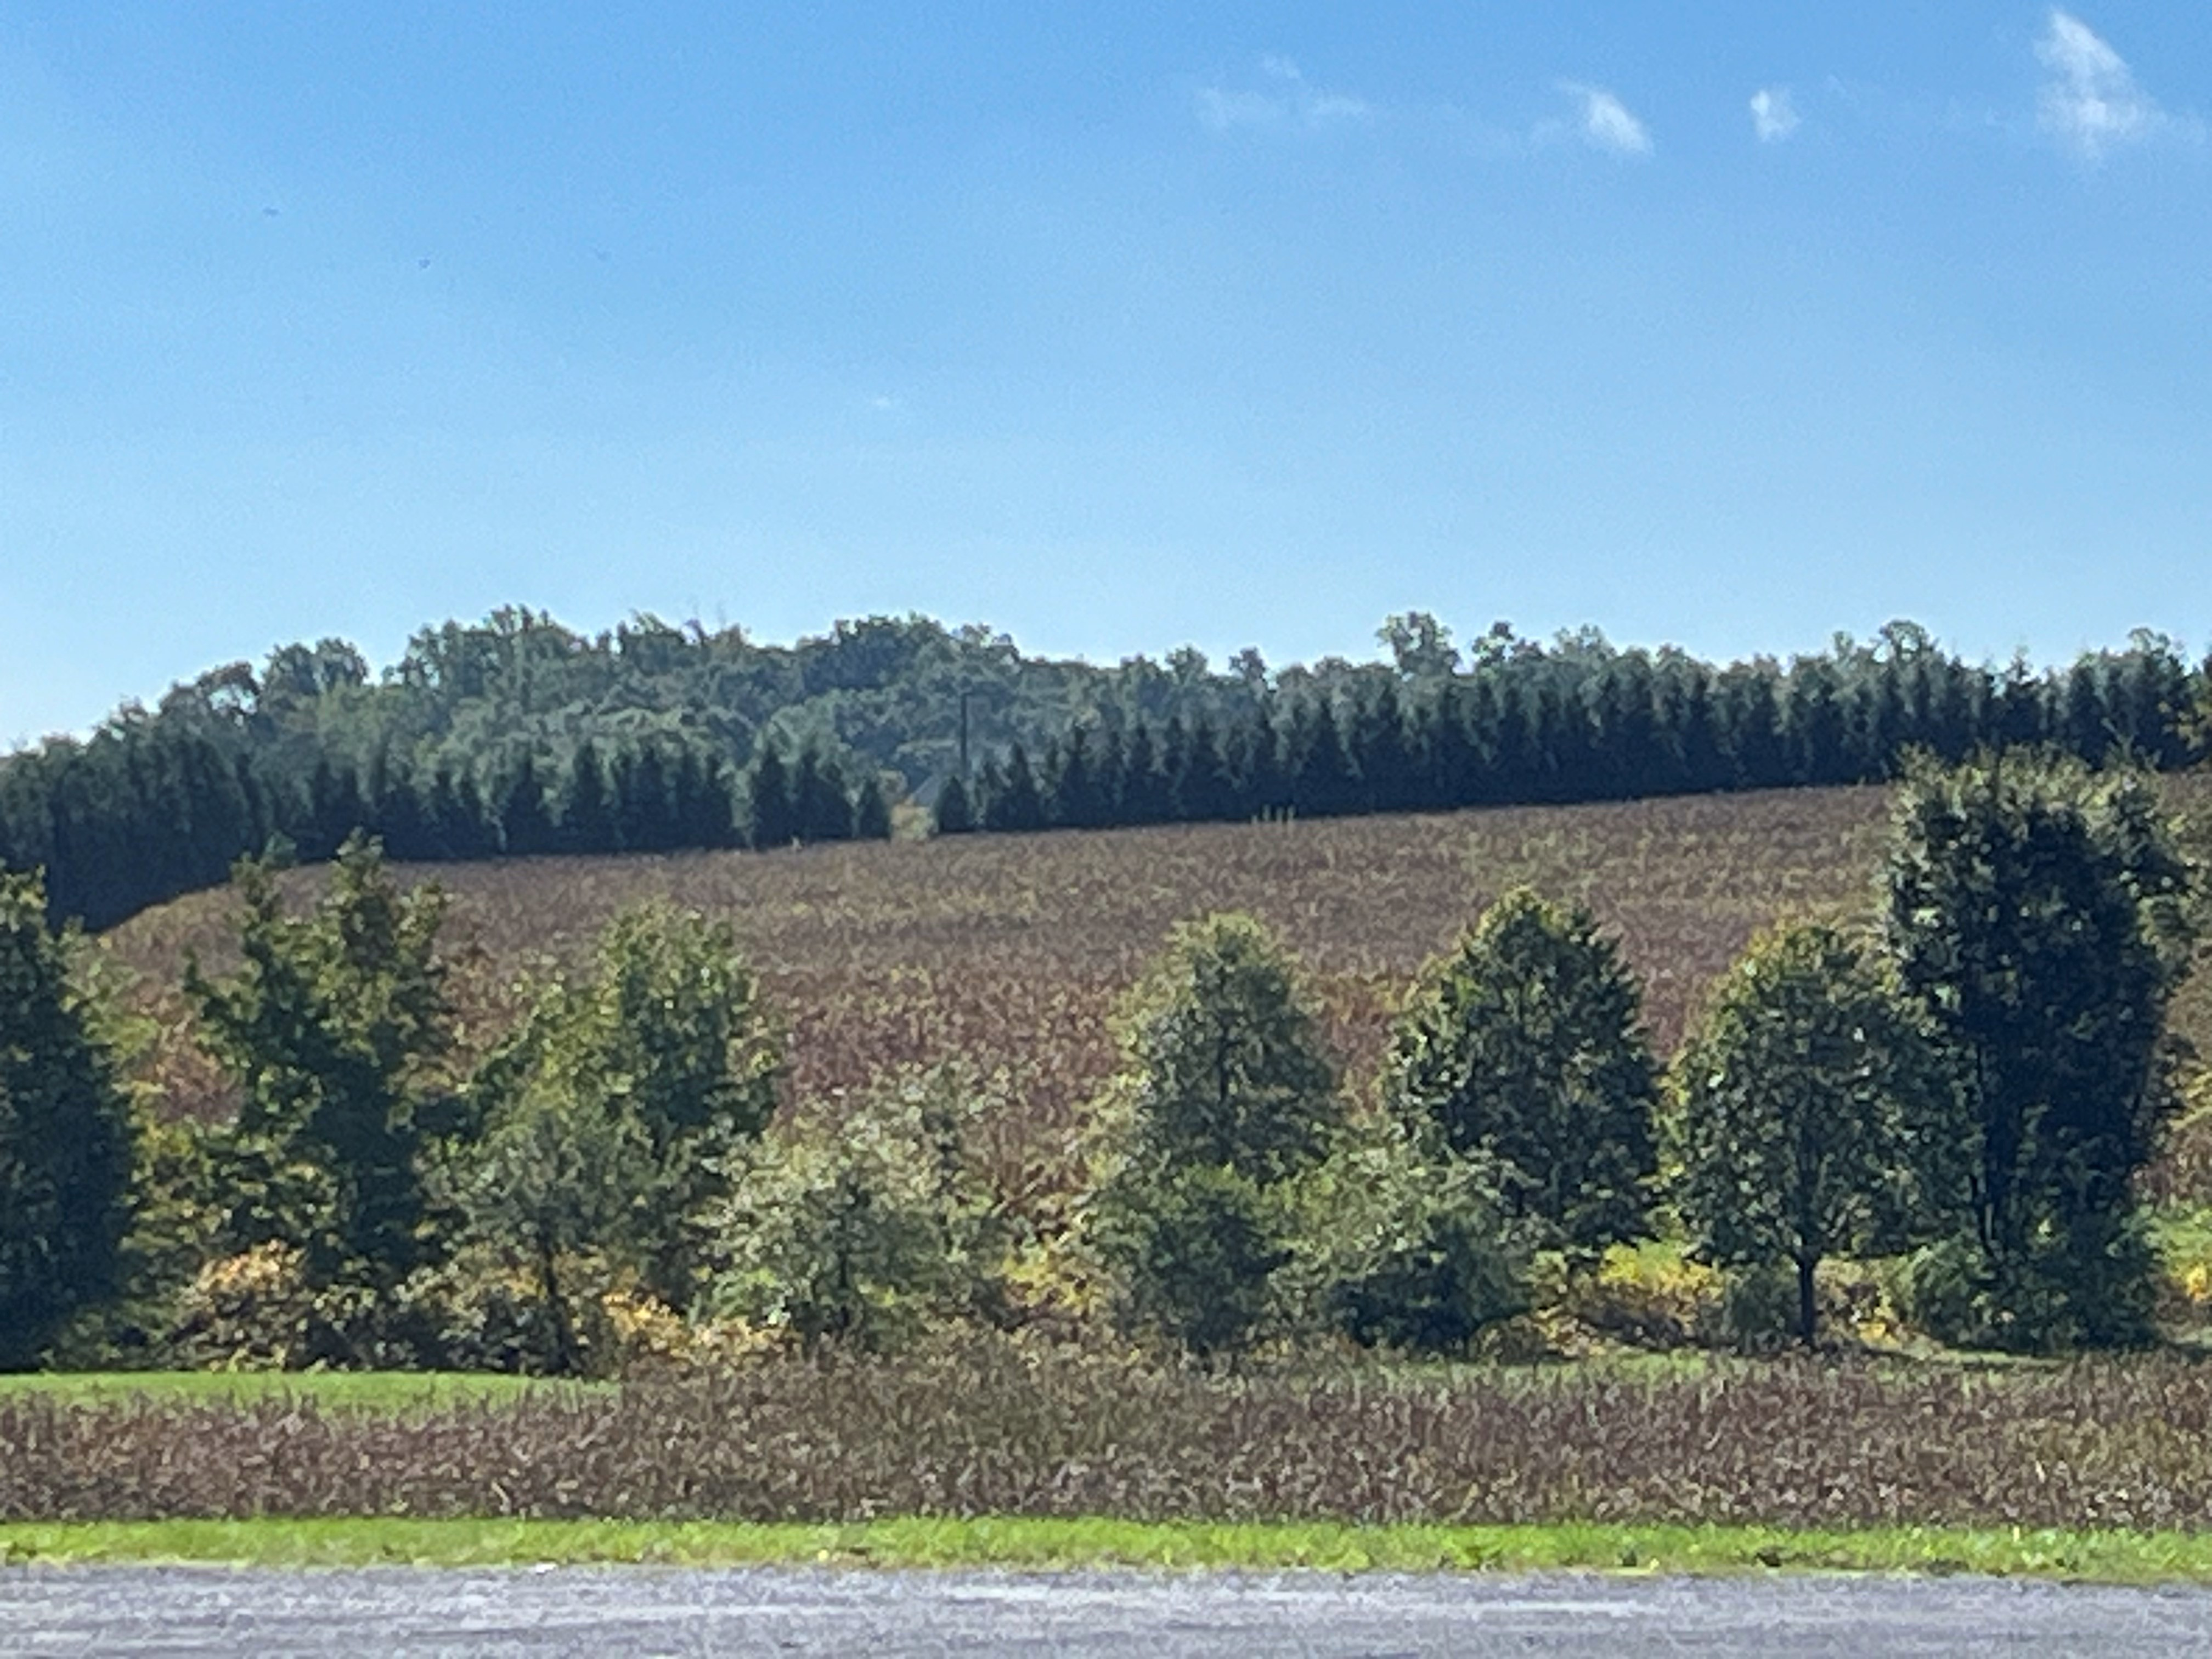
WELCOME
“Beware of false prophets, who come to you in sheep’s clothing, but inwardly they are ravenous wolves.” Matt. 7:15

Slide 2
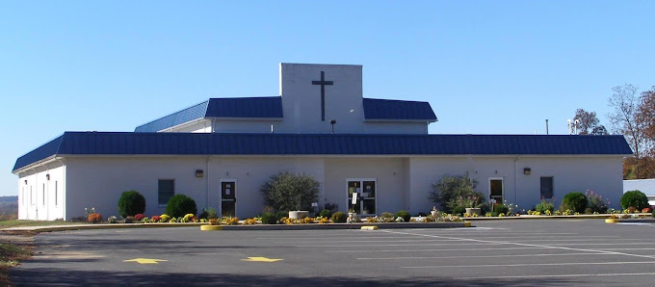
Adams County Christian Academy Rooted and Established in Love

Slide 3
Blurred Vision

Slide 4
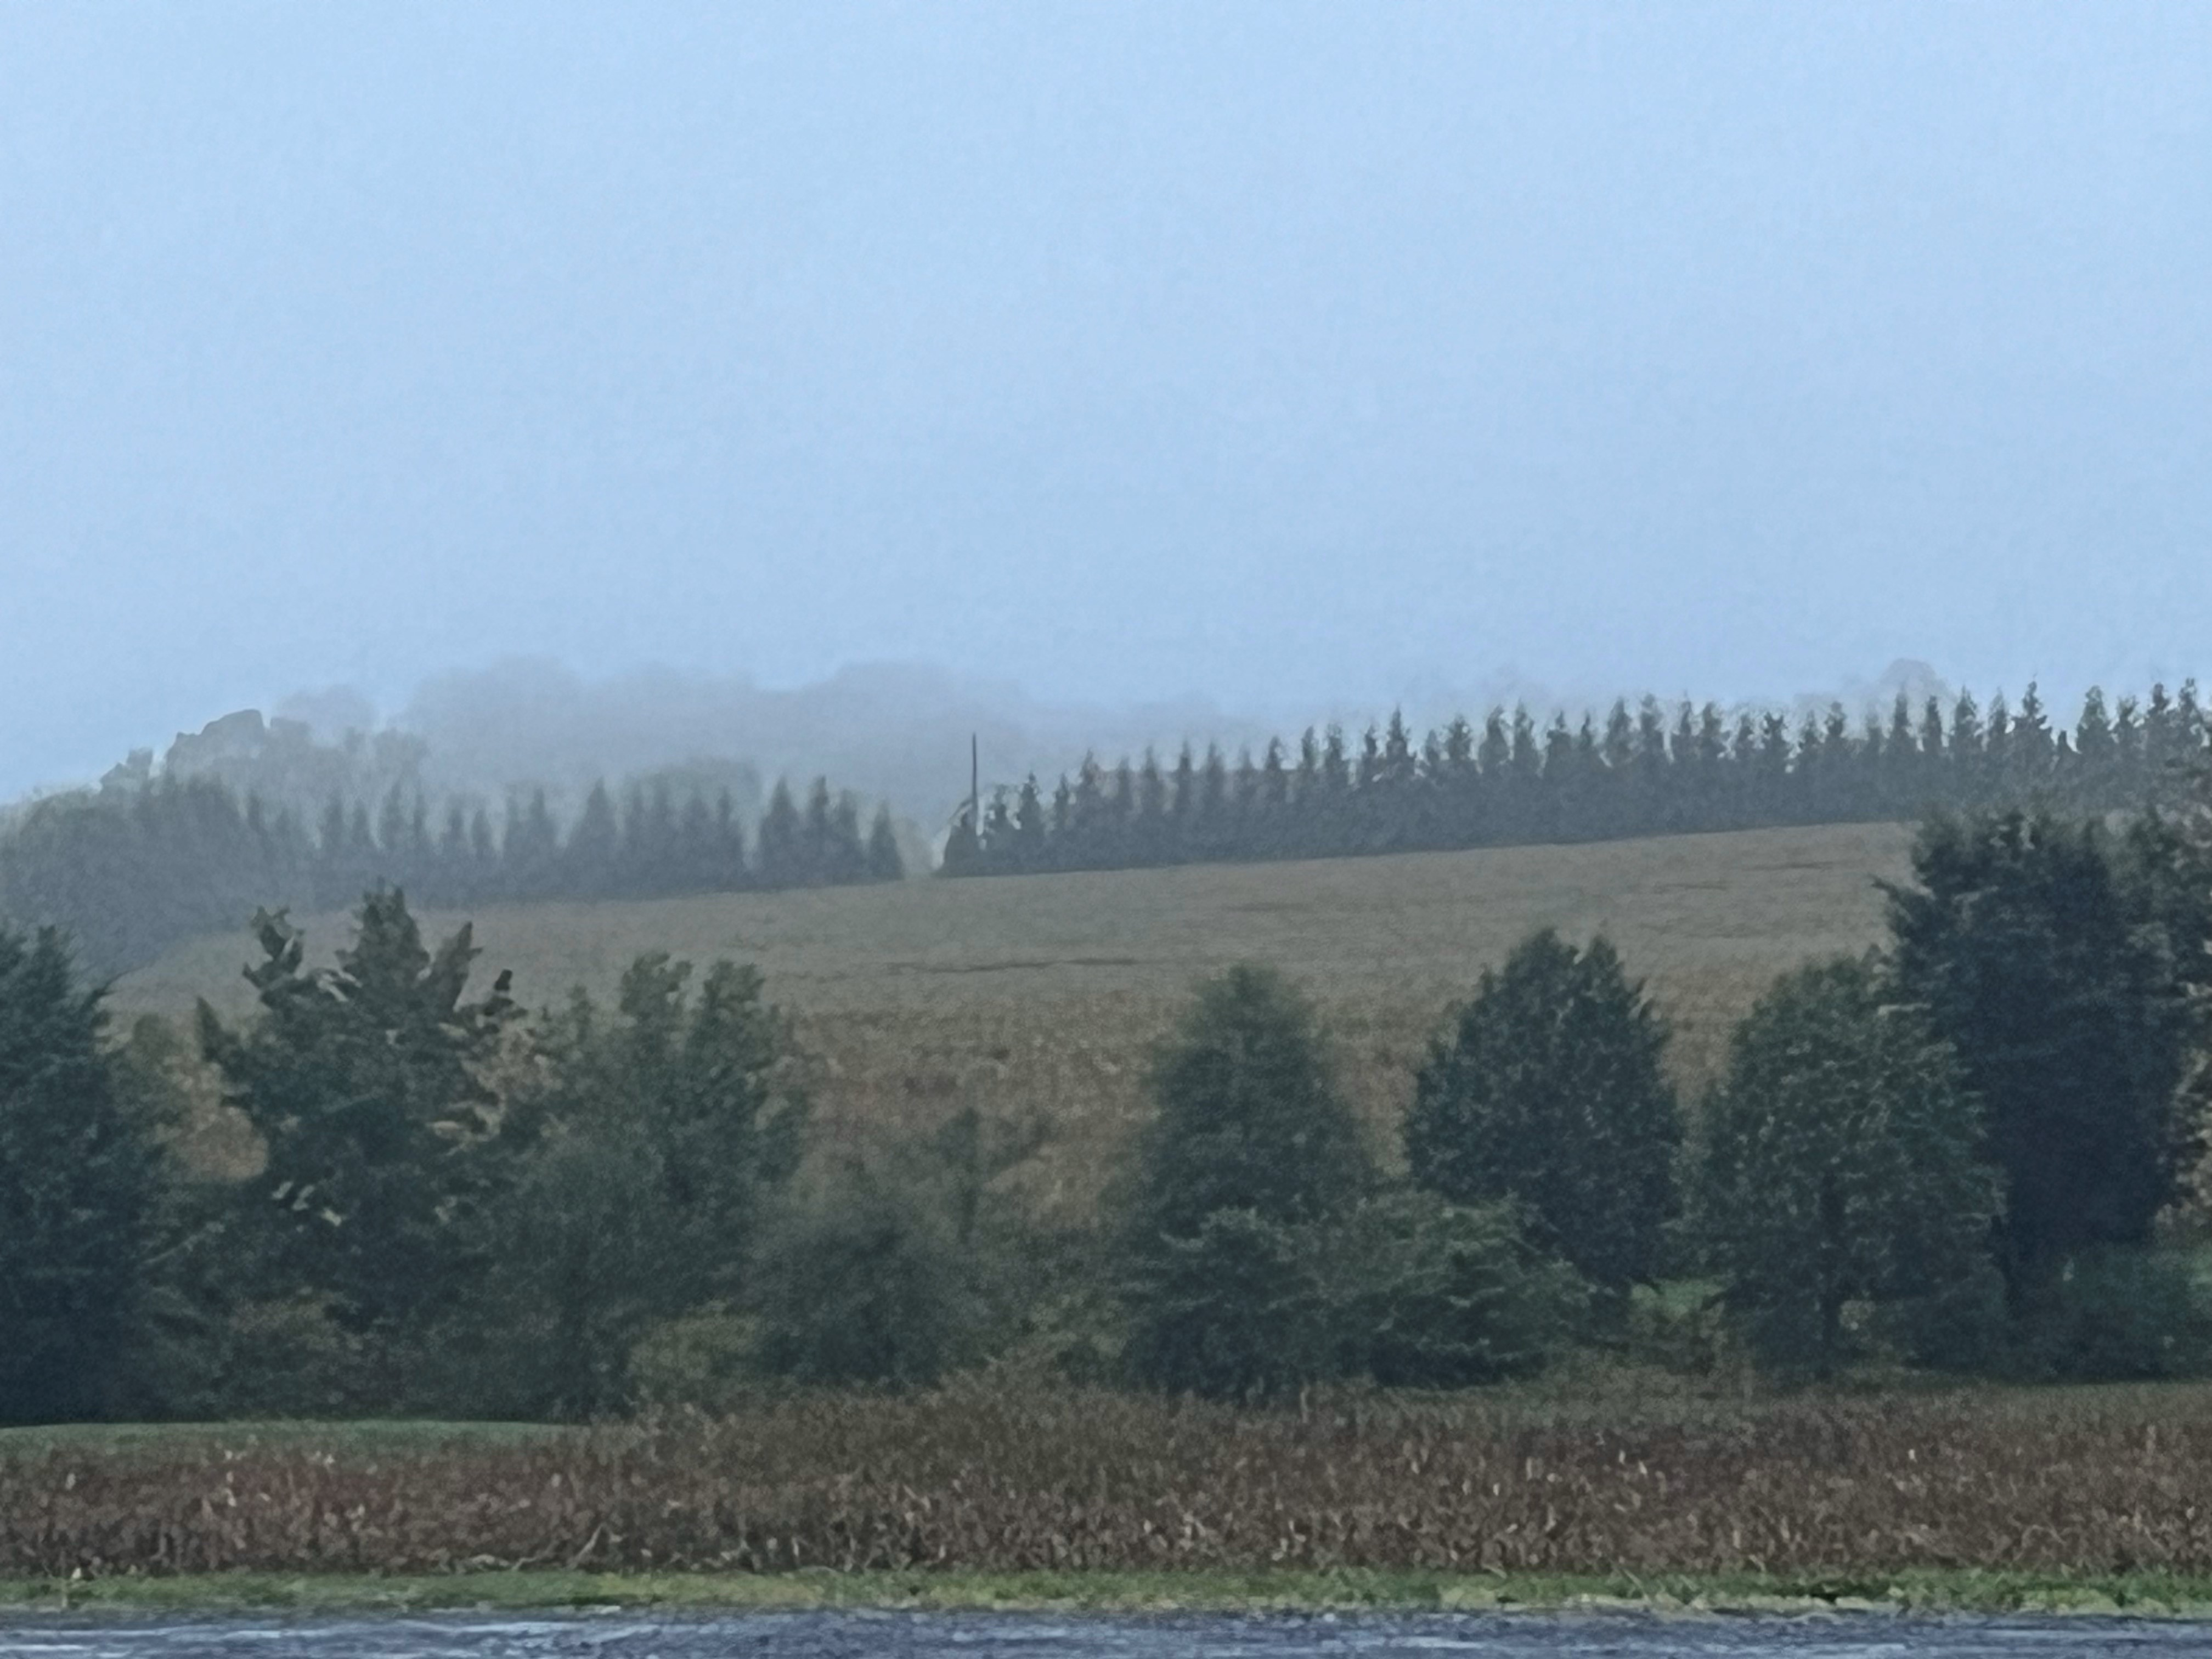

Slide 6
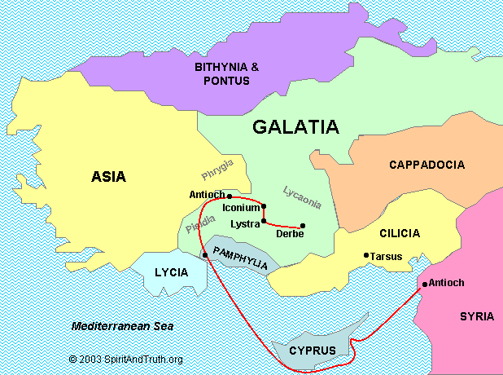
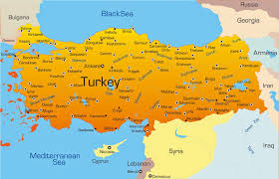
Galatia circa A.D. 55 Antioch of Pisidia (Acts 13:14) Iconium (Acts 13:51, (Acts 14:1) Lystra, and Derbe (Acts 14:6)
Modern-day Turkey

Slide 7
Paul’s normal practice was to go into the synagogue and share the Good News.
Acts 14:1 Now it happened in Iconium that they went together to the synagogue of the Jews, and so spoke that a great multitude both of the Jews and of the Greeks believed.

Slide 8
Acts 13:38,39 Therefore let it be known to you, brethren, that through this Man is preached to you the forgiveness of sins; and by Him everyone who believes is justified from all things from which you could not be justified by the law of Moses.

Slide 9
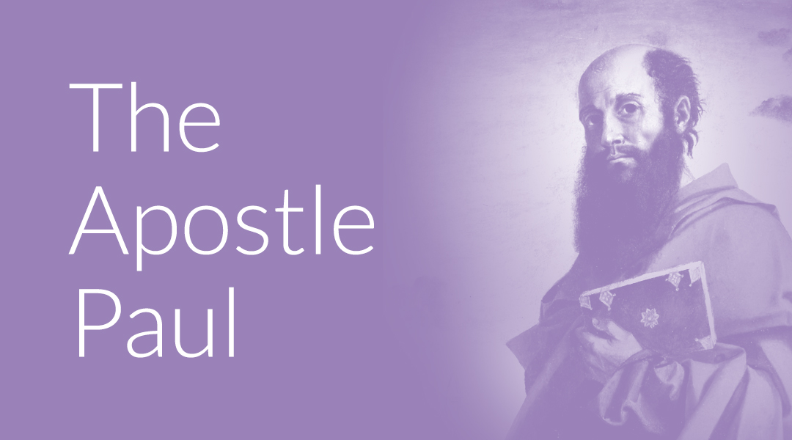
Gal 1:1 Paul, an apostle…
Apostle: “One who is sent out.”
Qualification of an Apostle.

Slide 10
Witness of the resurrection of Christ.
Acts 9:3-5 As he journeyed, he came near Damascus, and suddenly a light shone around him from heaven. Then he fell to the ground, and heard a voice saying to him, “Saul, Saul, why are you persecuting Me?” And he said, “Who are You, Lord?” Then the Lord said, “I am Jesus, whom you are persecuting.

Slide 11
Explicitly chosen by the Holy Spirit.
Acts 9:15 But the Lord said to him, “Go, for he is a chosen instrument of Mine, to bear My name before the Gentiles and kings and the sons of Israel;

Slide 12
Perform signs and wonders.
2Cor 12:12 The distinguishing marks of a true apostle were performed among you with all perseverance, by signs, wonders, and miracles.

Slide 13
Acts 16:17-18
This girl followed Paul and us, and cried out, saying, “These men are the servants of the Most High God, who proclaim to us the way of salvation.” ¹⁸ And this she did for many days.
But Paul, greatly annoyed, turned and said to the spirit, “I command you in the name of Jesus Christ to come out of her.” And he came out that very hour.

Slide 14
Acts 20:7-12 Now on the first day of the week, when the disciples came together to break bread, Paul, ready to depart the next day, spoke to them and continued his message until midnight. ⁸ There were many lamps in the upper room where they were gathered together. ⁹ And in a window sat a certain young man named Eutychus, who was sinking into a deep sleep. He was overcome by sleep; and as Paul continued speaking, he fell down from the third story and was taken up dead. ¹⁰ But Paul went down, fell on him, and embracing him said, “Do not trouble yourselves, for his life is in him.” ¹¹ Now when he had come up, had broken bread and eaten, and talked a long while, even till daybreak, he departed. ¹² And they brought the young man in alive, and they were not a little comforted.

Slide 15
Gal 1:6 I marvel that you are turning away so soon from Him who called you in the grace of Christ, to a different gospel,
The Message - I can’t believe how you waver—how easily you have turned traitor to him who called you by the grace of Christ by embracing an alternative message!
Acts 13 & 14 During Paul’s first missionary journey he planted churches in Galatia.

Slide 16
Merriam Webster – First: Preceding all others in time.
First place in events like:
Wrestling Quilting
Pickleball Golf Hunting
First car First house
First Love

Slide 17
Rev 2:4 Nevertheless I have this against you, that you have left your first love.
Not, romantic love, or a car or a house
They lost their passion, their devotion, their enthusiasm, their love for Him. They chose another path.

Slide 18
Gal 1:7 but there are some who trouble you and want to pervert the gospel of Christ.
Gal 1:9 As we have said before, so now I say again, if anyone preaches any other gospel to you than what you have received, let him be accursed.

Slide 19
Gal 1:14 And I advanced in Judaism beyond many of my contemporaries in my own nation, being more exceedingly zealous for the traditions of my fathers.
Tradition is a long-established custom or belief passed from generation to another generation.

Slide 20
TRADITIONS
Six-day work-week
Thanksgiving
St Patrick’s Day
Circumcision

Slide 21
Gal 1:12 For I neither received it from man, nor was I taught it, but it came through the revelation of Jesus Christ.
Acts 13:2 As they ministered to the Lord and fasted, the Holy Spirit said, “Now separate to Me, Barnabas and Saul for the work to which I have called them.”

Slide 22
Gal 1: 21-23
Afterward I went into the regions of Syria and Cilicia. ²² And I was unknown by face to the churches of Judea which were in Christ. ²³ But they were hearing only, “He who formerly persecuted us now preaches the faith which he once tried to destroy.”

Slide 23
Gal 1:24 And they glorified God in me.
When our efforts are done in light of the Gospel, God is glorified!

Slide 25
1 Samuel 16:7b For the Lord does not see as man sees; for man looks at the outward appearance, but the Lord looks at the heart.”

