Slide 1
Welcome
Gen 1:16 God made the greater light to rule the day.

Slide 2
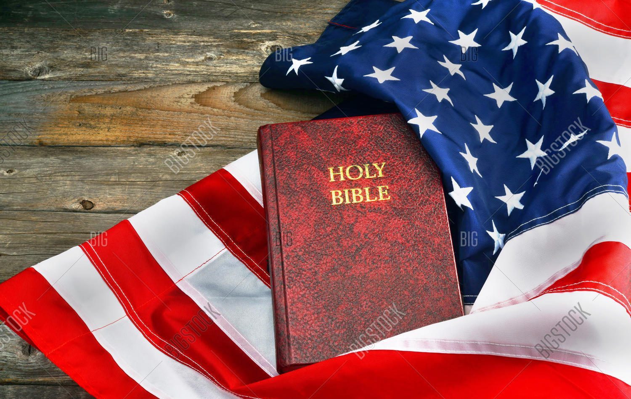
Grace BIBLE Chapel
Our Bible and Our Politics

Slide 3
Things we do because it’s RIGHT,
and is a way to LOVE our neighbor as ourself.
Pick up an empty bottle beside the road.
Dim our high beams when approaching others.
Stop for red light, on deserted road, at midnight.
Not __ in the __ool.
Vote in US government elections.

Slide 4
Phrases used to discourage Bible-Believing Christians from political involvement
Separation of Church & State
 Forbids religious individuals & institutions from influencing government (false).
 Protects religious individuals & institutions from government intrusion (true).
Prov 14:34 Righteousness exalts a nation, but sin is a reproach to any people.

Slide 5
☑ Tax Exempt Status
Churches “are absolutely prohibited from directly or indirectly participating in, or intervening in, any political campaign on behalf of (or in opposition to) any candidate for elective public office.”
 Fear of losing exemption must not limit our public proclamation of clear biblical truth.
 Tax deductions must not motivate our giving.
Rom 13:5,6 You must be subject (to governing authorities) not only because of wrath but also for conscience' sake. Because of this also pay taxes.

Slide 6
Christian Nationalism
 Pursuing a Theocracy where the Bible and the God of the Bible are forced upon everyone.
 Belief that the U.S. is a country founded on Christian religious principles and wanting policy and the broader culture to reflect those ideals.
Matt 5:13 You (disciples) are the salt of the earth;
14 You are the light of the world.
16 Let your light so shine before men that they see your good works and glorify your Father in heaven.

Slide 7
Bible examples of political involvement
OT Prophets - Moses, Daniel, Isaiah, Jeremiah all spoke truth to power, confronted kings, and influenced laws as well as social conscience.
NT Individuals - John the Baptist confronted Herod.
Jesus weighed in on tax issues, labeled King Herod as an unclean “fox”, and engaged with Pilate, the Roman governor.
Paul leveraged his Roman citizenship and the right to appeal to Caesar.

Slide 8
Our Bible and Our Politics
1 - Government was GOD’S Idea
✓ For protection
Rom 13:1,4 Let everyone submit to the governing authorities. For he is God's minister to you for good.
✓ For punishment
1Pet 2:13,14 Submit to every ordinance of man for the Lord's sake … to governors, as those who are sent by Him to punish evildoers and praise good.
➢ Government can become evil, but is not evil by definition.

Slide 9
The Sovereign God has put you in this place, under this government, at this time. We submit to God by participating in this system, to the best of our ability.
When godly people don’t participate in governance, they eventually live under ungodly people and laws, and have only themselves to blame.
Matt 5:13 If the salt loses its flavor, how shall it be seasoned? It is then good for nothing but to be thrown out and trampled underfoot by men.

Slide 10
2 - God will use FLAWED, SINFUL Leaders.
3 Types of Leaders
- Those who embrace, celebrate, and promote righteousness (II Kgs 22,23 - Josiah).
- Those who embrace, celebrate, and promote wickedness (I Kgs 16-22 - Ahab & Jezebel).
- Those who are flawed, but used for good (II Kgs 9 - Jehu).
➢ No human leader has the “total package”.

Slide 11
3 - Vote POLICIES over personalities.
Biblical themes to carefully consider
JUDGES - because God cares about Justice.
Isa 1:26 I will restore your judges as at the first. You will be called the righteous and faithful city.
Isa 61:8 I love justice; and hate robbery & wrongdoing.
Micah 6:8 What does the Lord require but to do justice, love kindness, and walk humbly with God.
➢ Support candidates who uphold righteous laws.

Slide 12
Biblical themes to carefully consider
BORDERS - because God cares about security
Acts 17:26 God has made from one blood every nation of men to dwell on all the face of the earth, and has determined their pre-appointed times and the boundaries of their dwellings.
Zech 7:10 Do not oppress the widow or the fatherless, the alien or the poor. Let none of you plan evil in his heart against his brother.
➢ Support candidates who respect proper boundaries.

Slide 13
Biblical themes to carefully consider
ISRAEL - because God has tied blessing and cursing to how others treat His chosen people.
Gen 12:2 I will make you (Abraham) a great nation; I will bless you and make your name great; And you will be a blessing.
3 I will bless those who bless you, and I will curse him who curses you; And in you all the families of the earth will be blessed.
➢ Support candidates who consistently favor Israel.

Slide 14
Biblical themes to carefully consider
RELIGIOUS LIBERTY - because God has given each person a free will and doesn’t force faith.
Josh 24:15 If it seems evil to you to serve the LORD, then choose for yourselves whom you will serve. But as for me and my house, we will serve the LORD.
Rom 14:5 One person honors one day above another; another every day alike. Let each be fully convinced in his own mind.
➢ Avoid candidates who “cancel culture”.

Slide 15
Biblical themes to carefully consider
BIOLOGICAL SEX - because God created male & female.
Gen 1:27 God created man in His own image; in the image of God He created him; male and female He created them.
Rom 1:28 Since they thought it foolish to acknowledge God, He abandoned them to their foolish thinking and let them do things that should never be done.
➢ Support candidates who see these issues compassionately but clearly.

Slide 16
Biblical themes to carefully consider
FAMILY - because God entrusts young children and elderly loved ones primarily to families, not professionals.
Ps 127:3 Children are a heritage from the LORD. The fruit of the womb is a reward.
Ex 20:12 Honor your father and your mother.
1Tim 5:8 If anyone does not provide for his own, and especially for those of his household, he has denied the faith and is worse than an unbeliever.
➢ Support candidates who empower biblical families.

Slide 17
Biblical themes to carefully consider
LIFE - because God gives it and only He determines when it starts, and how and when to end it.
Ps 139:13 You formed my inward parts; You knit me together in my mother's womb.
Exodus 20:13 You shall not murder.
Prov 6:17 The LORD hates hands that shed innocent blood.
➢ Support candidates who believe ALL lives matter.
Those who would murder the UNBORN
can not be trusted to govern the BORN.

Slide 18
Our Bibles and Our Politics
1 - Government was GOD’S Idea.
2 - God will use FLAWED, SINFUL Leaders.
3 - Vote POLICIES over personalities.
4 - VOTE!
Prov 13:22 It is how good men and women seek to leave something good for the next generation.
Matt 5:13 It is one way to be “salt and light”.
Matt 28:29 It is one way to “disciple the nations”.
Eph 5:15,16 It is one way to “redeem the time because the days are evil”.

Slide 19
God’s sovereign control over present elections and the return of Christ in the future always gives hope.
But never use these as excuses to wash our hands of opportunities and responsibilities that reflect our love for God, for our neighbor, and for our country.
Good political leaders can’t save us from hell, but they can help prevent “hell on earth”.
Find politicians who most closely align with biblical morals, vote for them, and pray they don’t change!

Slide 20
Grace BIBLE Chapel
Our Bible and Our Politics

Slide 21
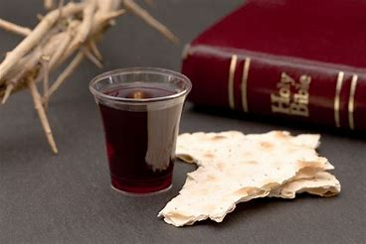

Slide 22
There Is a Redeemer # 365
There is a Redeemer, Jesus, God's own Son, Precious Lamb of God, Messiah, Holy one,

Slide 23
Thank you oh my Father, For giving us your Son, And leaving your Spirit, 'til the work on earth is done.

Slide 24
Jesus my redeemer, Name above all names, Precious Lamb of God, Messiah, Oh, for sinners slain.

Slide 25
Thank you oh my Father, For giving us your Son, And leaving your Spirit, 'til the work on earth is done.

Slide 27
When I stand in glory, I will see His face, And there I'll serve my King forever, In that holy place.

Slide 28
Thank you oh my Father, For giving us your Son, And leaving your Spirit, 'til the work on earth is done.

