Slide 1
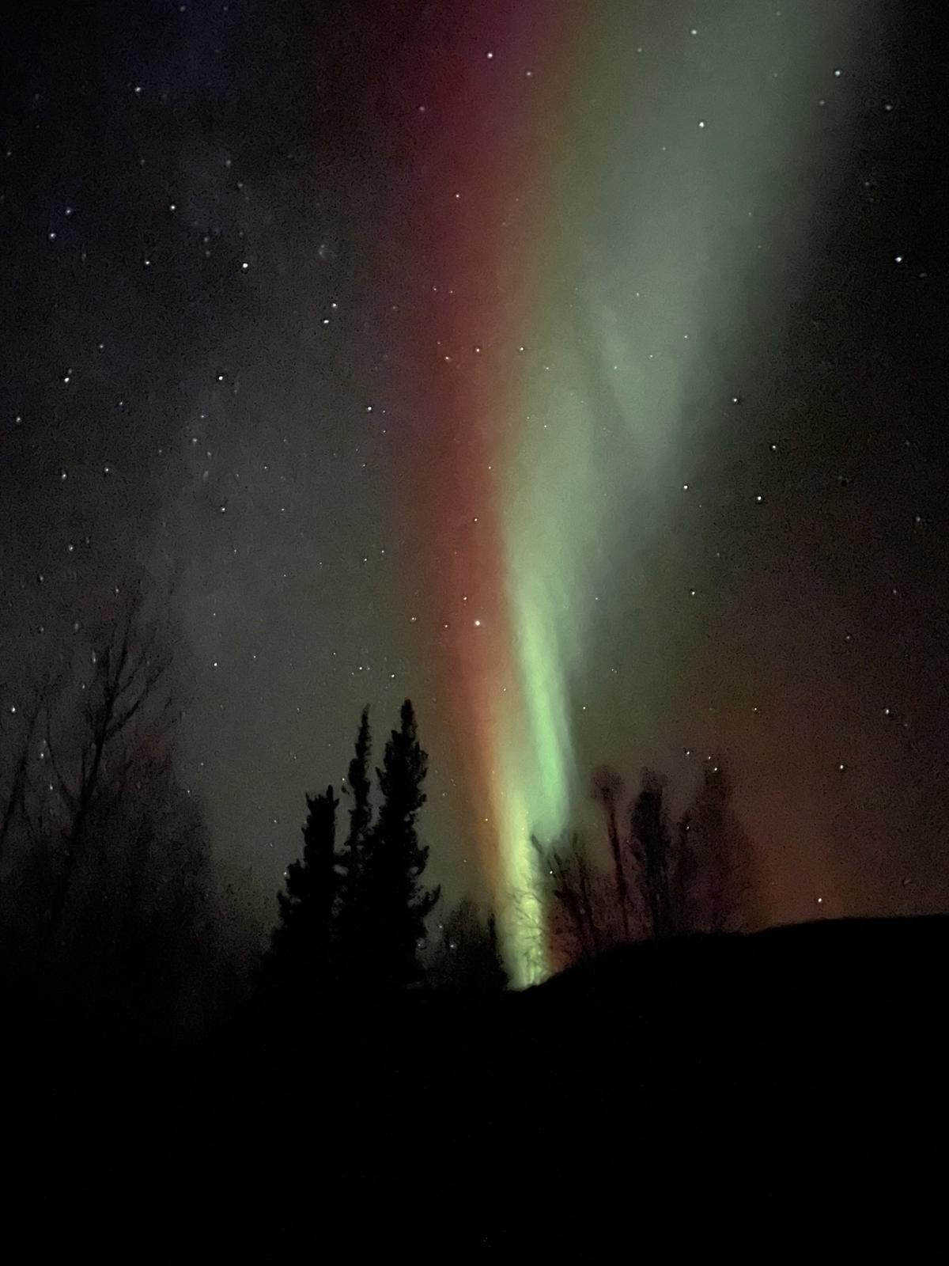
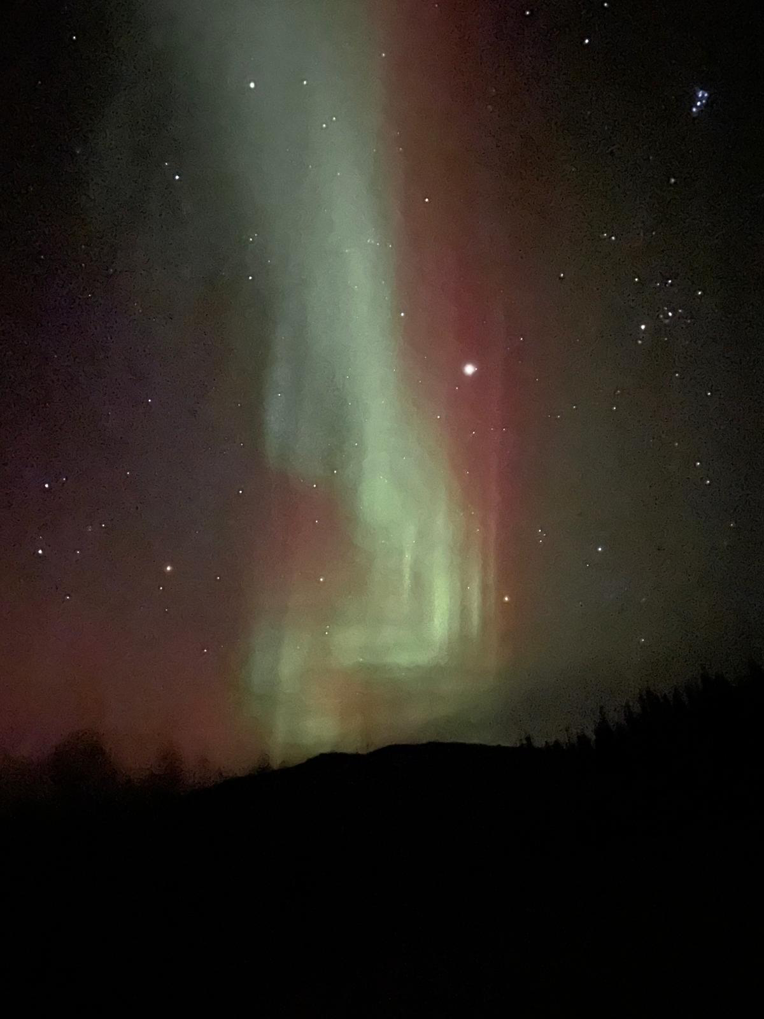
W
e
l
c
o
m
e
The heavens declare the glory of God. Ps 19:1

Slide 2
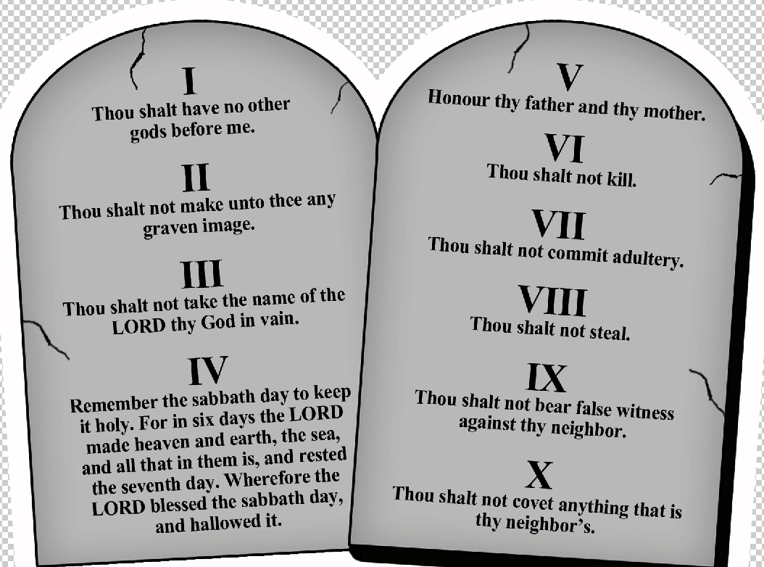
IDOLS

Slide 3
Ex 20:3-5 You shall have no other gods before Me. You shall not make for yourself a carved image. You shall not bow down to them nor serve them. For I, the LORD your God, am a jealous God.
Isa 42:8 I am the LORD, that is My name; And My glory I will not give to another, nor My praise to carved images.

Slide 4
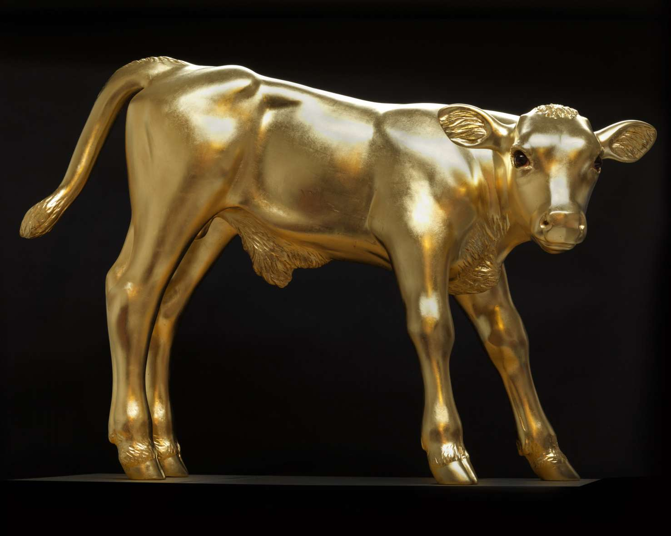
Biblical Idols

Slide 5
American Idols

Slide 6
Worshipping at the altar of …
Education – Developing minds without a moral compass.
Athletics – Producing heroes without holiness.
Entertainment – Popularizing play without productivity.

Slide 7
Worshipping at the altar of …
Health – Seeking eternal youth without the everlasting God.
Lust – Feeding appetites without agape.
Retirement – Institutionalizing life without labor.
Wealth – Accruing assets without almsgiving.

Slide 8
Worshipping at the altar of …
Entertainment – Popularizing play without productivity
Definition - providing or being provided with amusement or enjoyment.
Synonyms - show, performance, spectacle, extravaganza.

Slide 9
Forms of Entertainment
Cinema/Film Music
Banquets Dance
Games Animals/Circus
Reading Parades/Fireworks
Performance/Theater
Storytelling Sports

Slide 10
Biblically Positive or Neutral Entertainment
Cinema/Film Music
Banquets Dance
Games Animals/Circus
Reading Parades/Fireworks
Performance/Theater
Storytelling Sports

Slide 11
Biblical Freedom to Enjoy
I Tim 4:4,5 Every creature of God is good, and nothing is to be refused if it is received with thanksgiving; for it is sanctified by the word of God and prayer.
➢ Appreciate God’s good gifts and gratefully bring Him into the moment.

Slide 12
Biblical Freedom to Enjoy
I Cor 10:31 Whether you eat or drink, or whatever you do, do all to the glory of God.
➢ Even little things can reflect God’s character to anyone watching.

Slide 13
Biblical support for godly enjoyment has played a role in the development of sports, literature, art, music and more among Judeo-Christian cultures.
So the next time opportunity presents itself to enjoy a wholesome form of entertainment, think about this heritage and thank God for His good gifts!

Slide 14
Biblical Cautions
Several words that we associate with entertainment are NOT found in the Bible
(fun, games, play, vacation, sports).
In fact, words considered the opposite of these words ARE found in God’s Word
(sober, work, mourn, weep).

Slide 15
Biblical Cautions
Gal 5:13 You have been called to liberty; but do not use liberty as an opportunity for the flesh, but through love serve one another.
I Pet 2:16 Live as free, but do not use liberty as an excuse for vice, but as servants of God.

Slide 16
Luke 16:13 No servant can serve two masters; for either he will hate the one and love the other, or else he will be loyal to the one and despise the other. You cannot serve God and _________.

Slide 17
Steps toward IDOLATRY
Psalm 106
1 – Unredeemed cultural connections.
Taking cues from my surroundings
Ps 106:35 They mingled with the Gentiles and learned their works;

Slide 18
Entertainment Cautions
TV, Movies, Internet
Ps 101:3 I will set nothing wicked before my eyes.
Rom 1:32 Take pleasure in those who commit things worthy of (God’s judgement)

Slide 19
Entertainment Cautions
TV, Movies, Internet
Sports
1Tim 4:7,8 Exercise yourself toward godliness. For bodily exercise profits a little, but godliness is profitable for all things, having promise of the life that now is and of that which is to come.

Slide 20
Entertainment Cautions
TV, Movies, Internet
Sports
Church Worship and Culture
me & us focused rather than God & others;
casual & common rather than holy;
comfortable rather than self-denying;
fun rather than serving & cross-bearing.

Slide 21
Entertainment Cautions
TV, Movies, Internet ~ Sports ~ Church Culture
The Lord’s Day
Isa 58:13 If you turn away your foot from the Sabbath, from doing your pleasure on My holy day, and call the Sabbath a delight, the holy day of the LORD honorable, and shall honor Him, not doing your own ways, or finding your own pleasure, or speaking your own words,

Slide 22
Isa 58:14 Then you will delight yourself in the LORD; And I will cause you to ride on the high hills of the earth, and feed you with the heritage of Jacob your father. The mouth of the LORD has spoken."

Slide 23
Steps toward IDOLATRY
1 – Unredeemed cultural connections.
2 – No longer in charge, or free to leave.
Ps 106:36 They served their idols, which became a snare to them.
1Cor 6:12 “All things are lawful for me”, but all things are not helpful. “All things are lawful for me”, but I will not be brought under the power of any.

Slide 24
Steps toward IDOLATRY
3 – Willingness to sacrifice (or even kill) important, dependent relationships.
Ps 106:37 They even sacrificed their sons and their daughters to demons,
38 And shed innocent blood, the blood of their sons and daughters, whom they sacrificed to the idols of Canaan.

Slide 25
Steps toward IDOLATRY
4 – Left feeling dirty, cheap, and used.
Ps 106:39 Thus they were defiled by their own works, and played the harlot by their own deeds.

Slide 26
5 – Spiritual growth & well-being effected.
Ps 106:40 Therefore the wrath of the LORD was kindled against His people,
41 Those who hated them ruled over them (note the “location” words).
42 They were brought into subjection under their (enemies’) hand.
43 They rebelled, and were brought low for their iniquity.

Slide 27
(also notice the conflict words)
Ps 106:40 The wrath of the LORD was kindled against His people, so that He abhorred His own inheritance.
41 He gave them into the hand of the Gentiles, and those who hated them ruled over them.
42 Their enemies also oppressed them, and they were brought into subjection under their hand.

Slide 28
6 – But Hallelujah, God is merciful to any idolater who cries out to Him.
Ps 106:44 Nevertheless He regarded their affliction, when He heard their cry;
45 And for their sake He remembered His covenant, and relented according to the multitude of His mercies.

Slide 29
1Cor 10:13 No temptation (idol) has overtaken you except such as is common to man; but God is faithful, Who will not allow you to be tempted beyond what you are able, but with the temptation (idol) will also make the way of escape, that you may be able to bear it.
14 Therefore, my beloved, flee from idolatry.

Slide 30
American Idols
Worshipping at the altar of …
Entertainment – Popularizing play without productivity.
Tear down that IDOL!

Slide 31
➢ Keep entertainment in perspective.
Ps 84:10 A day in Your courts is better than a thousand. I would rather be a doorkeeper in the house of my God than dwell in the tents of wickedness.
- No amount of entertainment can bring ultimate fulfillment.
- Such satisfaction comes only by walking daily with Jesus as Savior & Lord.

Slide 32
➢ Find enjoyment in humble pursuits (Eccl 9).
(7) good food and drink.
(8) simple clothing & hygiene.
(9,10) joyful relationships & hard work.

Slide 33
➢ Don’t use entertainment to escape reality.
Eccl 3:13 Every man should eat and drink AND enjoy the good of all his labor—it is the gift of God.

Slide 34
Tear down that IDOL!
➢ Don’t excuse sin as “harmless fun”.
Eph 5:3 Let there be no sexual immorality, impurity, or greed among you. Such sins have no place among God’s people.
4 Obscene stories, foolish talk, and coarse jokes—these are not for you.

Slide 35
Eph 5:5 Know this, that no fornicator, unclean person, nor covetous man, who is an idolater, has any inheritance in the kingdom of Christ and God.
6 Let no one deceive you with empty words, for because of these things the wrath of God comes upon the sons of disobedience.

Slide 36
Tear down that IDOL!
➢ Monitor and test your ability to stop.
I Cor 6:12 All things are lawful for me, but all things are not helpful. All things are lawful for me, but I will not be brought under the power of any.
- Fast (1 day, 3 days, a week, a month).
- Remove (put off) and replace (put on).

Slide 37
Worshipping at the altar of …
Entertainment – Popularizing play without productivity.
Tear down that IDOL!
Athletics – Producing heroes without holiness.

