Slide 1
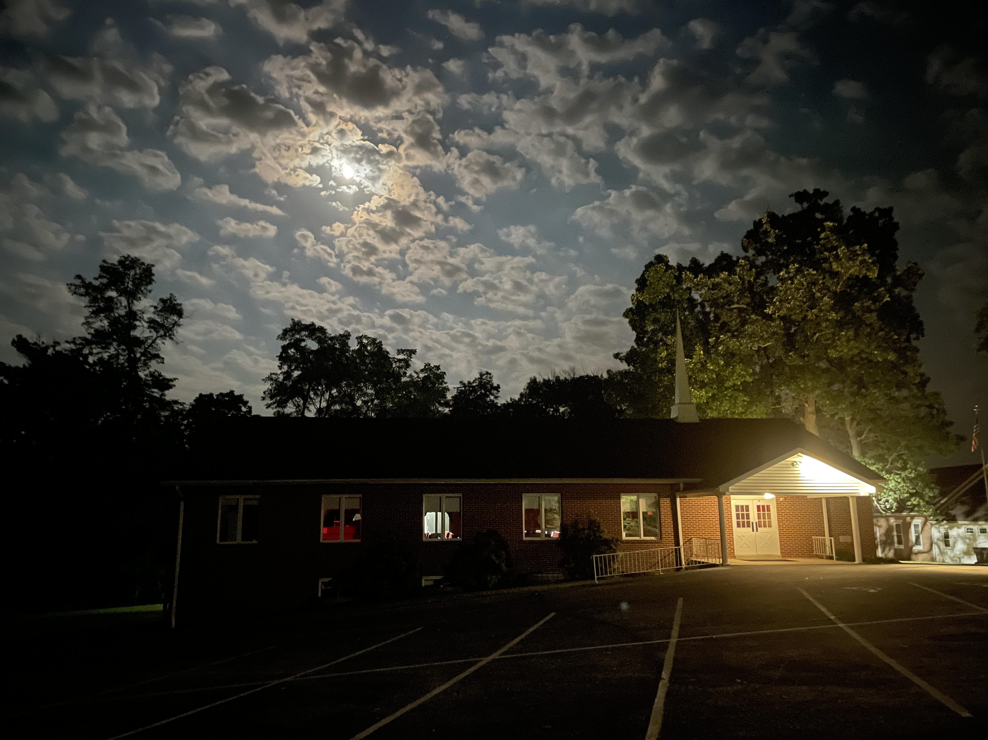
Welcome
1933-1944
I must work the works of Him who sent Me while it is day;
the night is coming when no one can work. John 9:4

Slide 2
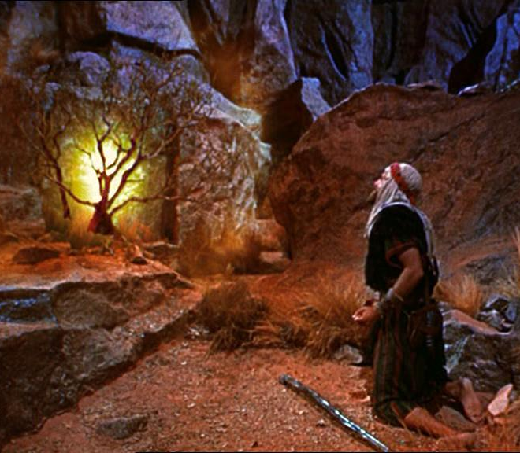
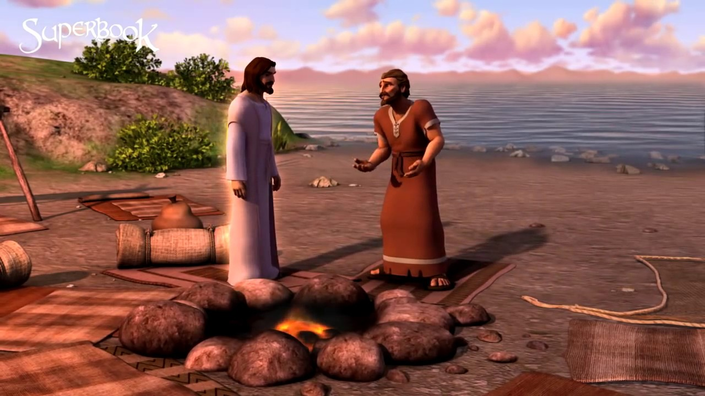
Biblical Fireside Chats
MOSES
PETER
Reassuring
a Fearful Leader
Restoring
a Fallen Leader

Slide 3
Lessons from Jesus’ Restoration of Peter
Leaders sin/fail God.
God will pursue each.
Forgiveness is available.
Repentance is required.
Restored usefulness is the goal. Gal 6:1
PETER
Restoring
a Fallen Leader

Slide 4
Gal 6:1 If anyone is overtaken in any trespass, you who are spiritual restore such a one in a spirit of gentleness, considering
yourself lest you also be tempted.
Restoring
a Fallen Leader

Slide 5
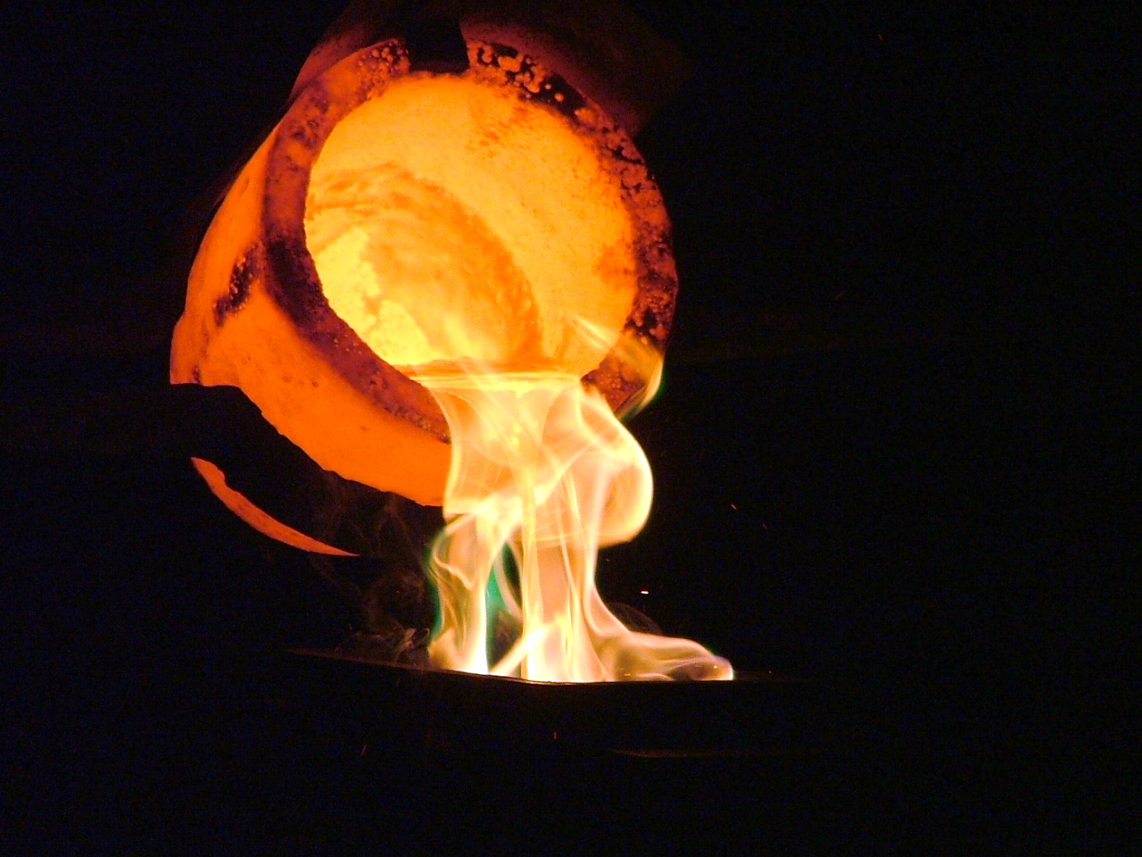
A Future Final “Fireside”

Slide 6
1Cor 3:9 We are God's fellow workers; you are God's field, you are God's building.
1Cor 3:10 According to the grace of God which was given me, as a builder I (Paul) have laid the foundation, and another builds on it.
1Cor 3:11 No other foundation can
anyone lay than that which is laid,
which is Jesus Christ.

Slide 7
1Cor 3:12 Now if anyone builds on this foundation with gold, silver, precious stones (valuable & durable), wood, hay, straw (cheap & combustible),
1Cor 3:13 each one's work will become clear; for the Day will declare it, because it will be revealed by fire; and the fire will test each one’s work, of what sort
it is.

Slide 8
1Cor 3:14 If anyone's work which he has built on it endures, he will receive a reward.
1Cor 3:15 If anyone's work is burned, he will suffer loss; but he himself will be saved, yet so as through fire.

Slide 9
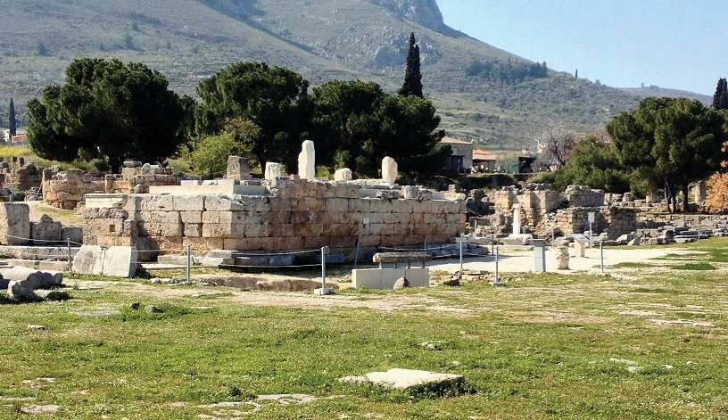
Judgment Seat (Bema) of Christ
“Bema” = raised platform where judgments were made.

Slide 10
Judgment Seat (Bema) of Christ
“Bema” = raised platform where judgments were made.
Distinct from Great White Throne Judgment
Bema - Rom 14:10-12; 1 Cor 3:10-15; 2 Cor 5:9-10
GWT - Revelation 20:11-15; Hebrews 9:27
Heb 9:27 It is appointed for men to die once, but after this the judgment.

Slide 11
Distinctions
Bema - Believers examined by Jesus Christ (Jn 5:22-25).
GWT - Unbelievers judged by Jesus Christ (John 5:26-29).
John 5:22 The Father judges no one, but has committed all judgment to the Son,
28 The hour is coming in which all who are in the graves will hear His voice
29 and come forth—those who have done good, to the resurrection of life, and those who have done evil, to the resurrection of condemnation.

Slide 12
Distinctions
Bema - Believers examined by Jesus Christ (Jn 5:22-25).
GWT - Unbelievers judged by Jesus Christ (John 5:26-29).
Bema - After Rapture, during Tribulation; before Millenium.
GWT - After Millenium; before Lake of Fire.

Slide 13
Distinctions
Bema - No condemnation (Rom 8:1).
There is therefore now no condemnation to those who are in Christ Jesus, who do not walk according to the flesh, but according to the Spirit.
GWT - Righteous judgment w/o appeal (Rom 2:5).
In accordance with your hardness and your impenitent heart you are treasuring up for yourself wrath in the day of wrath and revelation of the righteous judgment of God.

Slide 14
Distinctions
Bema - Believers’ motives & desires for serving God & others are evaluated, with all pure, faithful, fruitful works rewarded (II Cor 5:9.10).
We make it our aim to be well pleasing to Him. For we must all appear before the judgment seat of Christ, that each one may receive the things done in the body, according to what he has done, whether good or bad.

Slide 15
GWT - All who rebelled against God’s righteousness and resisted His grace during life are condemned to separation from God for eternity (Rev 20:11-15).
11 I saw a great white throne and Him who sat on it, from whose face the earth and the heaven fled away. And there was found no place for them.
12 And I saw the dead, small and great, standing before God, and books were opened. And another book was opened, which is the Book of Life. And the dead were judged according to their works, by the things which were written in the books.

Slide 16
GWT - All who rebelled against God’s righteousness and resisted His grace during life are condemned to separation from God for eternity (Rev 20:11-15).
13 The sea gave up the dead who were in it, and Death and Hades delivered up the dead who were in them. And they were judged, each one according to his works.
14 Then Death and Hades were cast into the lake of fire. This is the second death.
15 And anyone not found written in the Book of Life was cast into the lake of fire.

Slide 17
Bema - All impurity, unfaithfulness, fruitlessness within our works are burned (I Cor 3:12-15).
12 If anyone builds with gold, silver, precious stones, wood, hay, straw,
13 each one's work will become clear; for the Day will declare it, for it will be revealed by fire; and the fire will test each one's work, of what sort it is.
14 If anyone's work which he has built on it endures, he will receive a reward.
15 If anyone's work is burned, he will suffer loss; but he himself will be saved, yet so as through fire.

Slide 18
Distinctions
Bema - All impurity, unfaithfulness, fruitlessness within our works are burned (I Cor 3:11-15).
GWT - Fires are “hotter” for some than others (Luke 10).
13 Woe to you, Bethsaida! For if the mighty works which were done in you (by Jesus) had been done in Tyre and Sidon, they would have repented long ago, sitting in sackcloth and ashes.
14 But it will be more tolerable for Tyre and Sidon at the judgment than for you.

Slide 19
Distinctions
Bema - Time & place where believers works are evaluated for rewards (awards ceremony) with lesser or greater authority/responsibilities assigned.
Matt 25:21 Well done, good and faithful servant; you were faithful over a few things, I will make you ruler over many things. Enter into the joy of your Lord.
GWT - Time & place where unbelievers are judged.
Matt 25:41 Depart from Me, you cursed, into the everlasting fire prepared for the devil and his angels.

Slide 20
Heavenly Rewards - Crowns
Victor’s Crown (Self-Control) - I Cor 9:25-27
25 All who compete for the prize are temperate in all things. Now they do it to obtain a perishable crown, but we for an imperishable crown.
26 Therefore I run: not with uncertainty. I fight: not as one who beats the air.
27 But I discipline my body and bring it into subjection, lest, when I have preached to others, I myself should become disqualified.

Slide 21
Heavenly Rewards
Crown of Righteousness (Looking for Jesus)
2Tim 4:7 I (Paul) have fought the good fight, I have finished the race, I have kept the faith.
8 Finally, there is laid up for me the crown of righteousness, which the Lord, the righteous Judge, will give to me on that Day, and not to me only but also to all who have loved His appearing.

Slide 22
Heavenly Rewards
Crown of Life (Suffering)
James 1:12 Blessed is the man who endures temptation; for when he has been approved, he will receive the crown of life which the Lord has promised to those who love Him.
Rev 2:10 Do not fear any of those things which you are about to suffer. Indeed, the devil is about to throw some of you into prison, that you may be tested, and you will have tribulation ten days. Be faithful until death, and I will give you the crown of life.

Slide 23
Heavenly Rewards
Crown of Glory (Shepherding) - I Peter 5:2-4
2 Shepherd the flock of God which is among you, serving as overseers, not by compulsion but willingly, not for dishonest gain but eagerly;
3 nor as being lords over those entrusted to you, but being examples to the flock;
4 and when the Chief Shepherd appears, you will receive the crown of glory that does not fade away.

Slide 24
Heavenly Rewards
Crown of Rejoicing (Soul-Winning)
I Thess 2:19 What is our hope, or joy, or crown of rejoicing? Is it not even you in the presence of our Lord Jesus Christ at His coming?
Phil 4:1 Therefore, my beloved and longed-for brethren, my joy and crown, so stand fast in the Lord, beloved.

Slide 25
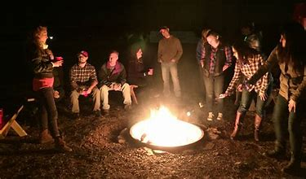
“Fireside Chats”
Fearful Moses at Burning Bush - Fortified
Fallen Peter at the Sea Side - Forgiven
All Believers at the Bema - Faithfulness Crowned
Tonight around the Fireplace - Fellowship

Slide 26
O Church, Arise
O Church arise and put your armor on Hear the call of Christ our Captain. For now the weak can say that
they are strong In the strength that God has given.

Slide 27
With shield of faith and belt of truth We’ll stand against the devil’s lies. An army bold whose battle-cry is Love Reaching out to those in darkness.

Slide 28
Come see the cross where love and mercy meet As the Son of God is stricken. Then see His foes lie crushed
beneath His feet, For the Conqueror has risen.

Slide 29
And as the stone is rolled away, And Christ emerges from the grave. This victory march continues
till the day Every eye and heart shall see Him.

Slide 30
So, Spirit come,
put strength in every stride, Give grace for every hurdle. That we may run with faith
to win the prize Of a servant good and faithful.

Slide 31
As saints of old still line the way, Retelling triumphs of His grace. We hear their calls and hunger
for the day When with Christ we stand in glory.

