Slide 1
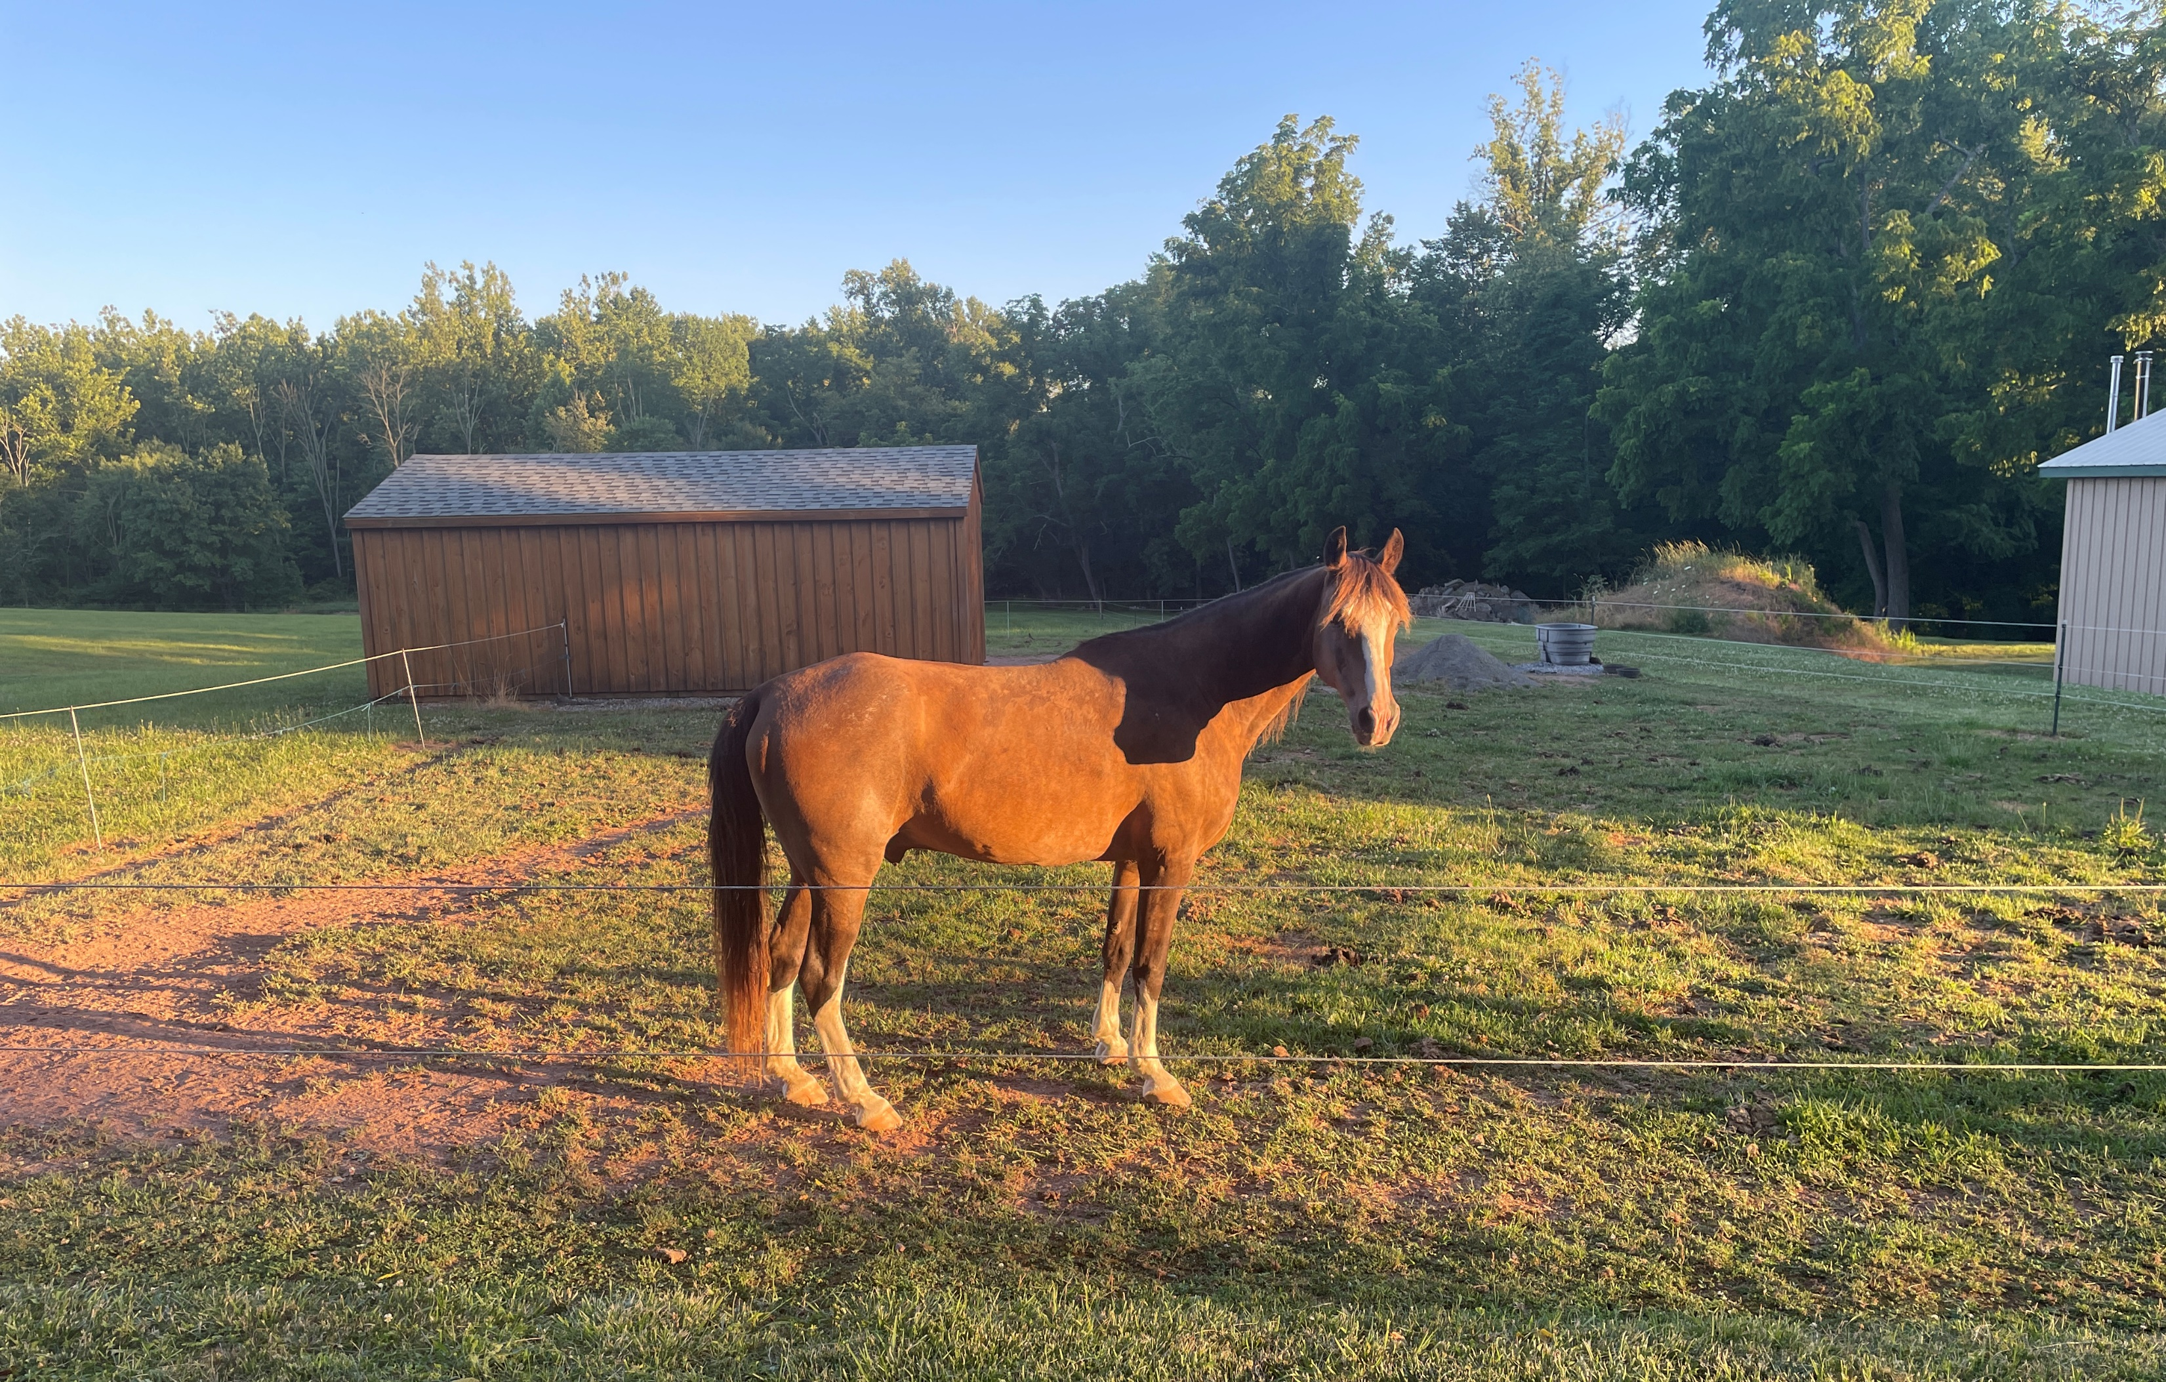
Welcome
The horse is prepared for the day of battle,
but deliverance is of the LORD. Prov 21:31

Slide 2
Week before Jesus’ crucifixion (Mark’s Gospel)
Sun - Welcomed by Jerusalem crowd; Palms (11)
Mon - Fig tree cursed; Temple cleansed (11)
Tues - Withered tree observed; Jesus’ authority challenged (11); IMPORTANT TEACHING (12,13)
Wed - ?? Jesus anointed; Judas conspires (14)
Thurs - Last Supper; Garden betrayal; Trials (14)
Fri - Trials; Peter’s denials; Cross; Death; Burial (14,15)
Sun - Resurrection (16)

Slide 3
Mark 12
➢ Jesus moving from DOING to TEACHING
➢ He speaks in 30 out of 44 verses
(1-12) Accusing Parable from Jesus
(13-17) Political Trap from Pharisees
(18-27) “What If …” Dilemma from Sadducees
(28-34) Commandment Question from Scribes
(35-44) Condemning Contrast from Jesus
➢ The common people heard Him gladly! (37)

Slide 4
Attacks Against Jesus
(13-17) Attack # 1 by the Pharisees & Herodians
Goal - Discredit Jesus POLITICALLY (Taxes)
Them - Who should we obey, God or Government?
Jesus - Both
Mark 12:17 And Jesus said to them, "Render to Caesar the things that are Caesar's, and to God the things that are God's." And they marveled at Him.

Slide 5
Portrait of Jesus’ Attackers
(13) They make unusual alliances against Him.
Pharisees = very religious group, focused on the Law of God, attack Jesus’ theology
Herodians = very political group, focused on the Law of Rome, attack Jesus’ politics
Goal = get Jesus to say something that causes Romans to arrest and kill him.

Slide 6
Portrait of Jesus’ Attackers
(13) They make unusual alliances against Jesus.
(14) They say anything to further their goal.
Teacher - title of honor and respect.
we know you are truthful - flattery, identifying with crowd, masquerading as truth seekers.
you care about no one (you’re a straight shooter)
truth spoken, but for devious purposes.
you teach the way of God (which we don’t believe).

Slide 7
Portrait of Jesus’ Attackers
(13) They make unusual alliances against Him.
(14) They say anything to further their goal.
(15) They ask questions, not to learn, but to trap (12).
Teacher, does God want us to obey Caesar?
➢ Yes, pay taxes, submit to civil law (17).
➢ Yes, understand & submit to God’s law (28-31).
(Luke 23:2) They will lie if it suits their purposes.
"We found this fellow perverting the nation, and forbidding to pay taxes to Caesar”.

Slide 8
Attacks Against Jesus
(13-17) Attack # 1 by the Pharisees & Herodians
(18-27) Attack # 2 by the Sadducees
Goal - Discredit Jesus THEOLOGICALLY (Resurrection)
Them - Can you resolve a hypothetical dilemma?
Jesus - You don’t know God’s Word or His power.
(25) Eternity (which you don’t believe) is different.
(26) Moses (who you honor) wrote of life after death.
(27) You are making big mistakes!

Slide 9
Attacks Against Jesus
(13-17) Attack # 1 by the Pharisees & Herodians
(18-27) Attack # 2 by the Sadducees
(28-34) Attack # 3 by the Scribes
Goal - Discredit Jesus’ POPULARLTY (Commands)
Them - Can you narrow obeying God down to only 1 command?
Jesus - The 1 command is to LOVE, but it must be obeyed in 2 directions (God & neighbor)
➢ We quit!! (34) We’ll try bribing Judas Iscariot.

Slide 10
Counter Attack by Jesus
(38) CAUTION (Beware)
protect yourself against these “protectors”.
shield yourself from these “shepherds”.
they are wolves in sheep's clothing.
they will pull the wool over your eyes!
since there’s nothing on the inside, they fill the `outside with worthless symbols & pursuits.

Slide 11
(38) fancy clothes (enlarged tassels);
public recognitions (Rabbi, Teacher, Father);
(39) reserved seats for worship (platform);
head tables at meals;
(40) preying on the vulnerable (widows, orphans, poor & aliens - no “true religion” James 1:27);
praying to show off (empty repetition).
(37) And the common people heard Him gladly.

Slide 12
Counter Attack by Jesus
(38) CAUTION (Beware)
(40) CONDEMNATION (greater judgment)
Matt 23 - hypocrites, blind guides, fools, serpents, brood of vipers, make disciples who are “twice as much a son of hell” as they are.
(41-44) CASUALTIES (widows)
➢ pompous, privileged, predatory leaders
➢ dutiful, sacrificial, victimized widow

Slide 13
When false teachers have control, they take privileges while vulnerable followers get poverty.
Not a lesson on godly giving, but on corrupt taking.
This is the message of Jesus treating the Temple as a den of thieves (11:17).
This is the message of the pointed parable (12:1-12).
This is the meaning of devouring widows houses (40).
12:12 They sought to lay hands on Him, but they feared the multitude, they knew He had spoken against them.

Slide 14
Mark 12:7 But those vinedressers said among themselves, “This is the heir. Come, let us kill him, and the inheritance will be ours.”
8 So they took him and killed him and cast him out.
9 Therefore what will the owner of the vineyard do? He will come and destroy the vinedressers, and give the vineyard to others.

Slide 15
Mark 12:10 Have you not even read this Scripture: “The stone which the builders rejected has become the chief cornerstone.
11 This was the Lord's doing, and it is marvelous in our eyes”?
Things are not falling apart for Jesus, they are falling into place.
Is your life, today and every day, being built around Jesus the Cornerstone?

