Slide 1
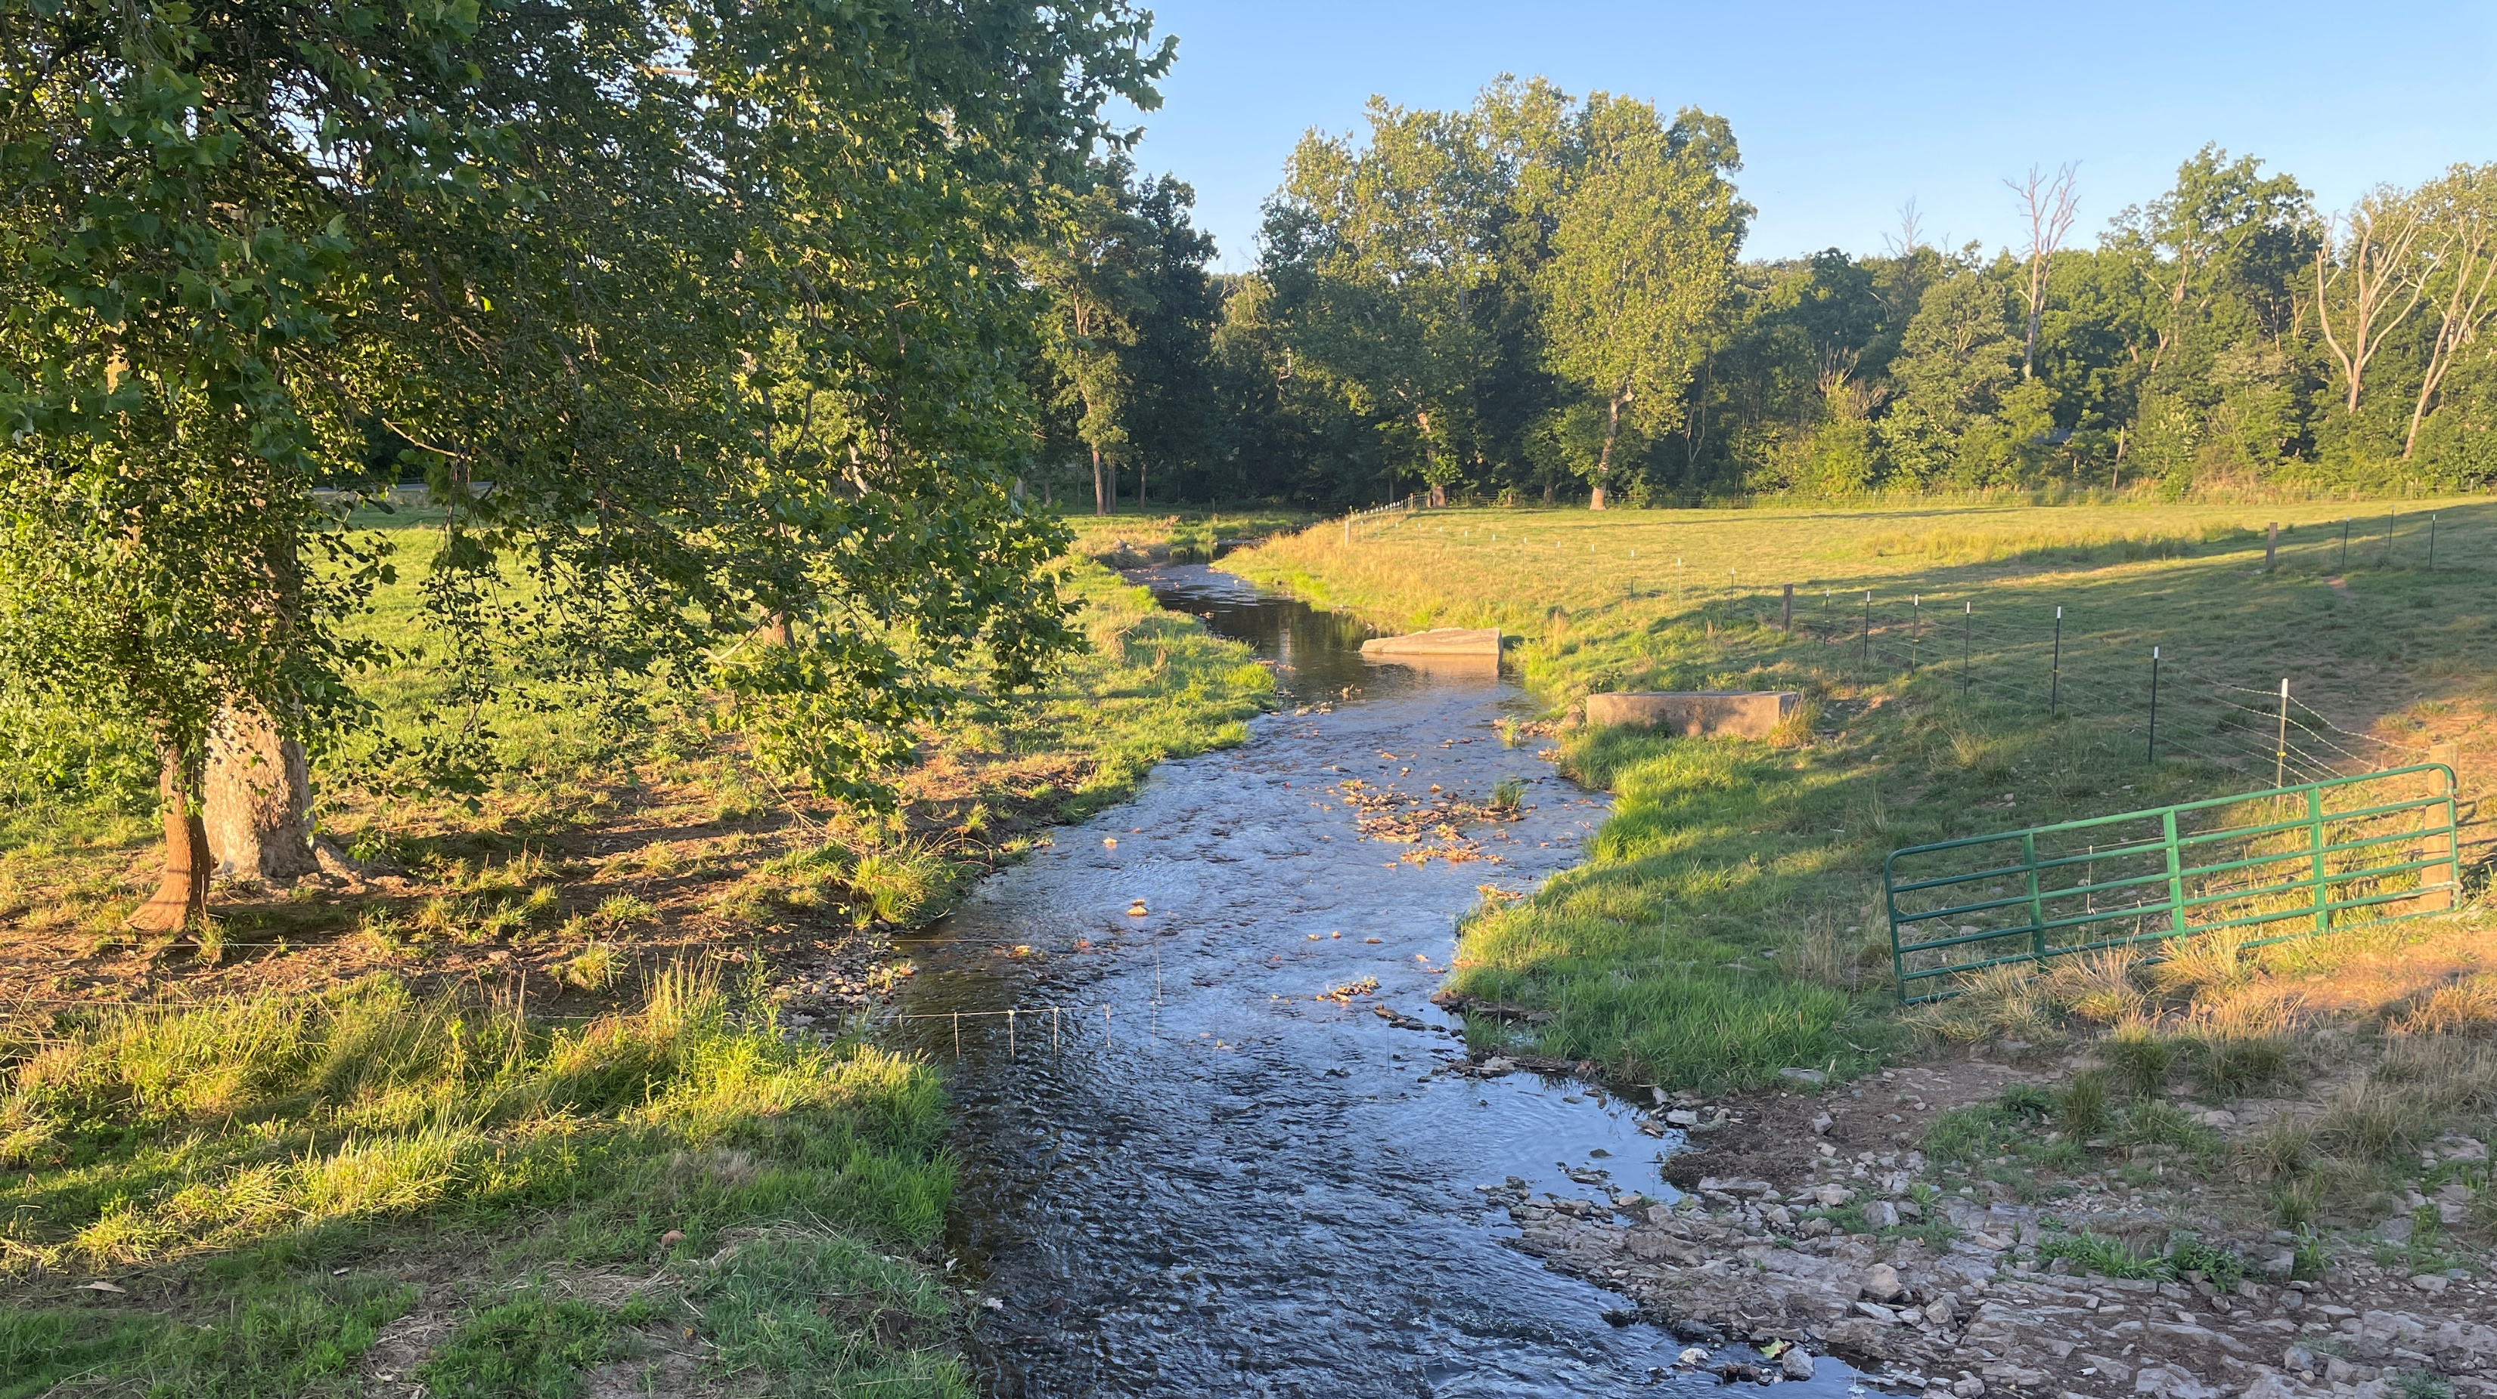
Welcome
(Those who meditate on God’s Word) will be like a tree planted by the rivers of water. Psalm 1:3

Slide 2
Mark 10
➢ Jesus’ prophesied “job description”.
Luke 4:18 The Spirit of the Lord is upon me. He has anointed me to preach the gospel to the poor;
he has sent me to heal the brokenhearted,
to proclaim liberty to the captives and recovery of sight to the blind,
to set at liberty those who are oppressed.
➢ Overlooked candidates for “liberation”.
PRISONERS of WEALTH

Slide 3
Mark 10:17-34
Jesus and the Rich Ruler (Luke 18:18)
(17) Revealing posture & question from a stranger.
- Posture shows eager (runs) humility (kneels).
- Question shows respect (good) but uncertainty (what).
(18,19) Revealing response from Jesus.
- “Good” is a perfect standard met only by God.
- Law describes what “good” does/doesn’t do.

Slide 4
(20) Honest answer by the Rich Ruler.
- I have done “good” things for a long time.
- There is still something missing in my life.
(21) Revealing command from the loving Jesus.
- Law reveals his actions (checklist looks “good”).
- Treasure reveals heart (what he loves is not “good”).
loves things more than people; earth more than heaven; comforts more than cross; following self more than Jesus.
- Law has done its intended job (led him to Jesus).

Slide 5
What can we learn about wealth?
(17) Wealth does not guarantee eternal life.
(20) It can be accumulated & held virtuously.
(21,22) But it can blind even virtuous people.
(23) Having wealth makes it hard to inherit eternal life.
(24) Having it () can lead to trusting it ().
(25,26) It can make salvation seem humanly impossible.
(27) Despite wealth’s power, God is more powerful.

Slide 6
What is your attitude toward wealth?
☑ Can you give away relatively large amounts?
☑ Do you get scared when you have less than you are accustomed to?
☑ Does seeing wealthy people who are less virtuous or less industrious than you get under your skin?
☑ Is wealth a tool to serve God & others, or a scorecard showing how much God loves you?
☑ Is Jesus or wealth your Savior and identity?

Slide 7
Why does Jesus love (21) this Rich Ruler?
Jesus is also a Rich Ruler who gives away all.
2Cor 8:9 For you know the grace of our Lord Jesus Christ, that though He was rich, yet for your sakes He became poor, that through His poverty you might become rich.
Jesus is heading to a “poverty” no one else has known (Mark 10:32-34).
Jesus knows He’s the One by Whom “impossible” salvations will come (Mk 10:26,27; John 3:16).

Slide 8
Luke 4:18 The Spirit of the Lord is upon me. He has anointed me to preach the gospel to the poor;
he has sent me to heal the brokenhearted,
to proclaim liberty to the captives and recovery of sight to the blind,
to set at liberty those who are oppressed.
➢ Overlooked candidates for “liberation”.
PRISONERS of WEALTH

Slide 9
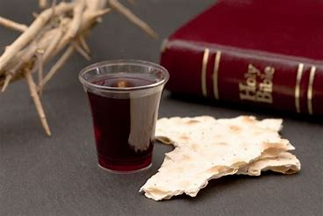

Slide 10
#313
Jesus, keep me near the cross, There a precious fountain Free to all, a healing stream Flows from Calvary’s mountain.

Slide 11
In the cross, in the cross, Be my glory ever; Till my raptured soul shall find Rest beyond the river.

