Slide 1
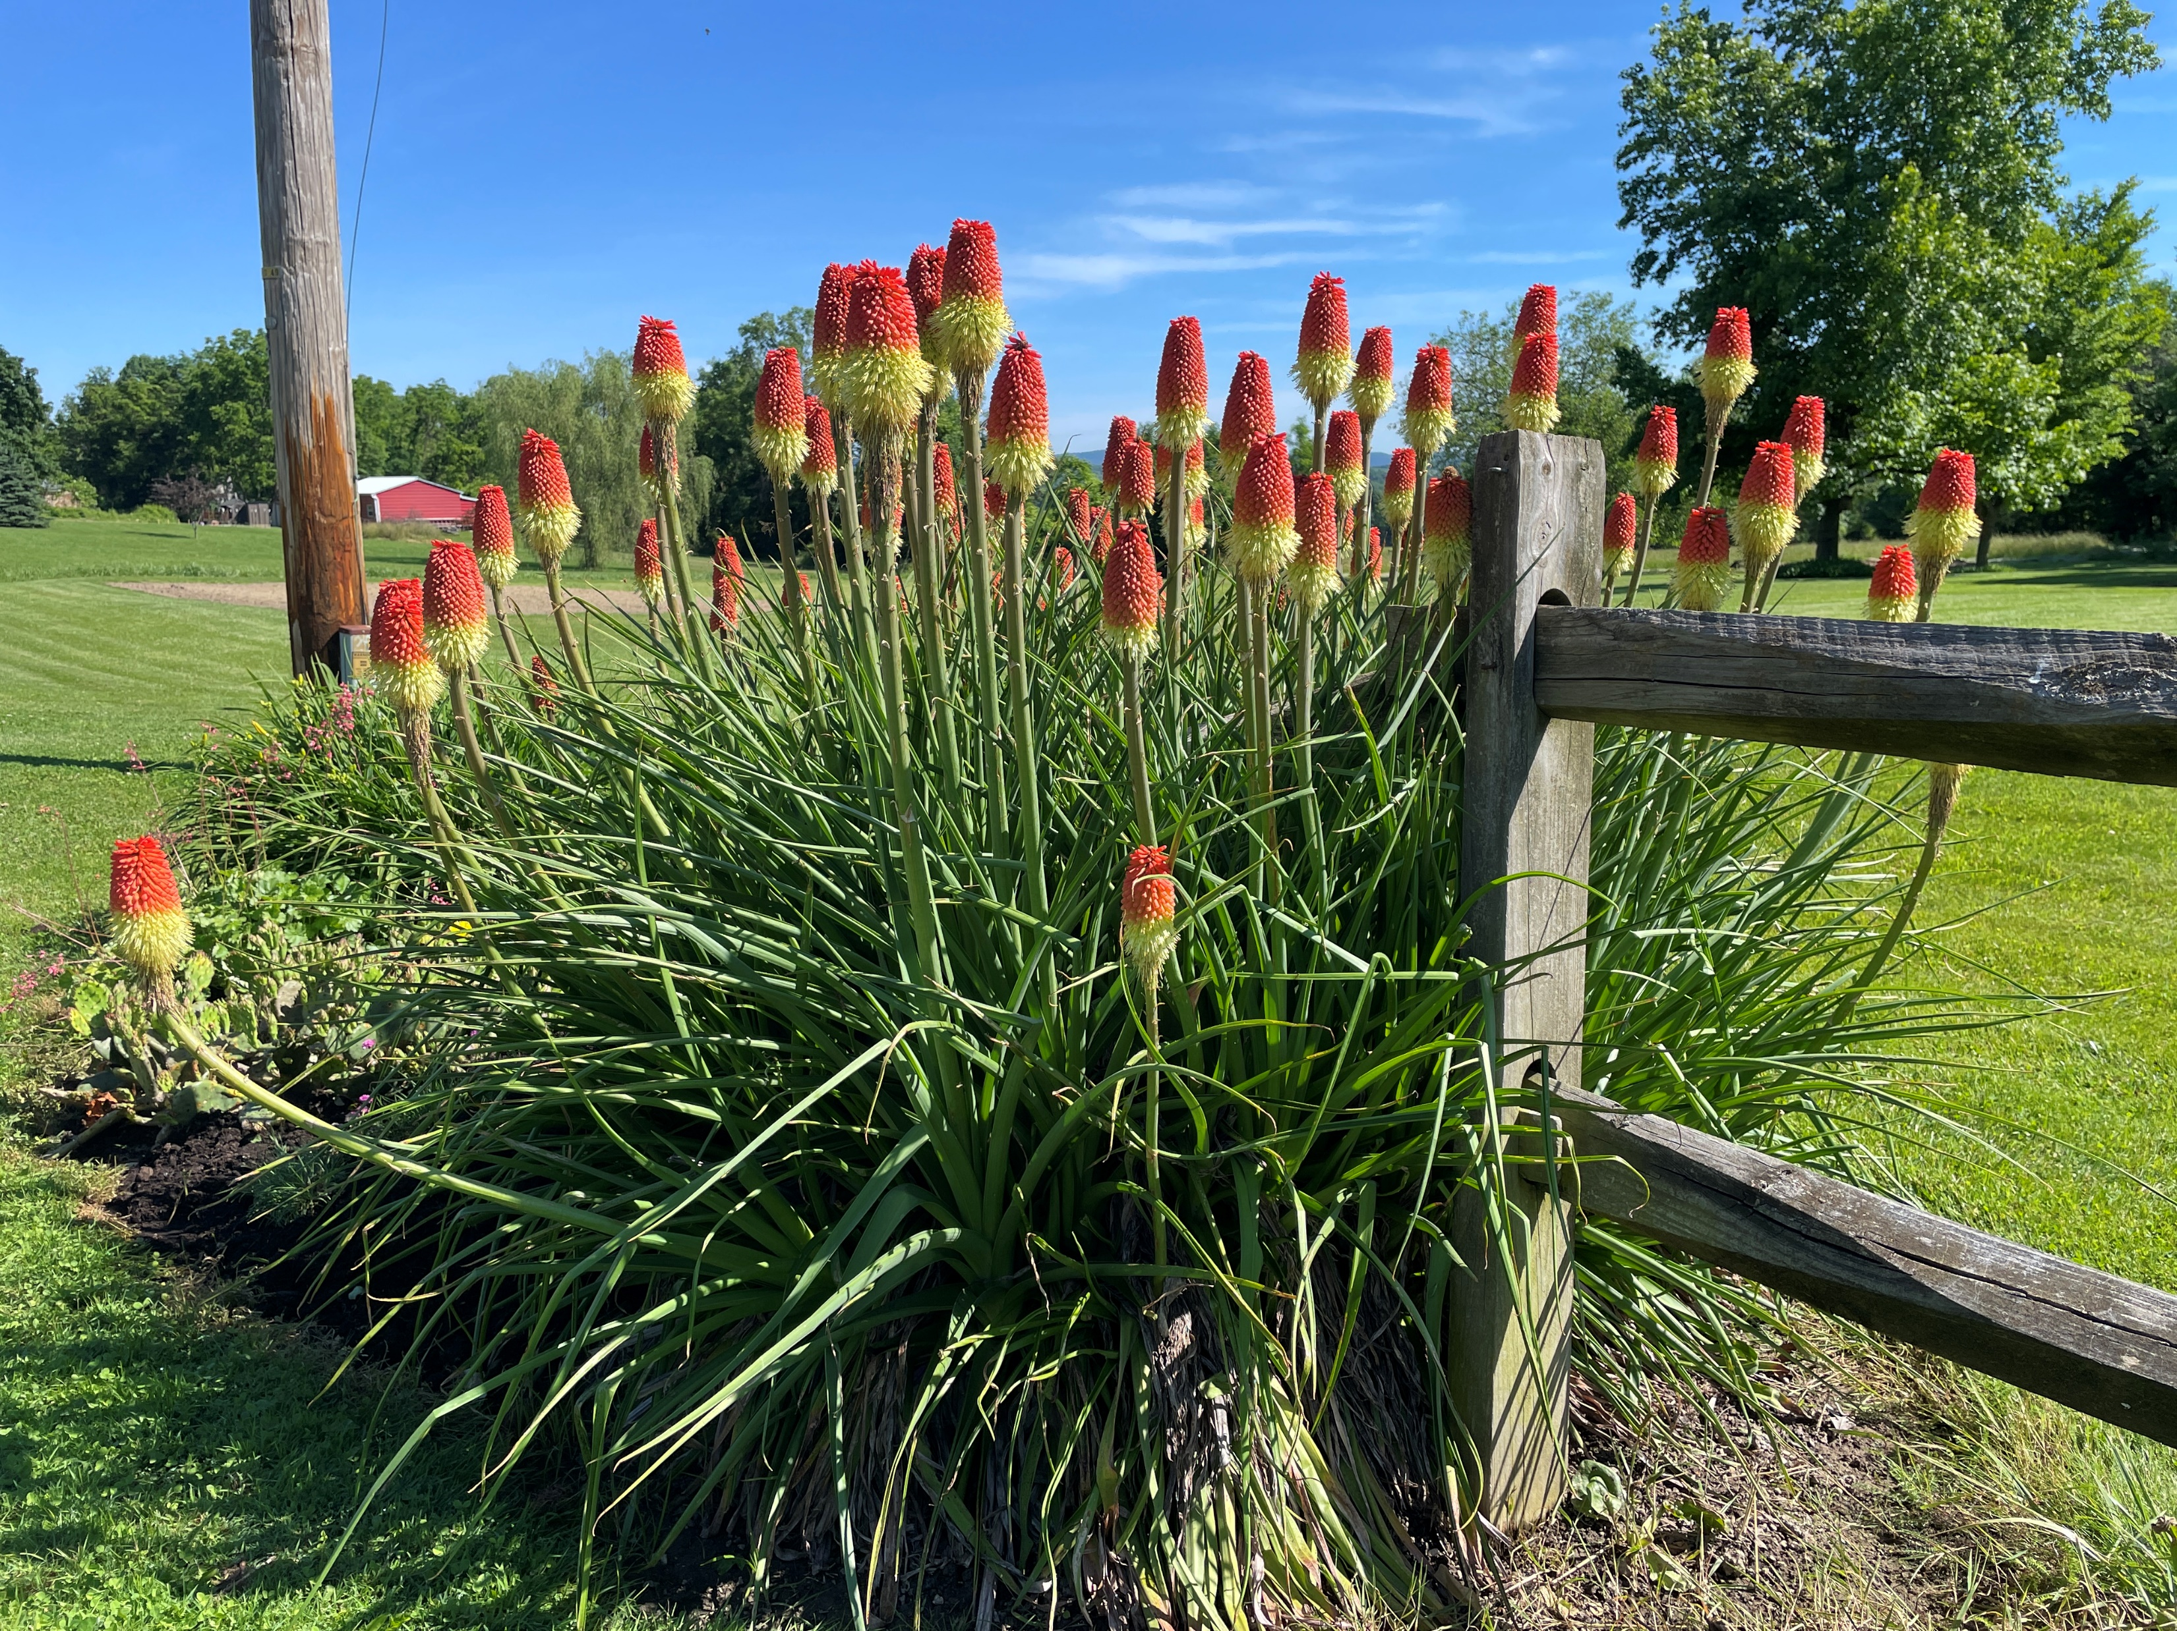
Welcome
The grass withers and the flower fades,
but God’s word endures forever. I Peter 1:24,25

Slide 2
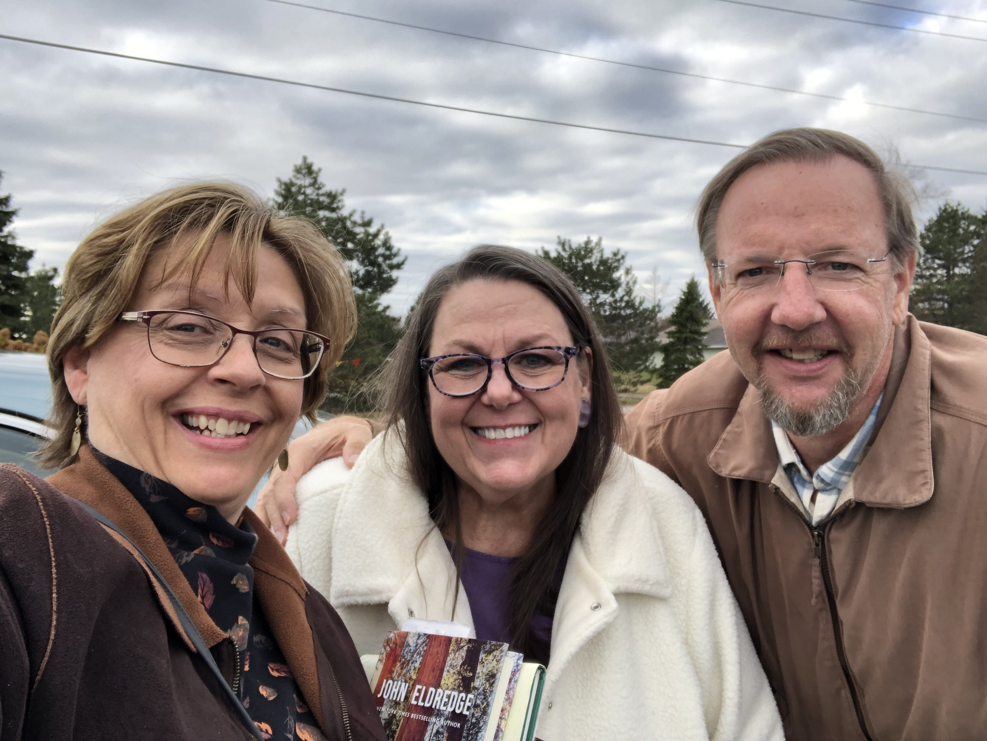
Eichelbergers with Ripe for Harvest Czech Republic - Evangelism, Discipleship, Training Stateside - Mentoring, Seminars, Team-Building
Pam
Brian

Slide 3
The law of the LORD is perfect, converting the soul;
The testimony of the LORD is sure, making wise the simple *
The statutes of the LORD are right, rejoicing the heart;
The commandment of the LORD is pure, enlightening the eyes *
The fear of the LORD is clean, enduring forever;
The judgments of the LORD are true & righteous altogether *
*More to be desired are they than gold, Yea, than much fine gold; Sweeter also than honey and the honeycomb.
Moreover by them is Your servant warned, And in keeping them there is great reward.

Slide 4
Is He Worthy?
Do you feel the world is broken? (We do)
Do you feel the shadows deepen? (We do)
But do you know that all the dark won't stop the light from getting through?
(We do)
Do you wish that you could see it, all made new? (We do)

Slide 5
Is all creation groaning? (It is)
Is a new creation coming? (It is)
Is the glory of the Lord to be
the light within our midst? (It is)
Is it good that we remind ourselves of this? (It is)

Slide 6
Is anyone worthy? Is anyone whole?
Is anyone able to break, the seal
and open the scroll?
The Lion of Judah,
who conquered the grave
He is David's root and the Lamb
Who died to ransom the slave.

Slide 7
Is He worthy? Is He worthy?
Of all blessing and honor and glory?
Is He worthy of this? (He is)

Slide 8
Does the Father truly love us? (He does)
Does the Spirit move among us? (He does)
And does Jesus our Messiah
Hold forever those He loves? (He does)
Does our God intend to dwell again
with us? (He does)

Slide 9
Is anyone worthy? Is anyone whole?
Is anyone able to break, the seal
and open the scroll?
The Lion of Judah,
who conquered the grave,
He is David's root and the Lamb
Who died to ransom the slave.

Slide 10
From ev'ry people and tribe,
ev'ry nation and tongue
He has made us a kingdom
and priests to God
To reign with the Son.

Slide 11
Is He worthy? Is He worthy?
Of all blessing and honor and glory?
Is He worthy? Is He worthy?
Is He worthy of this?
HE IS!

Slide 12
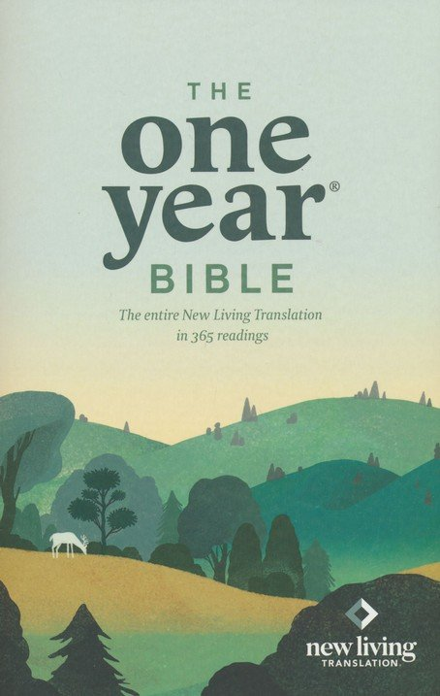
Grace BIBLE Chapel
Exploring our “Middle” name
Wednesdays
7:00 PM
sharing favorite verses
or insights
& prayer time.

Slide 13
Adult Sunday School Class
Begins Next Sunday 9:30 in the Sanctuary

Slide 14
Heb 13:7 Remember those who rule over you, who have spoken THE WORD OF GOD to you, whose faith follow, considering the outcome of their conduct.
Col 3:16 Let THE WORD OF CHRIST dwell in you richly in all wisdom, teaching and admonishing one another in psalms and hymns and spiritual songs.
1Tim 5:17 Let the elders who rule well be counted worthy of double honor, especially those who labor in THE WORD AND DOCTRINE.

Slide 15
7 Metaphors IN the Bible … ABOUT the Bible
The vast power and purposes of God’s Word.
Heb 4:12,13 - A SWORD that Pierces
The word of God is living and powerful, and sharper than any two-edged sword, piercing even to the division of soul and spirit, and of joints and marrow, and is a discerner of the thoughts and intents of the heart. And there is no creature hidden from His sight, but all things are naked and open to the eyes of Him to whom we must give account.

Slide 16
Heb 4:12,13 - A SWORD that Pierces
It is the Divine Word
It is the Living Word - Heb 3:7 The Holy Spirit says (present tense); John 6:63.
It is Powerful - active, energetic, never listless, continues to do its work.
It is Sharp - no dull books, or blunt chapters.
It Pierces - penetrates facades and excuses, gets to the heart (“I’m just borrowing it”).

Slide 17
Heb 4:12,13 - A SWORD that Pierces
It Judges - critiquing or discerning, rendering the Divine verdict on inner thoughts, attitudes, intentions.
(13) God has already seen, scripture lets us see what He sees; it strips us down like in the ancient gyms; it “exposes the neck” to the One to Whom we must answer.
Example = Acts 2:37 (Joel 2; Psalm 16; Ps 110)

Slide 18
James 1:23 - A MIRROR that Reveals
If anyone is a hearer of the word and not a doer, he is like a man observing his natural face in a mirror.
It gives you self-knowledge, it tells it like it is, it inventories the soul.
It does the uncomfortable but necessary work of revealing truth about me.
(25) No one will be saved or sanctified until they see themselves from God’s view.

Slide 19
I Peter 1:23 - A SEED that Reproduces
Having been born again, not of corruptible seed but incorruptible, through the word of God which lives and abides forever.
- The life of God is implanted in a person’s soul.
- Heaven comes to us before we ever go to heaven.
Neg - not perishable, decaying seed, temporal.
Pos - imperishable seed, (Luke 8:5; John 11:25).
- Those dead in sin are given eternal life.

Slide 20
I Peter 2:2 - The MILK that Nourishes
As newborn babes, desire the pure milk of the word, that you may grow thereby.
- Never outgrow being like a newborn baby, childlike, craving God’s pure Word.
- It is the soul’s source of nutrition, protection, growth, stimulant, satisfaction.
- By it (the Bible), you will be fully saved (justified & sanctified) - Ps 119:9,11; Jesus’ temptations

Slide 21
Psalm 119:105 - A LAMP that Shines
Thy word is a lamp to my feet, a light to my path.
1 - We live in a dark and ever darkening world!
2 - The Word gives necessary light for travelers. Not an option for a few, but a necessity for all. Ps 19:8; II Pet 1:19; Phil 2:15,16
3 - Feet = walking/obeying. It has come thru my ears into my heart, and settles into my walking.
- Like a railway, safety depends on accurate signals.

Slide 22
Adult Sunday School Class
Begins Next Sunday 9:30 in the Sanctuary

Slide 23
Jeremiah 23:29a - A FIRE that Consumes
"Is not My word like a fire?" says the LORD.
- Rhetorical question dealing with false prophets (25,26,27,28,30,31,32,34). Answer is “Yes”.
- Pos uses for fire, but this is neg - consuming.
- Scripture, properly used, either blesses or burns.
- The Bible is a red-hot book.

Slide 24
Jeremiah 23:29b - A HAMMER that Shatters
"And is not My word like a hammer that breaks the rock in pieces?”
- Another rhetorical question. Answer is “Yes”.
- Humanly weak people open & proclaim God’s Word, and as a sledgehammer it shatters rock-hard minds, hearts, and arguments.
- Pride & self-righteousness are crushed by it.
- The result is a sculpture more like Christ.

Slide 25
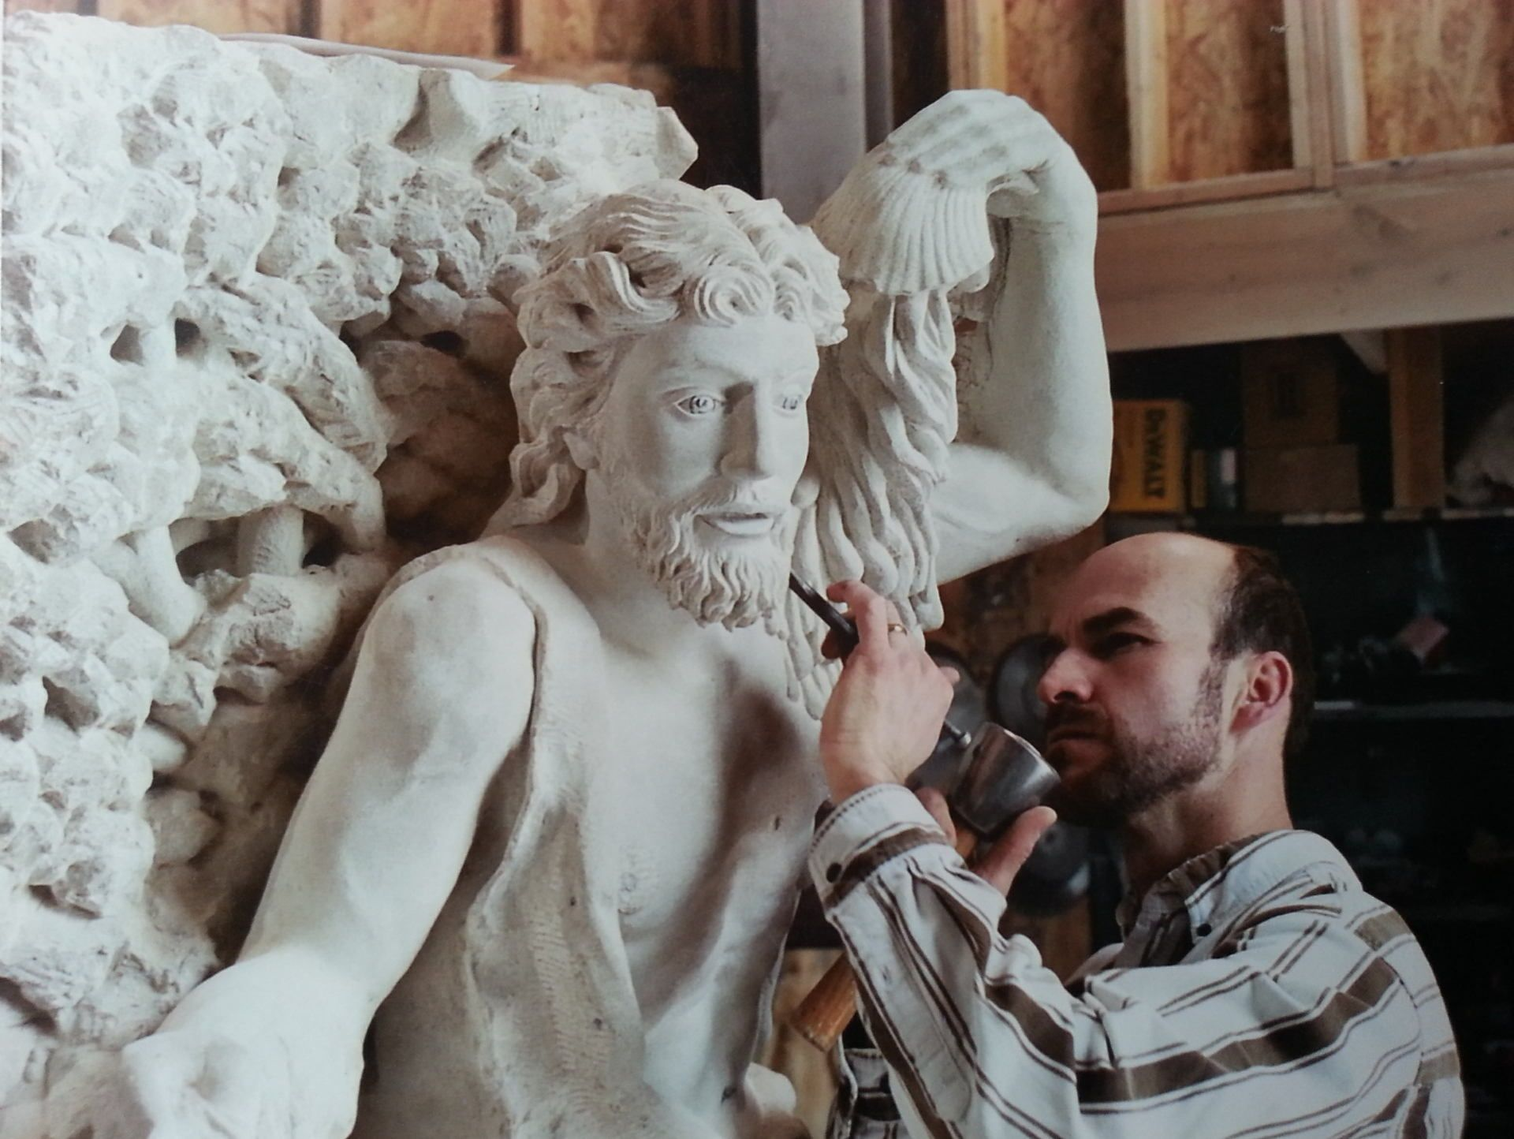

Slide 26
Grace BIBLE Chapel
It’s a SWORD that Pierces - Wield it
It’s a MIRROR that Reveals - Look at it
It’s the SEED that Reproduces - Scatter it
It’s the MILK that Nourishes - Serve it
It’s a LAMP that Shines - Lift it
It’s a FIRE that Consumes - Spread it
It’s a HAMMER that Shatters - Swing it

Slide 27
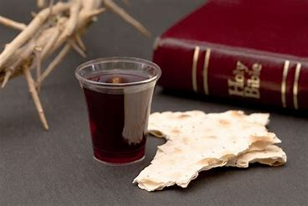

Slide 28
What can wash away my sin? (# 308)
Nothing but the blood of Jesus;
What can make me whole again?
Nothing but the blood of Jesus.

Slide 29
Oh! precious is the flow
That makes me white as snow;
No other fount I know,
Nothing but the blood of Jesus.

Slide 30
For my pardon, this I see,
Nothing but the blood of Jesus;
For my cleansing this my plea,
Nothing but the blood of Jesus.

Slide 31
Oh! precious is the flow
That makes me white as snow;
No other fount I know,
Nothing but the blood of Jesus.

Slide 32
This is all my hope and peace,
Nothing but the blood of Jesus;
This is all my righteousness,
Nothing but the blood of Jesus.

Slide 33
Oh! precious is the flow
That makes me white as snow;
No other fount I know,
Nothing but the blood of Jesus.

