Slide 1
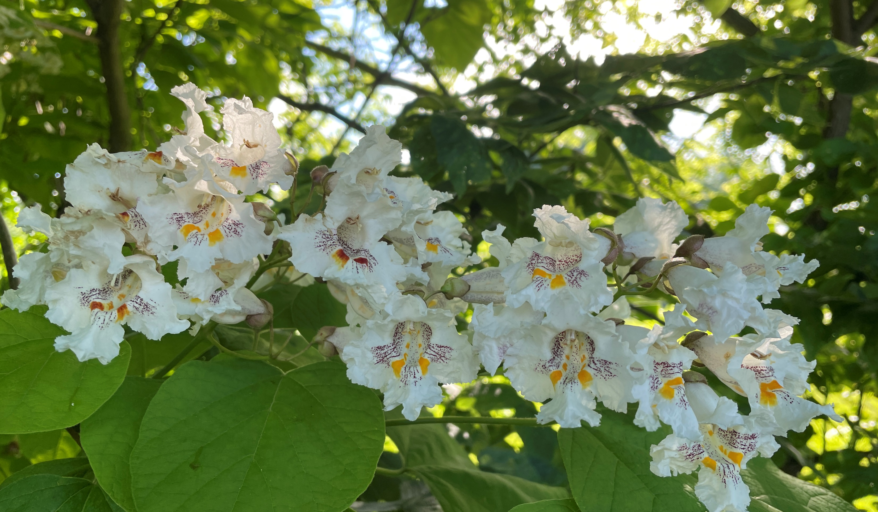
Welcome
Rejoice in the LORD,
O you righteous!
Praise from the upright is beautiful. Ps 33:1

Slide 2
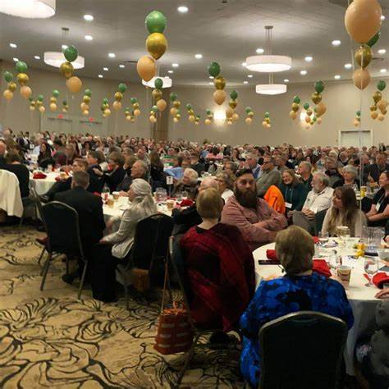
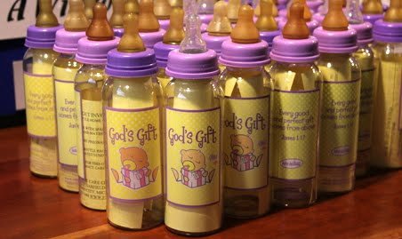
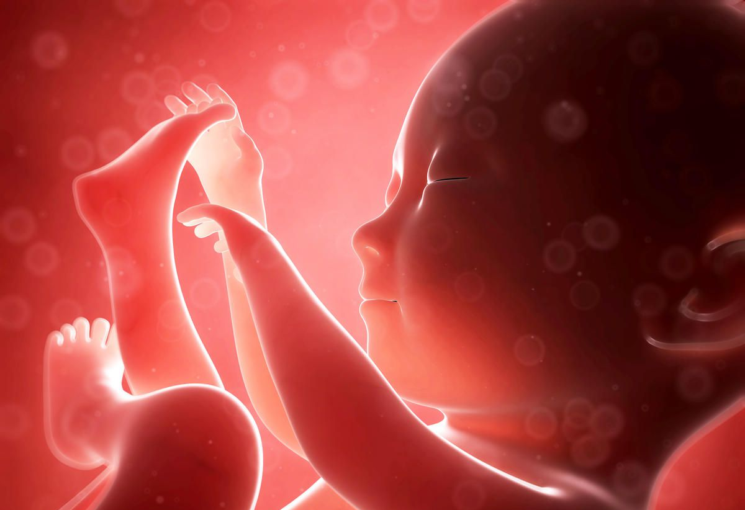
Capital Area Pregnancy Center

Slide 3
#313
Jesus, keep me near the cross, There a precious fountain Free to all, a healing stream Flows from Calvary’s mountain.

Slide 4
In the cross, in the cross, Be my glory ever; Till my raptured soul shall find Rest beyond the river.

Slide 5
Near the cross! O Lamb of God, Bring its scenes before me.
Help me walk from day to day
With its shadows o’er me.

Slide 6
In the cross, in the cross, Be my glory ever; Till my raptured soul shall find Rest beyond the river.

Slide 7
# 399
I Have Decided
to follow Jesus (3x)
No turning back,
no turning back!

Slide 8
The world behind me,
the cross before me (3x)
No turning back,
no turning back!

Slide 9
Though no one joins me,
still I will follow (3x)
No turning back,
no turning back!

Slide 10
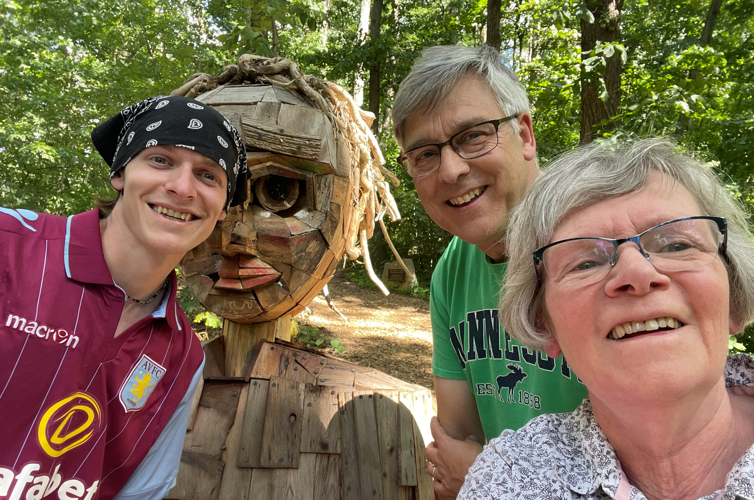
Mark 8

Slide 11
Mark 8 - Observations
1 - Many numbers (3,7,4K,5,5K,12,3).
2 - Different locations visited.
(7:31) Tyre, Sidon, Decapolis - Gentile controlled
(8:10) Dalmanutha - Mixed control
(8:22) Bethsaida - Jewish control
(8:27) Caesarea Philippi - Gentile control
3 - Emotions expressed (2,12,32-33)

Slide 12
Mark 8 - Watershed Chapter
- near pinnacle of ministry, popularity & scrutiny.
(13 miracles; 8 crowds; 6 conflicts with Rulers)
- end of time in Gentile territory (7:26,31; 8:27).
- shakes dust off feet (no more miracles - 12,13a).
- clearest declaration of who Jesus is (29).
- first of 3 predictions of Jesus’ sufferings (31).
- focus shifting from Jesus serving multitudes to Jesus training His disciples.

Slide 13
Healing the Blind Man (22-26)
1 of 2 miracles found ONLY in Mark (7:32ff deaf)
• Both brought to Jesus.
• Both involve Jesus’ touching (common in Mark).
• Both men taken out of the spotlight for miracle.
• Both involve spit (not magical, but clearly the transfer of something very personal).
• Both asked not to spread the news (avoiding a circus atmosphere and stirring conflicts).

Slide 14
Healing the Blind Man (22-26)
Anticipates Jesus’ kingdom (Luke 4:16-21)
Jesus found the place (Isa 61) where it was written:
“The Spirit of the Lord is upon me, anointing me to preach the gospel to the poor; to heal the brokenhearted, to proclaim liberty to the captives and recovery of sight to the blind.”
And He began to say to them, "Today this Scripture is fulfilled in your hearing."

Slide 15
Healing the Blind Man (22-26)
Anticipates Jesus’ kingdom
Expresses Jesus’ compassion (2).
Confirms Jesus’ judgment (Mt 11:21)

Slide 16
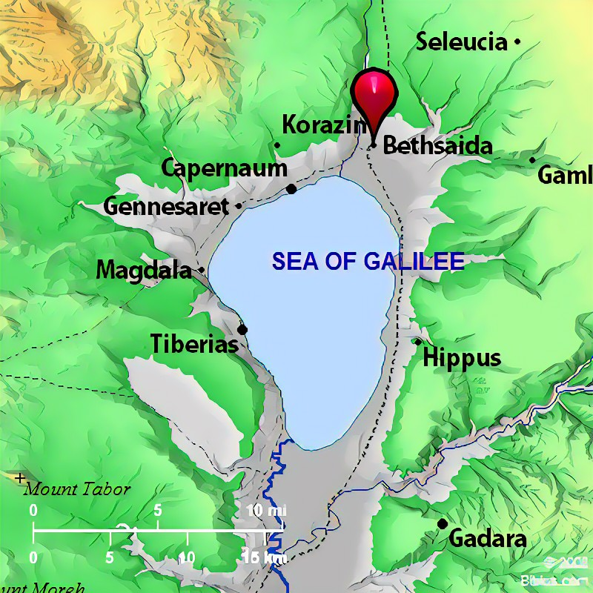
Matt 11:21 Woe to you, Bethsaida! For if the mighty works which were done in you had been done in Tyre and Sidon, they would have repented long ago in sackcloth and ashes.

Slide 17
Healing the Blind Man (22-26)
Anticipates Jesus’ kingdom
Expresses Jesus’ compassion
Confirms Jesus’ judgment - spiritual leaven (15)
Illustrates people’s spiritual blindness (21).
- Only recorded “2-stage” miracle.
- spiritual insights often come slowly.
Demonstrates Jesus’ deity (as with any miracle)
- leads to Peter’s confession (27-29).

Slide 18
Jesus Training His Disciples
(27-30) Grasping His identity is fundamental.
(31-33) Accepting His teaching is difficult.
“Peter, if you resist my plan to die, you resist God. You side with Satan against God. Satan doesn’t want me dead, because he wants you in hell. Satan wants me to bow down and worship him and jump off temples for fame and turn stones into bread for self-preservation. The last thing he wants is for a ransom to be paid for his captives. But that’s what God wants, Peter, because, he loves you. My coming to die as your ransom is the love of God.” (Jn 3:16)

Slide 19
Jesus Training His Disciples
(27-30) Grasping His identity is fundamental.
(31-33) Accepting His teaching is difficult.
(34-38) Desiring His ways is unnatural because …
it leads to painful selflessness (34).
it may lead to physical martyrdom (35).
it requires valuing souls above all we see (36,37).
it means choosing, again and again, whose rebuke (33) and approval is important (38).

Slide 20
He Will Hold Me Fast
When I fear my faith will fail,
Christ will hold me fast.
When the tempter would prevail,
He will hold me fast.

Slide 21
I could never keep my hold
Through life's fearful path.
For my love is often cold,
He must hold me fast.

Slide 22
He will hold me fast,
He will hold me fast.
For my Savior loves me so,
He will hold me fast!

Slide 23
Those He saves are His delight,
Christ will hold me fast.
Precious in His holy sight,
He will hold me fast.

Slide 24
He'll not let my soul be lost,
His promises shall last.
Bought by Him at such a cost,
He will hold me fast.

Slide 25
He will hold me fast,
He will hold me fast.
For my Savior loves me so,
He will hold me fast!

Slide 26
For my life He bled and died,
Christ will hold me fast.
Justice has been satisfied,
He will hold me fast.

Slide 27
Raised with Him to endless life,
He will hold me fast.
'Til our faith is turned to sight,
When He comes at last!

Slide 28
He will hold me fast,
He will hold me fast.
For my Savior loves me so,
He will hold me fast!

