Slide 1
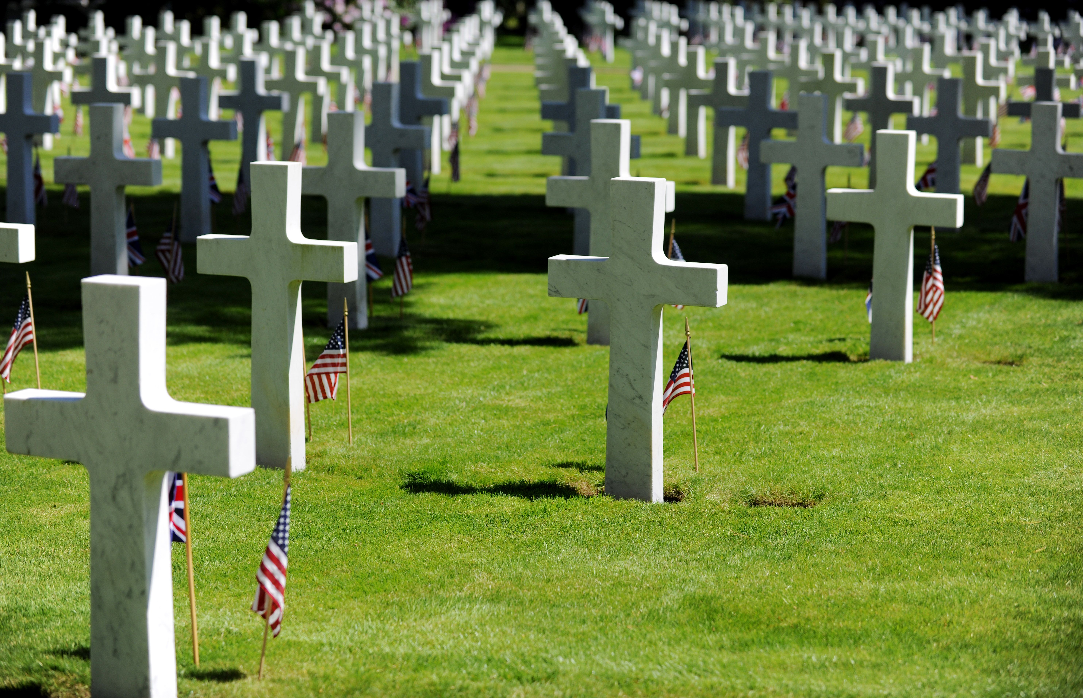
Welcome
For a good man some
would even dare to die.
But God demonstrates His own love toward us, in that while we were still sinners, Christ died for us. Romans 5:7,8

Slide 2
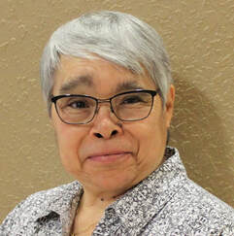
Marta Galdamez
Serving Deaf churches and raising awareness in Hearing churches of the need to reach Deaf communities with the gospel.

Slide 3
O Church, Arise (#661)
O Church arise and put your armor on Hear the call of Christ our Captain. For now the weak can say that they are strong In the strength that God has given.

Slide 4
With shield of faith and belt of truth We’ll stand against the devil’s lies. An army bold whose battle-cry is Love Reaching out to those in darkness

Slide 5
Our call to war to love the captive soul But to rage against the captor. And with the sword that makes the wounded whole We will fight with faith and valor.

Slide 6
When faced with trials on every side We know the outcome is secure. And Christ will have the prize for which He died, An inheritance of nations.

Slide 7
Come see the cross where love and mercy meet As the Son of God is stricken. Then see His foes lie crushed beneath His feet, For the Conqueror has risen.

Slide 8
And as the stone is rolled away, And Christ emerges from the grave. This victory march continues till the day Every eye and heart shall see Him.

Slide 9
So, Spirit come put strength in every stride, Give grace for every hurdle. That we may run with faith to win the prize Of a servant good and faithful.

Slide 10
As saints of old still line the way, Retelling triumphs of His grace. We hear their calls and hunger for the day When with Christ we stand in glory.

Slide 11
(years of war) Memorial Day Figures
(8) Revolutionary = 6,800 US casualties
(4) Civil = 650,000
(1) WW 1 = 53,400
(4) WW 2 = 290,000
(3) Korea = 36,500
(19) Vietnam = 58,200
(8 & 20) Iraq & Afghanistan = 7,000 US casualties

Slide 12
How did each war START?
Revolutionary = Militia shots at Lexington/Concord
Civil = Confederate artillery fired at Fort Sumter
WW 1 = Archduke Ferdinand assassinated
WW 2 = German invasion of Poland
Korea = North Korean invasion of South Korea
Vietnam = Tet Offensive, Battle of Ia Drang Valley

Slide 13
How does the Bible say Wars begin?
James 4:1 Where do wars and fights come from among you? Do they not come from your desires for pleasure that war within you?
Mark 7:20,21 Jesus said, "What comes out of a man, that defiles a man. For from within, out of the heart of men, proceed evil thoughts, adulteries, fornications, murders, …

Slide 14
Red Letter verses - Jesus speaking vs doing
Mark 1 - 5 “Jesus-speaking verses” out of 45
2 - 15 of 28
3 - 13 of 35
*4 - 32 of 41
5 - 9 of 43
6 - 7 of 56
*7 - 20 of 37 (101 of 285 so far)

Slide 15
What does Jesus say we should remember about Conflict?
(Mark 7:1-13) It happens when people choose man’s traditions over God’s commands.
(1,2) people looking to find fault with others.
(3,4) “insiders” establishing many petty religious and cultural traditions (7 famous words).
(6,7) people saying one thing, but doing another.
(10-13) people pursuing loop holes & exemptions instead of relationships & righteousness.

Slide 16
What does Jesus say about Conflicts?
(Mark 7:1-13) It happens when people choose man’s traditions over God’s commands.
(14-23) It occurs when outward symptoms are prioritized over inward conditions.
(15,16) defilement is connected with externals.
(17-19) heart matters are not understood.
(20-23) evil symptoms are labeled and addressed, but not the evil source (heart).

Slide 17
Addressing symptoms, but not HEARTS affects …
(6,7) Worship - It becomes vain (purposeless). (John 4:23,24 - spirit & truth).
(11-13) Obedience - Rules are made to hurt, not help. (Mark 12:31 - love your neighbors).
(18,19) Eating - It is manipulated for virtue signaling. (Mark 2:18,23-24; 7:5 - Galatians 2:11,12)

Slide 18
Gal 2:11 When Peter had come to Antioch, I (Paul) withstood him to his face, because he was to be blamed;
12 for before certain men came from James (Jerusalem), he would eat with the Gentiles; but when they came, he withdrew and separated himself, fearing those who were of the circumcision (Jews).

Slide 19
Addressing symptoms, but not HEARTS affects …
Worship - It becomes vain (purposeless). Obedience - Rules are made to hurt, not help.
Eating - It is manipulated for virtue signaling.
(20-23) Evil - Its source (heart), if not changed, will keep defiling lives. (Matt 12:34,35).

Slide 20
- True individually
Matthew 12:34 Brood of vipers! How can you, being evil, speak good things? For out of the abundance of the heart the mouth speaks.
35 A good man out of the good treasure of his heart brings forth good things, and an evil man out of the evil treasure (of his heart) brings forth evil things.

Slide 21
- True politically
Our Constitution was made only for a moral and religious people. It is wholly inadequate to the government of any other. - John Adams

Slide 22
Bible Basics about the HEART
➢ A SINFUL heart is standard equipment.
Jeremiah 17:9 The heart is deceitful above all things, and desperately wicked; Who can know it?
➢ A NEW CLEAN heart from God is required.
Psalm 51:10 Create in me a clean heart, O God, and renew a steadfast spirit within me.
Ezekiel 36:26 I will give you a new heart and put a new spirit within you; I will take the heart of stone out of your flesh and give you a heart of flesh.

Slide 23
➢ Asking God to EXAMINE my heart is a priority.
Psalm 139:23 Search me, O God, and know my heart; Try me, and know my anxieties;
24 And see if there is any wicked way in me, and lead me in the way everlasting.
➢ PROTECTING my heart requires diligence.
Proverbs 4:23 Keep your heart with all diligence, for out of it spring the issues of life.

Slide 24
A BIBLE-FILLED and SPIRIT-FILLED heart brings spiritual victories over sin & evil.
Psalm 119:11 Your word I have hidden in my heart, that I might not sin against You.
Eph 5:16-19 Make the best use of the time, because the days are evil. Understand what the will of the Lord is. Be filled with the Spirit, addressing one another in psalms and hymns and spiritual songs.

Slide 25
What does Jesus say we should remember about Conflict? (Mark 7)
(1-13) It happens when people choose man’s traditions over God’s commands.
(14-23) It occurs when outward symptoms are prioritized over inward conditions (heart).
Mark 7:6 Jesus said to them, "Well did Isaiah prophesy of you hypocrites, as it is written: ‘This people honors Me with their lips, but their heart is far from Me’”.

Slide 26
Search me, O God (#497)
Search me, O God, and know my heart today, Try me, O Savior, know my thoughts, I pray; See if there be some wicked way in me; Cleanse me from every sin, and set me free.

Slide 27
I praise Thee, Lord, for cleansing me from sin; Fulfill Thy word and make me pure within; Fill me with fire, where once I burned with shame; Grant my desire to magnify Thy name.

Slide 28
Lord, take my life, and make it wholly Thine; Fill my poor heart with Thy great love divine; Take all my will, my passion, self and pride; I now surrender, Lord, in me abide.

Slide 29
O Holy Ghost, revival comes from Thee; Send a revival, start the work in me; Thy Word declares Thou wilt supply our need; For blessings now, O Lord, I humbly plead.

