Slide 1
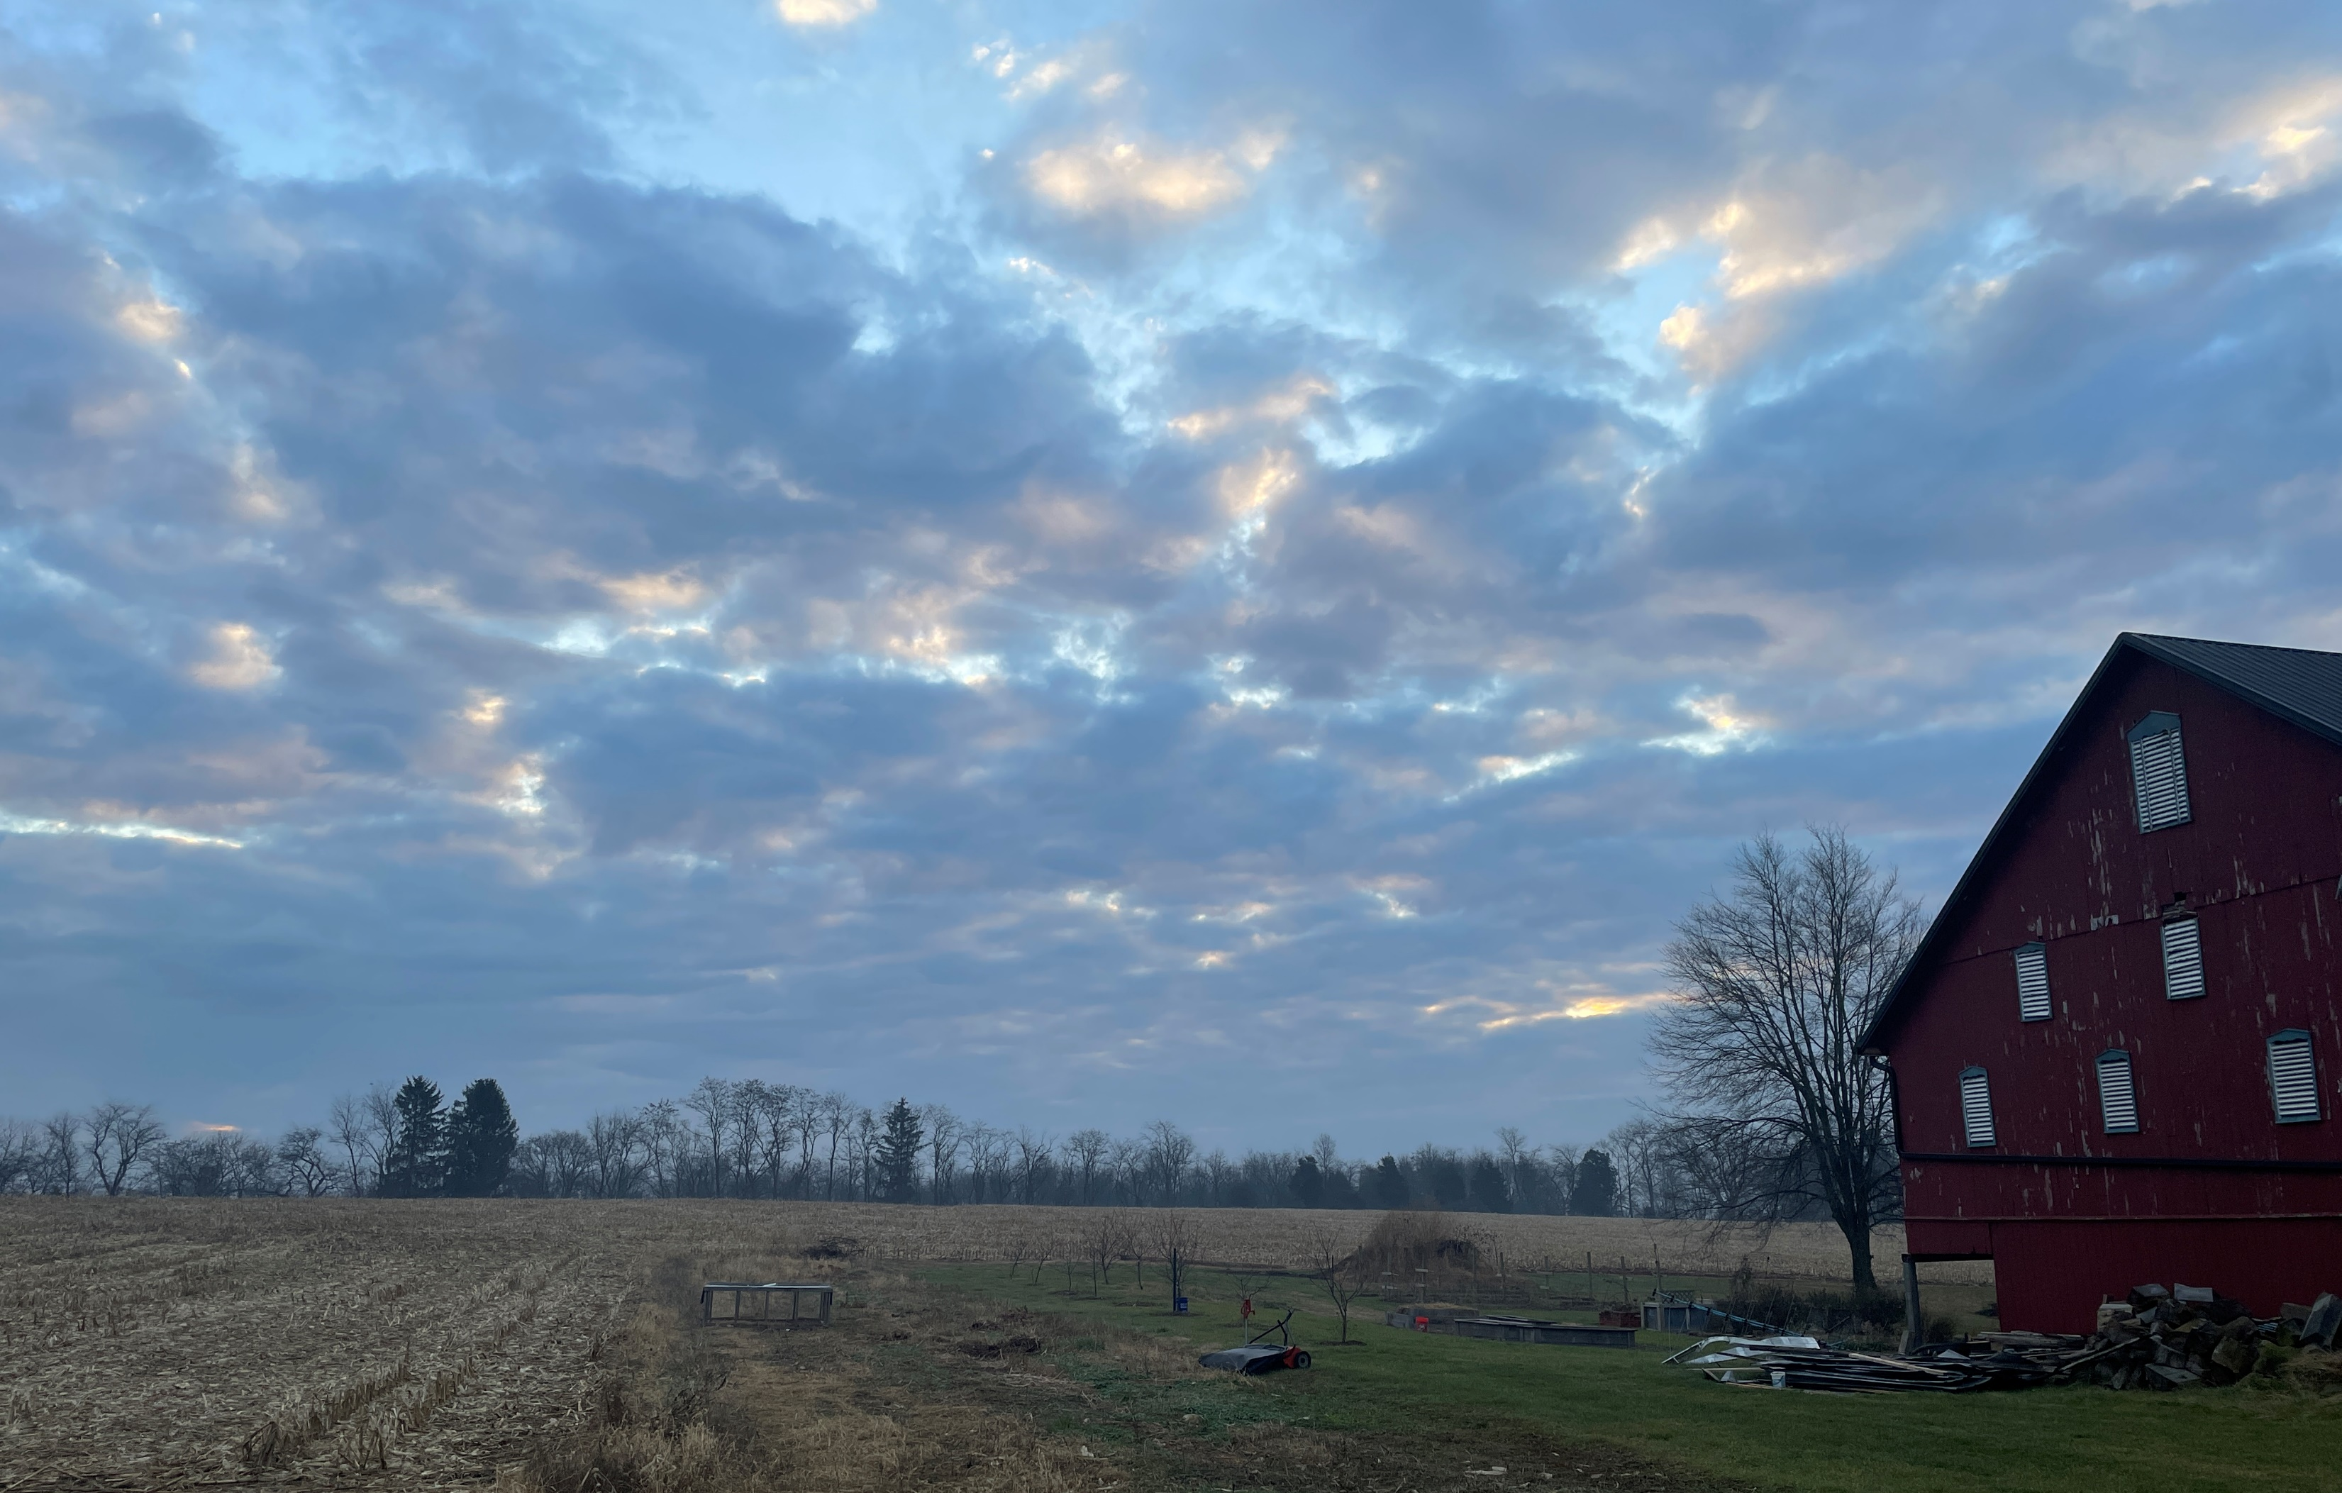
Psalm 90:12 Teach us to number our days, that we may gain a heart of wisdom.
Welcome to
Grace Bible Chapel
December 31, 2023

Slide 2
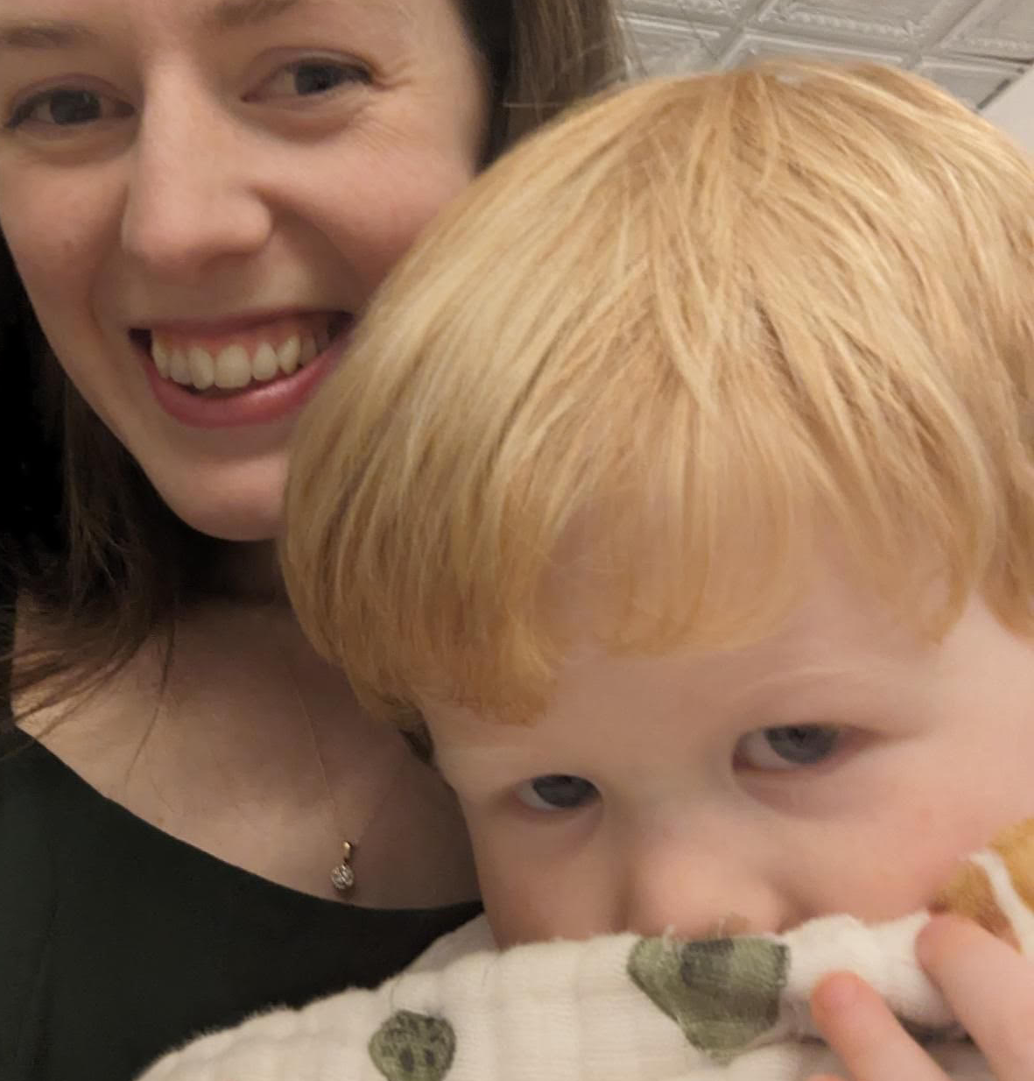
McCarthys - Caleb, Katie, Jack, Virgil, Nora

Slide 3
Entire
New
Living
Translation
arranged in 365
Daily
Readings

Slide 4
Daily readings from
Old Testament
New Testament
Psalms
Proverbs

Slide 5
2024 GBC middle name
series.
Wednesdays favorite verse or insight for Jan & Feb.

Slide 6
God’s Double Call
(Gen 22:11) Abraham - end a specific sacrifice
➢ “Here I am” and he found God’s provision.
13 Abraham lifted his eyes and looked, and behind him was a ram caught in a thicket by its horns. So Abraham took the ram, and offered it up for a burnt offering instead of his son.
14 And Abraham called the name of the place, The-LORD-Will-Provide.

Slide 7
God’s Double Call
(Exodus 3:4) Moses - lead others
➢ “Here I am” and then he made excuses
11 Moses said to God, "Who am I that I should go to Pharaoh?“
Objection #1 - I have no ABILITY
12 The LORD said, "I will be with you.”
God’s answer - My PRESENCE

Slide 8
Ex 3:13 Then Moses said, "If I come to the people of Israel and say to them, 'The God of your fathers has sent me to you,' and they ask me, 'What is his name?' what shall I say?"
Objection #2 - I have no AUTHORITY
Ex 3:14 God said to Moses, "Say this to the people of Israel, 'I AM has sent me to you.'"
God’s answer - My Personal Name (character)

Slide 9
Ex 4:1 Moses answered, “They will not believe me, but will say, 'The LORD did not appear to you.'"
Objection #3 - I have no AUDIENCE
Ex 4:2 The LORD said, "What is that in your hand?" He said, "A staff (symbol of authority).”
Ex 4:3 He said, "Throw it on the ground." It became a serpent, and Moses ran from it.
God’s answer - My POWER

Slide 10
Ex 4:10 Moses said, “Lord, I am not eloquent."
Objection #4 - I am not ARTICULATE
Ex 4:11 The LORD said, "Who has made man's mouth? Who makes him mute, deaf, seeing, or blind? Is it not I, the LORD?
Ex 4:12 Therefore go, and I will be with your mouth and teach you what to speak.
God’s answer - My PROVISION

Slide 11
Ex 4:13 But he said, "Oh, my Lord, please send someone else."
Objection #5 - I have no ASSISTANT
Ex 4:14 Then the anger of the LORD was kindled against Moses and he said, "Is there not Aaron, your brother, the Levite?
God’s answer - My PRIEST

Slide 12
God’s Double Call
(I Sam 3:10) Samuel - speak truth to power
➢ “I am listening”, and then he tells Eli everything and hides nothing.
At some point, maturity will require you to speak truth to those in authority.
It will be uncomfortable, risky, defining.

Slide 13
Other “Samuels”
Joseph speaking truth to brothers, Mrs. Potiphar, baker & butler, Pharaoh.
David to brothers, Goliath, king Saul.
Daniel to chief eunuch, Nebuchadnezzar.
3 Hebrew boys to Nebuchadnezzar.
Esther to Haman, king Ahasuerus.
Jesus (age 12) to teachers in the temple.

Slide 14
Timothy - 1Tim 4:12 Let no one despise your youth, but be an example in …
word (how you speak),
conduct (your lifestyle),
love (how you serve others, the vulnerable),
spirit (enthusiasm for more than what is seen),
faith (your confidence in God & His word),
purity (guarding your moral cleanliness).

Slide 15
God’s Double Call
(Matt 23:37-39) Jerusalem - to a wayward nation
➢ unwilling and then become desolate.
killed the prophets (messengers) and sent ones (apostles).
leave children unprotected.
homes & families become like a wasteland.
experience lasting spiritual blindness.

Slide 16
God’s Double Call
(Luke 22:31-34) Simon - watch and pray
➢ dismissive pride and then denial
underestimates spiritual warfare.
overestimates self, underestimates Jesus.
experiences failure (Lk 22:54-62), forgiveness (John 21), fruitfulness (Acts 1-15; 1&2 Peter).

Slide 17
God’s Double Call
(Acts 9:4) Saul - repent and serve
➢ “Who are you?” “What do you want me to do?” And then obeyed with help.
(5) not “you vs them”, but “you vs Me”.
(5) God intends disobedience to be painful.
(6,8) God invites and assists obedience.
(fall, forgiven, family of God, fruitful - 15)

Slide 18
God’s Triple Call
(Rev 22:17) Come - find lasting satisfaction
The Holy Spirit’s call.
The Bride of Christ’s call (churches - 16).
The Individual Disciple’s call.
(17) Come, find satisfying Living Water!
(20) Come, Lord Jesus!

Slide 19
There Is a Hope
There is a hope that burns within my heart,
That gives me strength for every passing day;
A glimpse of glory now revealed in meagre part,
Yet drives all doubt away:

Slide 20
I stand in Christ, with sins forgiven;
And Christ in me, the hope of heaven!
My highest calling and my deepest joy,
To make His will my home.

Slide 21
There is a hope that lifts my weary head,
A consolation strong against despair,
That when the world has plunged me in its deepest pit,
I find the Savior there!

Slide 22
Through present sufferings,
future's fear,
He whispers 'courage' in my ear.
For I am safe in everlasting arms,
And they will lead me home.

Slide 23
There is a hope that stands the test of time,
That lifts my eyes beyond the beckoning grave,
To see the matchless beauty of a day divine
When I behold His face!

Slide 24
When sufferings cease and sorrows die,
And every longing satisfied.
Then joy unspeakable will flood my soul,
For I am truly home! (repeat)

